Slide 1
Talking Video Heads
Saving Streaming Bitrate by Adaptively Applying Object-based Video Principles to Interview-like Footage
Maarten Wijnants, Sven Coppers, Gustavo Rovelo Ruiz, Peter Quax, Wim Lamotte
ACM MM2019 Paper ID: P5C-06

Slide 2
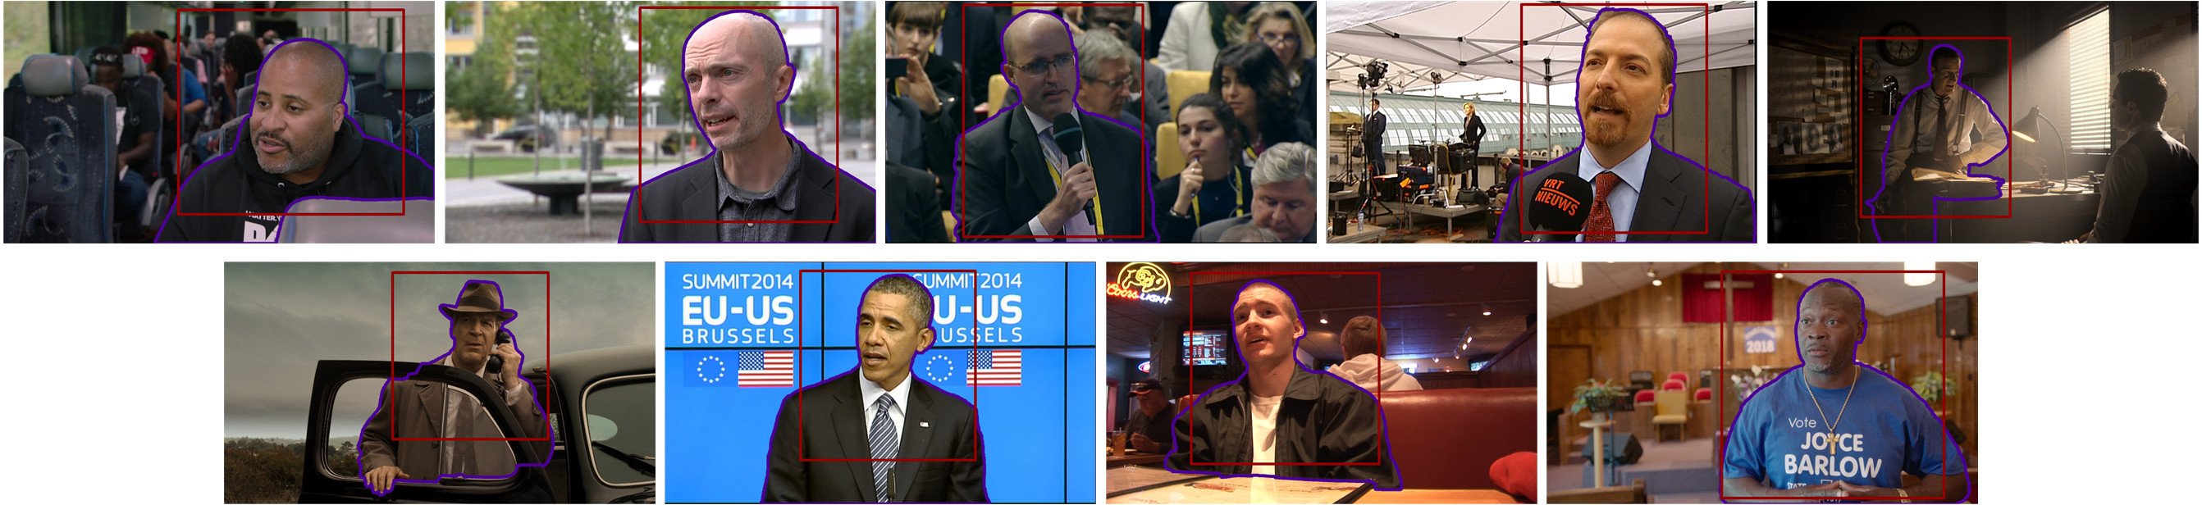
Research question
Does reducing the quality of the video background have a perceptual impact, especially in the context of
talking heads video?
Notes:
So this talk deals with the topic of video quality and how video is subjectively perceived by human viewers. Our research question was …
If not, streaming bitrate could be saved and hence the OTT streaming cost (in terms of network bandwidth consumption) could be reduced.
We wanted to investigate our research question specifically in the context of talking heads video footage, with which we refer to video shots featuring a person who is typically framed from the waste up and who is talking towards the camera. This type of footage commonly appears in various video genres like newscasts, interviews, talk shows, dialogue scenes in films, online lectures, documentaries, and so on.

Slide 3
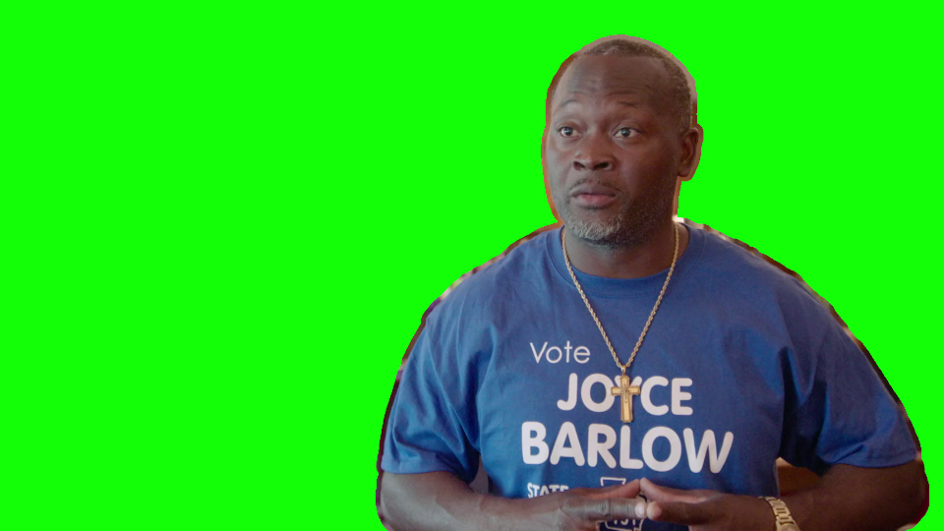
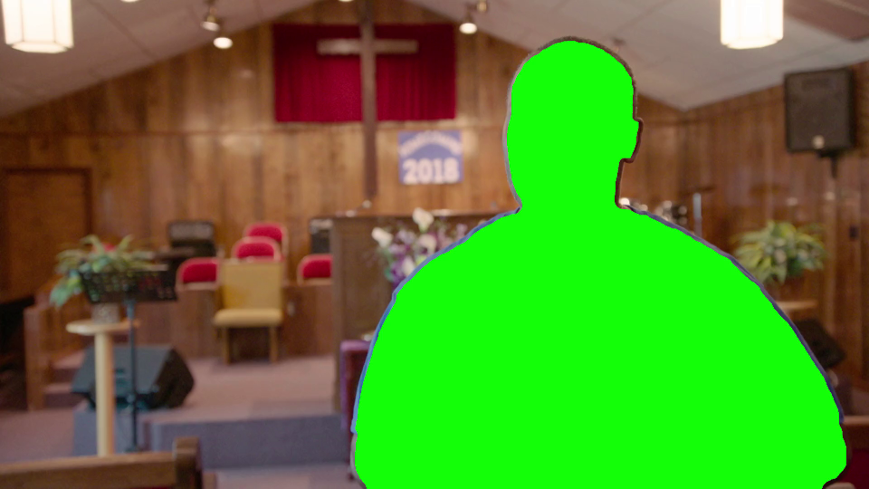
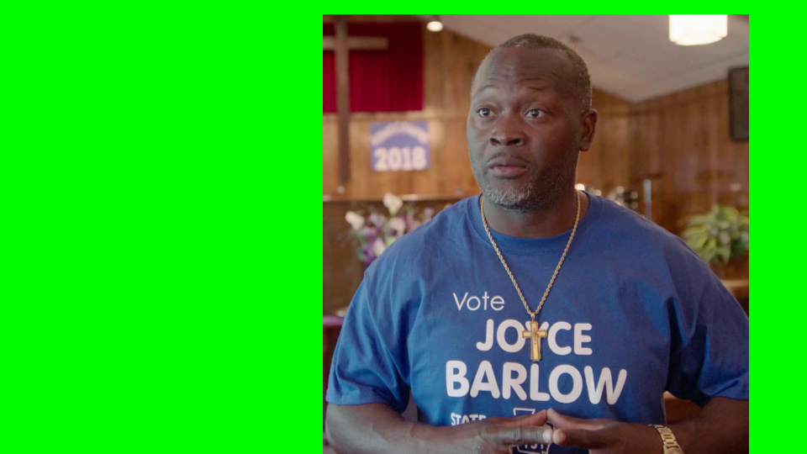
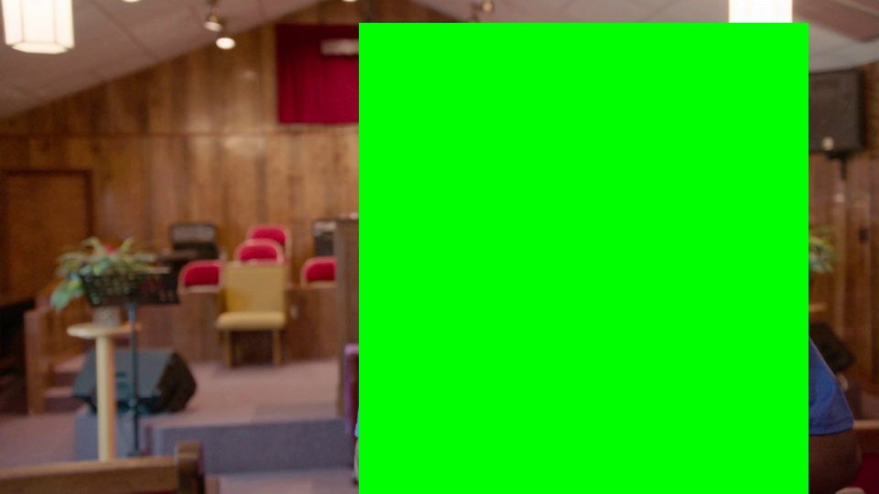
Methodology
Object-Based Video (OBV) [Wijnants et al., 2016]
  Video specialization of the Object-Based Media (OBM) principle
  Adaptive delivery of background & foreground object(s) of a video
    Yields intra-scene non-uniform bitrate allocation
  Implemented using …
    Standardized Web technologies → portable, multi-platform solution
    Vanilla video codec (H.264) and MPEG-DASH → directly deployable, no CAPEX
  2 alternative representation methods for foreground objects
    Contour-accurate
versus bounding box
Video content licensed by VRT
Notes:
To investigate our research question, we turned to our object-based video (OBV) paradigm that we introduced at ACM MM 2016.
OBV revolves around the disassembly of a video scene into a background and one or more foreground objects, such that these scene components can be streamed independently and in variable quality.
In contrast, a classic frame-based video codec will enact a rather homogeneous bitrate and hence quality distribution over the integral visual scene.
Pixels that do not belong to the corresponding back- or foreground are replaced by a fixed chroma value (typically green). At reception side, via WebGL chroma keying (commonly known as green screening), these chroma values are made transparent. Finally, the original video scene is recomposed by blending the processed object bitstreams in the appropriate order, on a frame-by-frame basis.

Slide 4
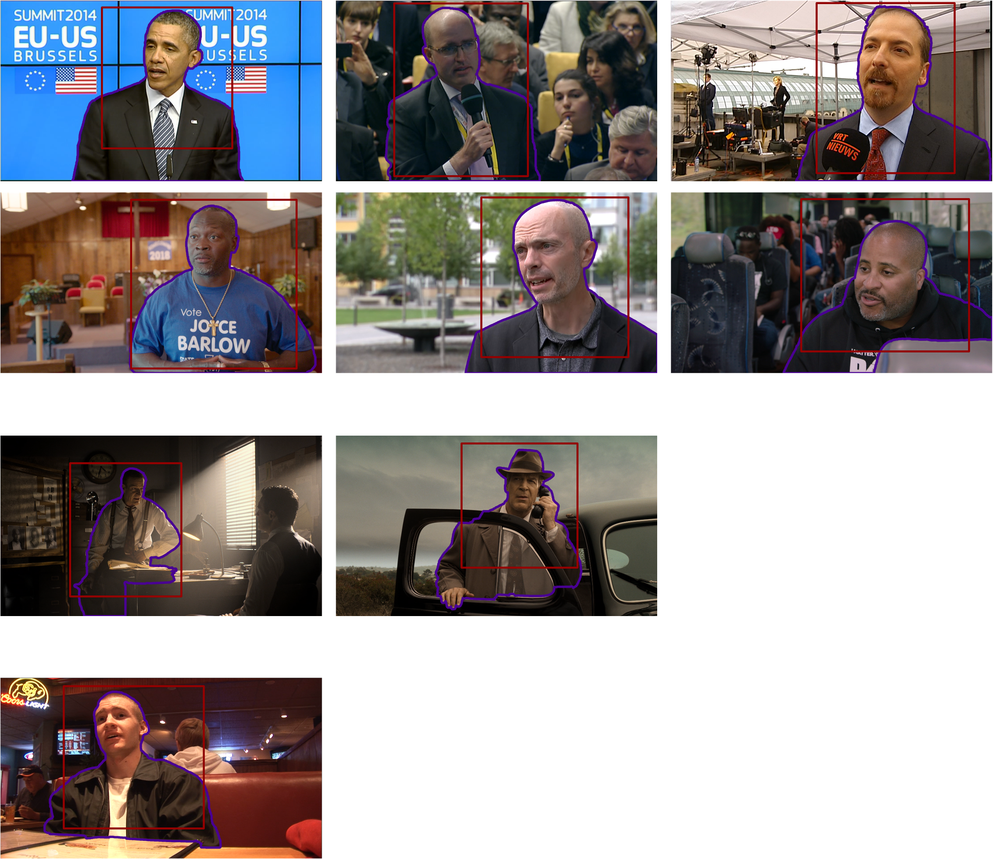
Content corpus
VRT
Netflix
NTIA
Video content licensed by VRT, Netflix, NTIA
Notes:
Of course, any video quality research needs a content corpus, and this slides shows the corpus that we compiled for this study. The corpus comprises videos from VRT, a Belgian public broadcaster, from Netflix and from NTIA (National Telecommunications and Information Administration), which is a telecommunications agency from the US government.
The video screenshots also show the positions of the contours and the bounding boxes that we applied to segment the foreground object from the scene. Each video clip involves one talking person (English speech) as foreground object.
In terms of source quality, you can see that our corpus is quite diverse, ranging from legacy 576i broadcast quality (720x 576 pixels, interlaced) up to native 4K.
The inclusion of lower-quality video in our content corpus is by design. Fluctuating source quality is a reality, especially in the OTT video streaming landscape (e.g., User-Generated Video, legacy footage). Therefore, we wanted to investigate how the proposed OBV paradigm fares with respectively high and lower-quality source material.

Slide 5
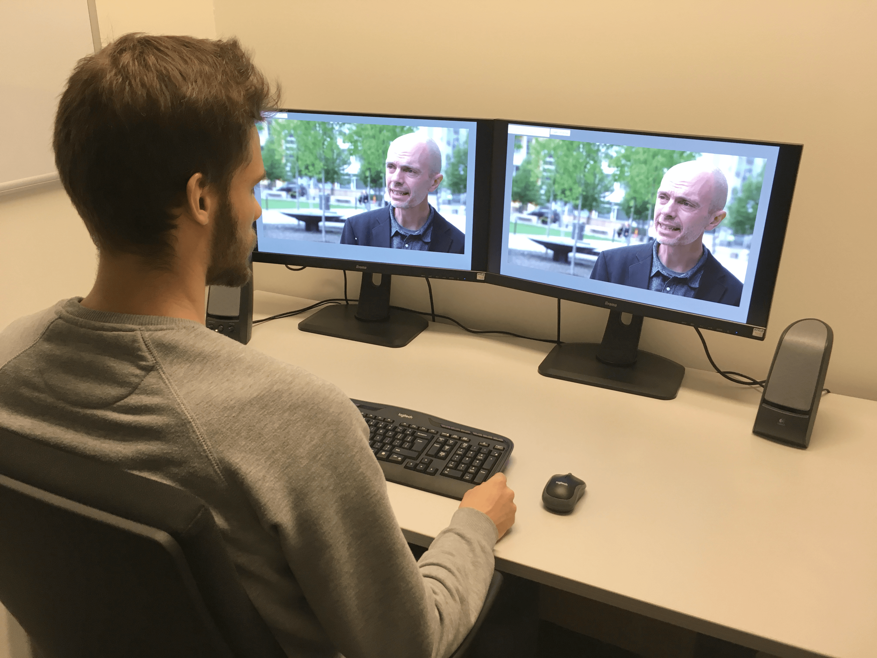
Experimental design
Two-step experimental design combining (bespoke) pre-study with standardized Absolute Category Rating test
Pre-study
Dual screen setup
Freely adjust OBV background Q
OBV-familiar users (n=18)
Identify thresholds
  No Difference (NoDiff)
  Barely Visible Differences (BVDiff)
  Still Acceptable (StillAcc)
Video content licensed by VRT
Notes:
Experiment 1:
Dual screen setup to perceptually compare traditional (at CRF 23) versus object-based video coding
OBV foreground always streamed at maximal quality (CRF 23)
OBV background quality could be freely adjusted (CRF 23 up to CRF 38)
Step-by-step decrease background quality to identify thresholds: No Difference (NoDiff), Barely Visible Differences (BVDiff), Still Acceptable (StillAcc), Cost Adjusted (CostAdj)
NoDiff = Identify the highest CRF value for which the traditional and object-based versions are quality-wise indistinguishable.
BVDiff = Identify the highest CRF value for which the quality differences between the traditional and object-based versions are barely visible. A quality difference was defined to be barely visible if it takes 10 seconds or more to ascertain its existence.
StillAcc = Determine the highest CRF value for which the object-based video version is visually still acceptable.
CostAdj = Revisit the StillAcc score by additionally taking cost savings information into account expressed as a bitrate percentage and also a monetary value (based on an estimate of mobile data cost) relative to the traditional version of the video.
Implemented with OBV-familiar participants (n=18)
The principal objective of experiment one was to quantitatively identify two cut-off points: (i) when do background quality impairments become perceptually apparent in OBV-based media presentations, and (ii) to what degree can background quality be reduced (and mixed with a high-quality foreground object) before integral scene quality becomes subjectively unacceptable. The experiment considered two independent variables, namely object representation method (contour versus bounding box) and content (corpus of nine videos). The total number of conditions in this study hence equalled 18.

Slide 6
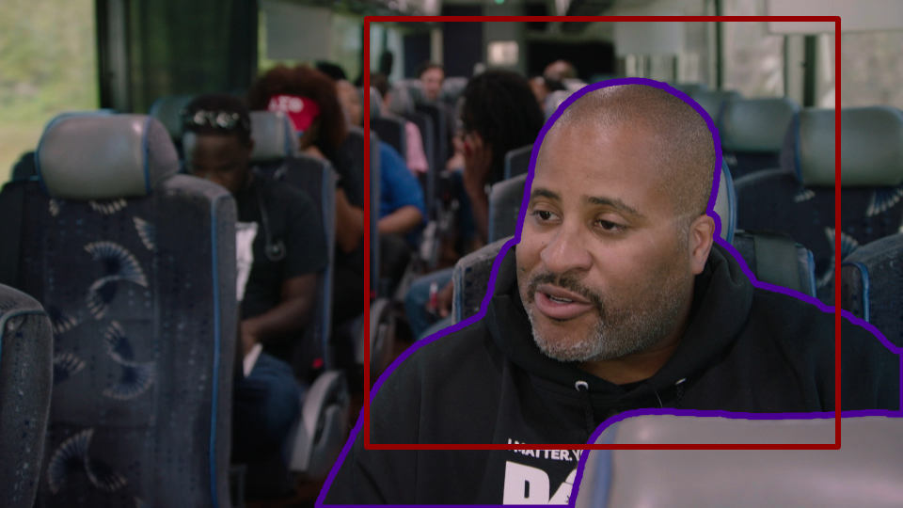
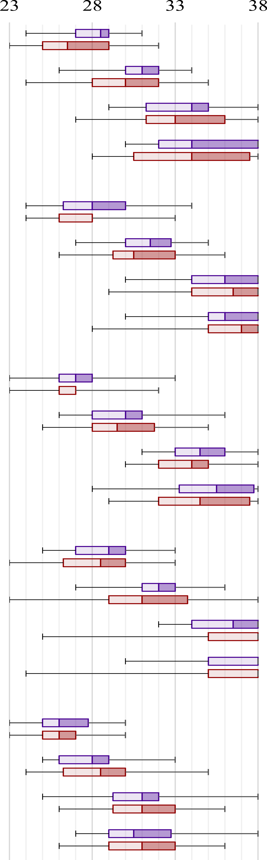
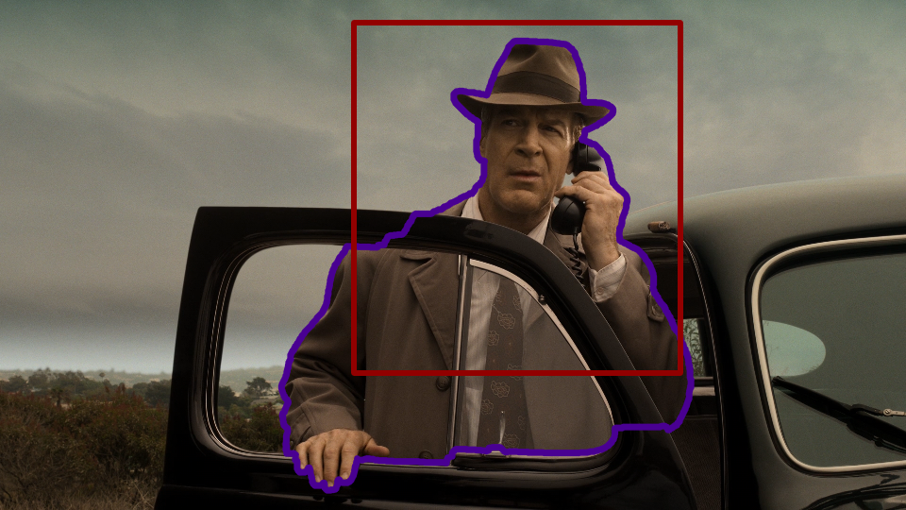
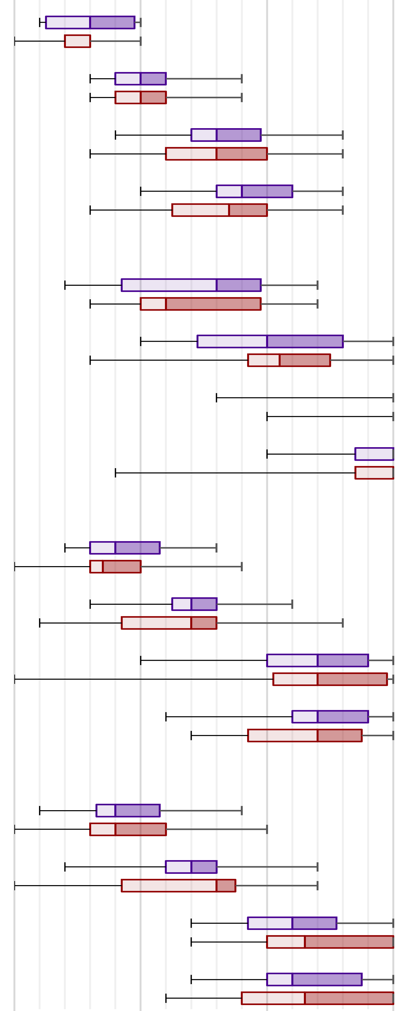
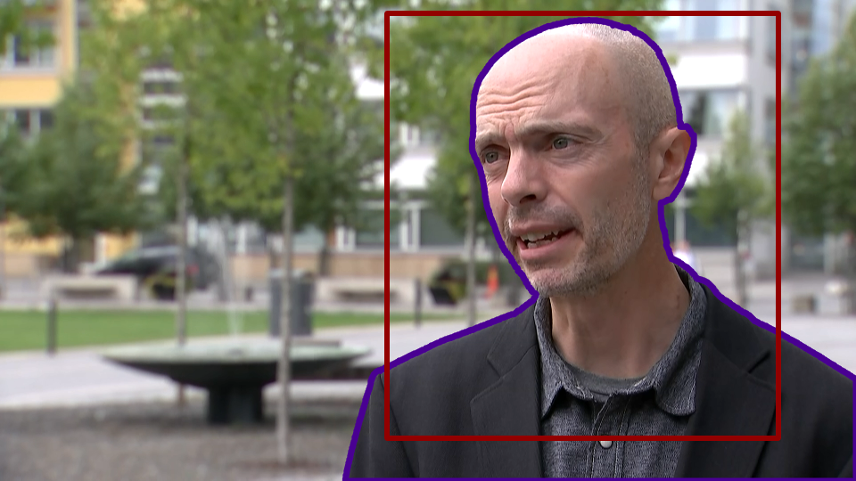
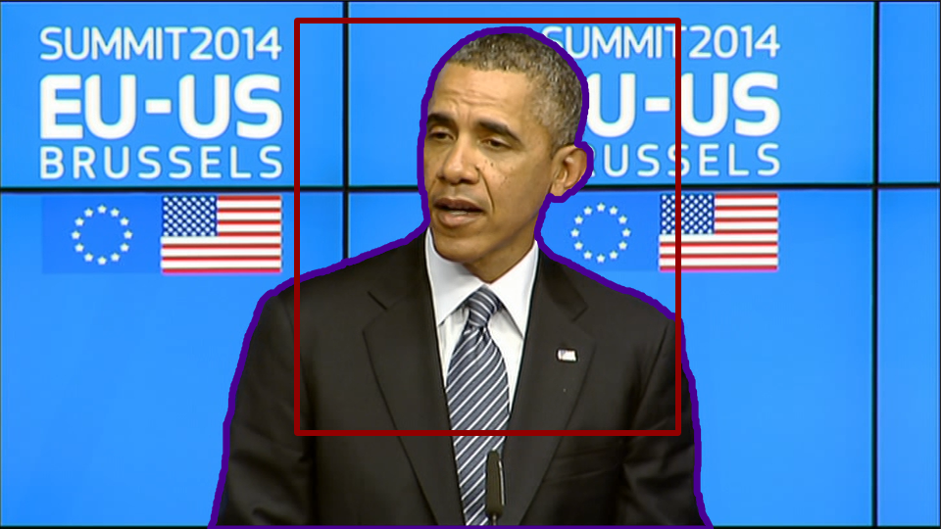
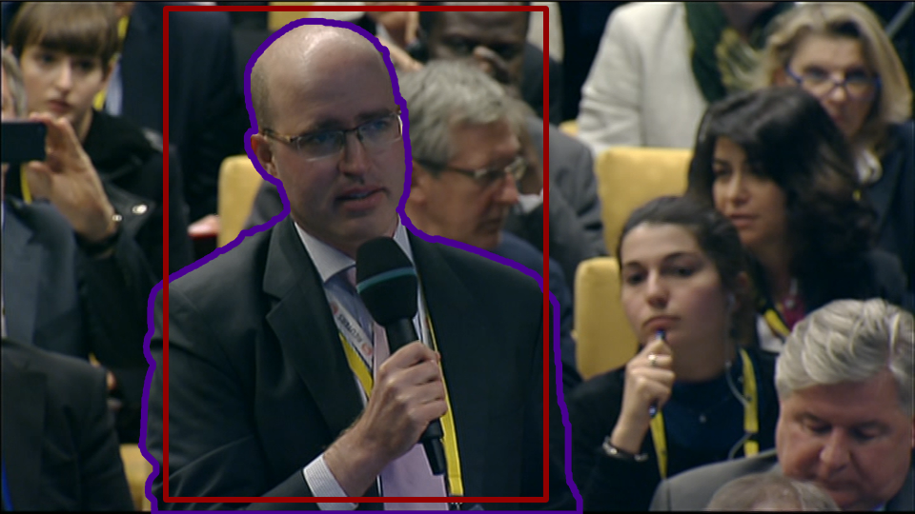
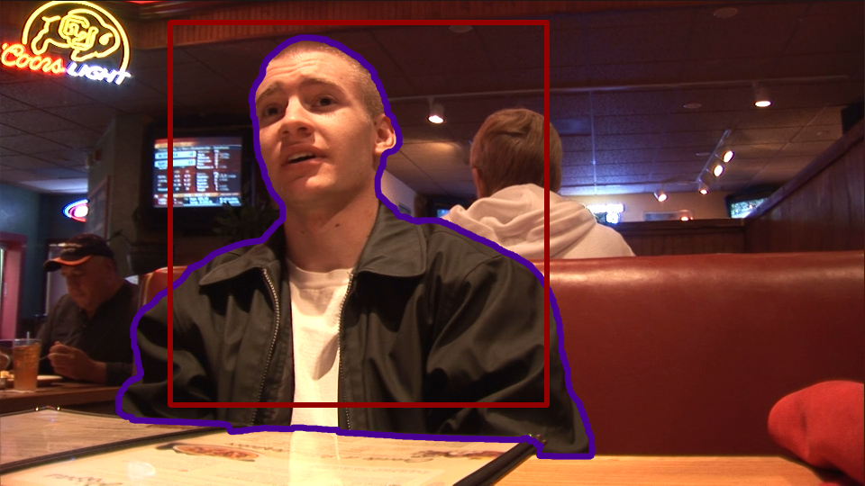
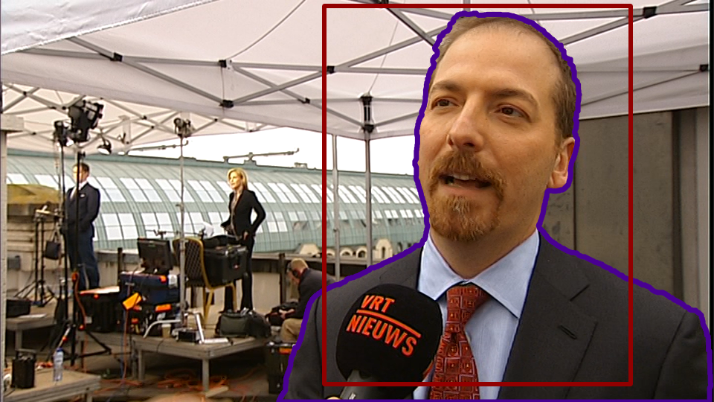
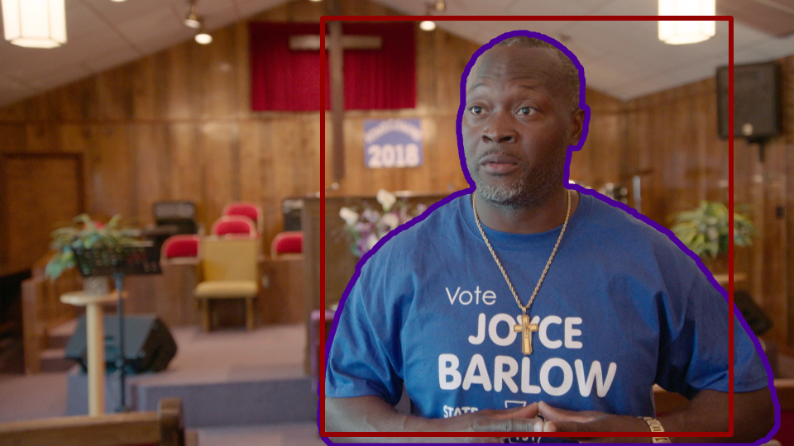
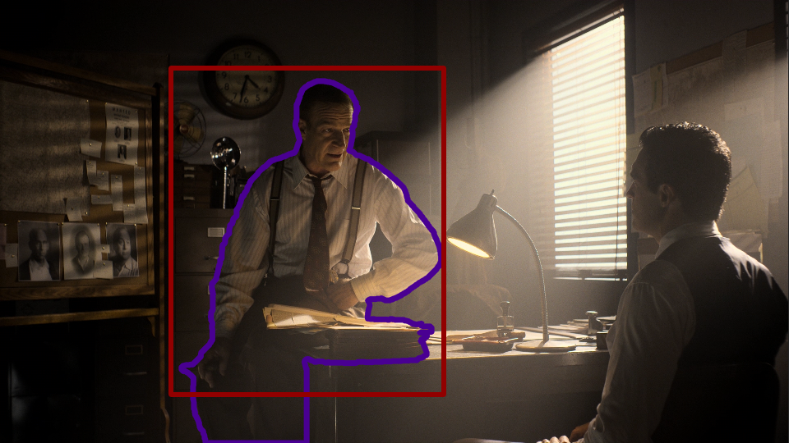
Results: Pre-study
23 28 33 38
23 28 33 38
Video content licensed by VRT, Netflix, NTIA
Notes:
Background quality distribution (CRF value box plots visualizing interquartile ranges) and bitrate savings (OBV at median CRF vs traditional encoding at CRF 23) for contour (in purple) vs bounding box (in red).
To control the background/foreground quality settings, we applied H.264 Constant Rate Factor (CRF) compression mode. Compression quality degrades as CRF rises (i.e., these are inversely proportional metrics). H.264's default CRF value is 23.
These charts reveal:
For each individual video and both object representation methods, the expected trend of CRF values increasing monotonically from the NoDiff up to the StillAcc task
Corpus-wide, substantial objective discrepancies with respect to quality reduction visibility and subjective acceptability turned out to exist. The two meridian videos are clearly the most demanding in terms of background quality. This was also confirmed by our qualitative data, which was gathered using a post-test semi-structured interview, in that the meridian backgrounds were described as “rich” [P02] and “filmlike” [P13, P15, P17, P18] with “high production value” [P10, P17, P18], “holding value in the scene as it sets the atmosphere” [P02, P17, P18] and thus “deserving to be seen in sufficient detail” [P08]
The bounding box method clearly achieves higher bitrate savings compared to contour. This finding might seem counterintuitive, as the bounding box always includes part of the background that is not captured in the contour representation. However, the rectangular shape of the bounding box (padded with a fixed chroma value to denote transparency, see Section 3) allows for efficient macroblock alignment with the bounding box edges. In contrast, the more erractic egdes of an object’s exact outline force the video encoder to apply finer-grained macroblock partitioning, which hurts compression performance.

Slide 7
Experimental design
Two-step experimental design combining (bespoke) pre-study with standardized Absolute Category Rating test
Pre-study
Dual screen setup
Freely adjust OBV background Q
Identify thresholds
  No Difference (NoDiff)
  Barely Visible Differences (BVDiff)
  Still Acceptable (StillAcc)
  Cost Adjusted (CostAdj)
OBV-familiar users (n=18)
Classic ACR test
5 pre-rendered video versions
  TR_CRF23 (traditional H.264)
  CT_NoDiff
  BB_NoDiff
  CT_BVDiff
  BB_BVDiff
3 clips used for training
OBV-agnostic users (n=30)
Notes:
Experiment 2:
For those of you who ware not familiar with the ACR procedure: it involves the sequential visualization and rating of a set of videos on a scale from 1 (bad) to 5 (excellent).
We prepared five distinct versions of each of the nine videos in our content corpus. These techniques encompassed a traditional encode at a CRF 23 quality setting (abbreviated as TR) which served as baseline, complemented with two contour-based (CT) and two bounding boxed (BB) OBV versions. All five techniques applied identical audio quality settings (i.e., stereo AAC at 128 kbps). The four OBV techniques combined a CRF 23 foreground quality with the (rounded down) median background CRF value corresponding to respectively the NoDiff and BVDiff task as elicited in experiment one.
Informed by the quantitative data captured as part of experiment one, experiment two aspired to uncover whether background quality reduction in OBV-based media presentations yields perceptual penalties for assessors who are unfamiliar with the OBV methodology.

Slide 8






Results: ACR test
Video content licensed by VRT and Netflix
Notes:
All 30 participants provided an opinion score for each of the 30 stimuli. The numeric values on these slides show the Mean Opinion Score (MOS) and standard deviation for each of the 5 pre-rendered versions of the 6 videos in our test data set. The graphical charts give an impression of the distribution of the opinion scores.
A statistically significant effect of technique on opinion score (χ2(4) = 24.4, p < 0.001) was observed when considering all six videos. A post-hoc test showed significant differences between BB_BVDiff and TR (p < 0.001, r = 0.17), between BB_BVDiff and CT_NoDiff (p < 0.05, r = 0.10), and between BB_NoDiff and TR (p < 0.01, r = 0.11).
We also analyzed the effect of technique on opinion score when considering the videos in isolation from each other. For the meridian3 scene, a post-hoc test showed significant differences between BB_BVDiff and TR (p < 0.005, r = 0.44), between BB_NoDiff and TR (p < 0.01, r = 0.33), and between CT_NoDiff and TR (p < 0.01, r = 0.34). These medium to large effect sizes can be attributed to the OBV-based techniques introducing noticeable compression artifacts in meridian3’s background. In the closing questionnaire, eight participants complained about color banding in the clouds, while two noticed “blockiness” or “flickering” in the car [P07,P21].
Now we knew from our pre-study experiment that the two Meridian clips posed the highest requirements in terms of subjective background quality. Also, the Meridian clips are the only filmic content in our corpus, and it is know from prior art that movie-like footage This finding is also confirmed by prior art, which shows that filmic footage maximizes viewers’ quality demands. Finally, the two Meridian clips are least representative of the talking heads footage that we are interested in.

Slide 9
Results: ACR test
average
bitrate saving
5%
14%
20%
27%
Notes:
So, with that in mind, if we drop the two Meridian clips from the equation, we get the following MOS averages, and I hope you agree with me that especially the two contour-based OBV instantiations perceptually perform on par with the traditionally encoded H.264 version. And they do so while conserving, on average, 5 and 14 percent of OTT streaming bitrate, respectively.

Slide 10
Conclusions
OBV-aware users are willing to incur quite extensive reductions in background quality
OBV methodology works well with classic talking heads footage, less compatible with movie-like content
Contour-based OBV lowered bitrate requirements by 14 percent for the non-movie content in our corpus
  Without loss in perceived visual quality
Notes:
Compared to frame-based video compression and for non-movie content, contour-based OBV succeeds in lowering bitrate requirements by up to 14 percent in our corpus (see Table 2) without incurring penalties in terms of perceived quality.

Slide 11
Thank you!
Questions?

Slide 12
Content corpus
576i @ 24.4 Mbps
1080p @ 100 Mbps
VRT
Progressive 4K
raw YUV422
Netflix
1080i
raw YUV422
NTIA
Video content licensed by VRT, Netflix, NTIA
Notes:
Of course, any video quality research needs a content corpus, and this slides shows the corpus that we compiled for this study. The corpus comprises videos from VRT, a Belgian public broadcaster, from Netflix and from NTIA (National Telecommunications and Information Administration), which is a telecommunications agency from the US government.
The video screenshots also show the positions of the contours and the bounding boxes that we applied to segment the foreground object from the scene. Each video clip involves one talking person (English speech) as foreground object.
In terms of source quality, you can see that our corpus is quite diverse, ranging from legacy 576i broadcast quality (720x 576 pixels, interlaced) up to native 4K.
The inclusion of lower-quality video in our content corpus is by design. Fluctuating source quality is a reality, especially in the OTT video streaming landscape (e.g., User-Generated Video, legacy footage). Therefore, we wanted to investigate how the proposed OBV paradigm fares with respectively high and lower-quality source material.

Slide 13
Content corpus
Notes:
These graphs shows that our content corpus is also quite diverse in terms of low-level objective features. Here, the Spatial Information (SI) metric is an indicator of the visual complexity of the scene, whereas the Temporal Information (TI) metric summarizes corresponding pixel differences across successive frames; jointly, these metrics objectively estimate compression complexity. The colorfulness score is based on the methodology proposed by Hasler and Süsstrunk. The Obama clip has a “highly colorful” score, whereas all other videos range from “slightly colorful” to “quite colorful”. Finally, the luminance quantification is calculated as the average luma value across all pixels and frames of a video fragment (i.e., higher values denote brighter videos).

Slide 14
Results: Pre-study (inclusing CostAdj threshold)
23 28 33 38
23 28 33 38
Video content licensed by VRT, Netflix, NTIA
Notes:
Background quality distribution (CRF value box plots visualizing interquartile ranges) and bitrate savings (OBV at median CRF vs traditional encoding at CRF 23) for contour (in purple) vs bounding box (in red).
These charts reveal:
For each individual video and both object representation methods, the expected trend of CRF values increasing monotonically from the NoDiff up to the StillAcc task
On the other hand, CRF differences between the StillAcc and CostAdj tasks are small per individual condition; conditions even exist where the median CostAdj CRF value is below that of the StillAcc task. This finding can be attributed to the existence of a tipping point beyond which the relative bitrate bonus with each CRF increment becomes marginal while the relative perceptual penalty remains significant. Stated differently, quality keeps dropping with increasing CRF, yet resulting bitrate savings become ever smaller.
The bounding box method clearly achieves higher bitrate savings compared to contour. This finding might seem counterintuitive, as the bounding box always includes part of the background that is not captured in the contour representation. However, the rectangular shape of the bounding box (padded with a fixed chroma value to denote transparency, see Section 3) allows for efficient macroblock alignment with the bounding box edges. In contrast, the more erractic egdes of an object’s exact outline force the video encoder to apply finer-grained macroblock partitioning, which hurts compression performance.
Corpus-wide, substantial objective discrepancies with respect to quality reduction visibility and subjective acceptability turned out to exist. The two meridian videos are clearly the most demanding in terms of background quality. This was also confirmed by our qualitative data, which was gathered using a post-test semi-structured interview, in that the meridian backgrounds were described as “rich” [P02] and “filmlike” [P13, P15, P17, P18] with “high production value” [P10, P17, P18], “holding value in the scene as it sets the atmosphere” [P02, P17, P18] and thus “deserving to be seen in sufficient detail” [P08]

Slide 15
Results: ACR test
Objective quality metrics (average ± standard deviation) averaged over content corpus:
Notes:
From the table on this slide, we learn that traditional, frame-based H.264 encoding outperforms its four OBV competitors for each of the considered objective quality metrics (PSNR, SSIM, VMAF). This is not surprising, as the OBV versions utilize a lower quality background compared to the traditional setting. Similarly and again unsurprisingly, the objective quality scores for the BVDiff quality setting are consistently lower compared to the corresponding NoDiff values.
The question that we wanted to address with experiment 2 was whether these objectively measured differences in visual quality are actually perceived by human assessors.

Slide 16
Detrimental effect of spatiotemporal compression artifacts

Slide 17
Conclusions
  OBV-aware users are willing to incur quite extensive reductions in background quality
  OBV methodology works well with classic talking heads footage, less compatible with movie-like content
  Contour-based OBV lowered bitrate requirements by 14 percent for the non-movie content in our corpus
    Without loss in perceived visual quality
Discussion
  OBV-based video quality control
    Steered by consumers OR enforced at server side
  OBV methodology supports various levels of deployment granularity
    Tailored to individual videos OR operate on aggregated video genres and types
Notes:
Compared to frame-based video compression and for non-movie content, contour-based OBV succeeds in lowering bitrate requirements by up to 14 percent in our corpus (see Table 2) without incurring penalties in terms of perceived quality.
In terms of impact and practical adoption, OBV-based video quality control could directly be steered by consumers (cf. experiment one) or could be enforced at server side, either to generally lower the load on the transportation network or in the context of differential service delivery (e.g., basic versus premium subscriptions). Furthermore, our OBV methodology supports various levels of deployment granularity, in that it could either be tailored to individual videos or, conversely, could operate on the level of aggregated video genres and types. In the latter case, the results presented in this paper form a first step towards automatically deriving optimal quality settings for talking heads backgrounds, for example by leveraging our results as ground truth for machine learning or predictive modelling purposes.

