Slide 1
Standards-compliant
HTTP Adaptive Streaming of Static Light Fields
Hendrik Lievens, Hasselt University - tUL
Maarten Wijnants, Hasselt University - tUL
Nick Michiels, Hasselt University - tUL
Jeroen Put, Hasselt University - tUL
Peter Quax, Hasselt University - tUL - Flanders Make
Wim Lamotte, Hasselt University - tUL
Notes:
Whoami and talk about <title>

Slide 2
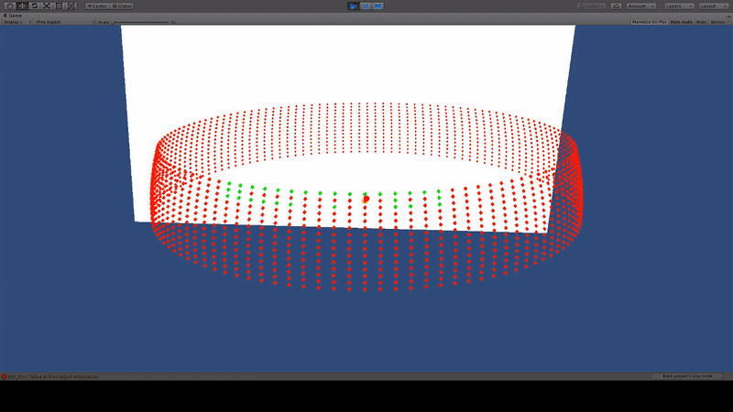
What is our work about?
Notes:
So here you can see an outside-in VR LF experience.
This was our starting point and we set out to improve this experience
<Title> consists out of DASH, which I will come back to later in my talk, but first let’s talk a little bit about light fields.

Slide 3
Static Light Fields (LFs)
Digital Image:
Captures the intensity of a scene or object
at a certain position in space
at a fixed point in time
Light Field:
All the light that flow through a specific scene
intensity + direction
Static:
at a fixed point in time

Slide 4
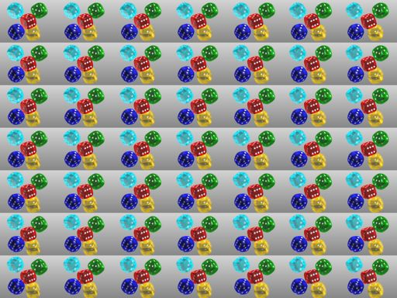

Slide 5
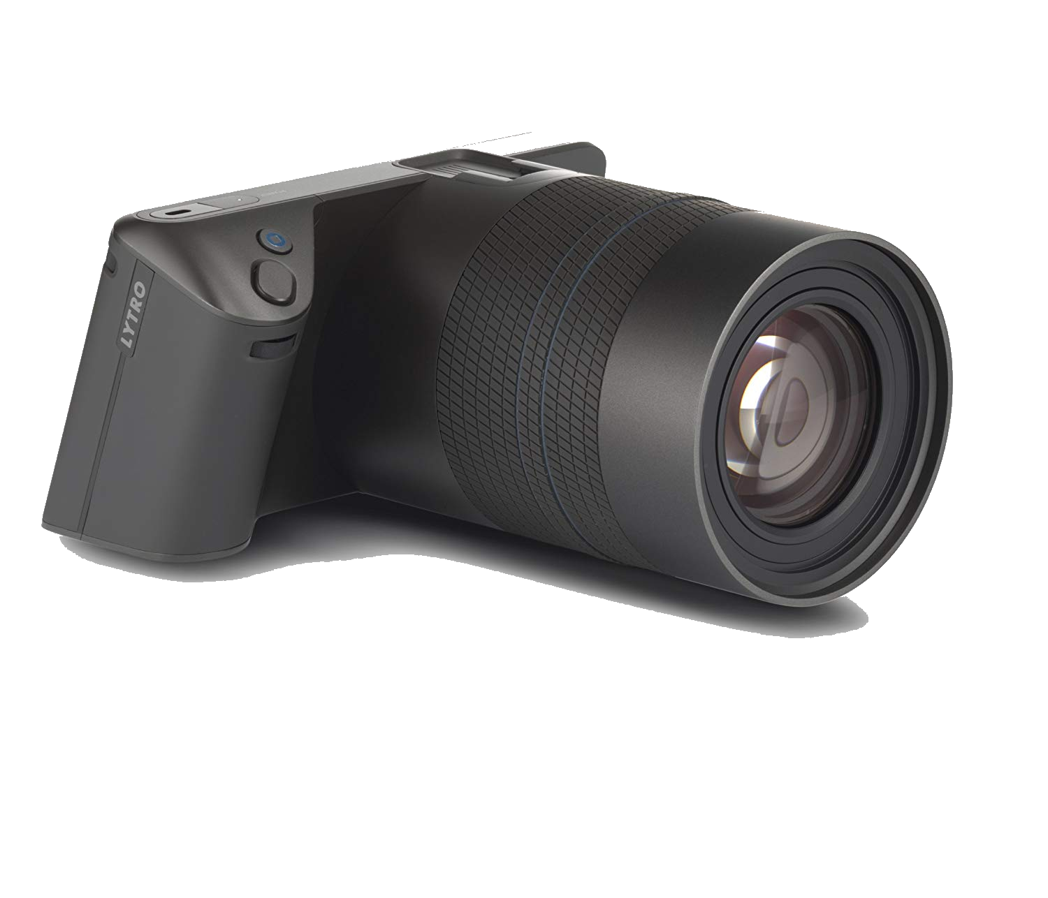
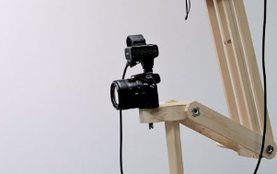
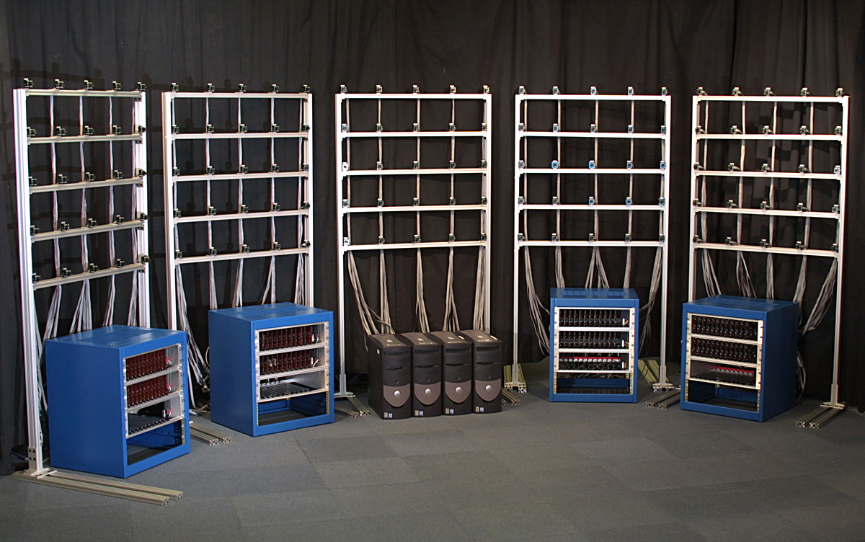
How to acquire a static LF?
A static LF (structured) can be captured by:
Digital cameras, equipped with micro-lens arrays
A single camera on a gantry
Multiple cameras
Notes:
Lijst image bronnen

Slide 6
What can we do with them?
Effective technology to precisely visualize complex inanimate objects
Perhaps, no 3D models of the object, scene exist
Photorealistic by default (reflection, shadows, …)
Straight-forward algorithm to re-visualize
Especially with VR Head-mounted Display (HMD)
Notes:
Image: kozijn machine 3D model? Foto!

Slide 7
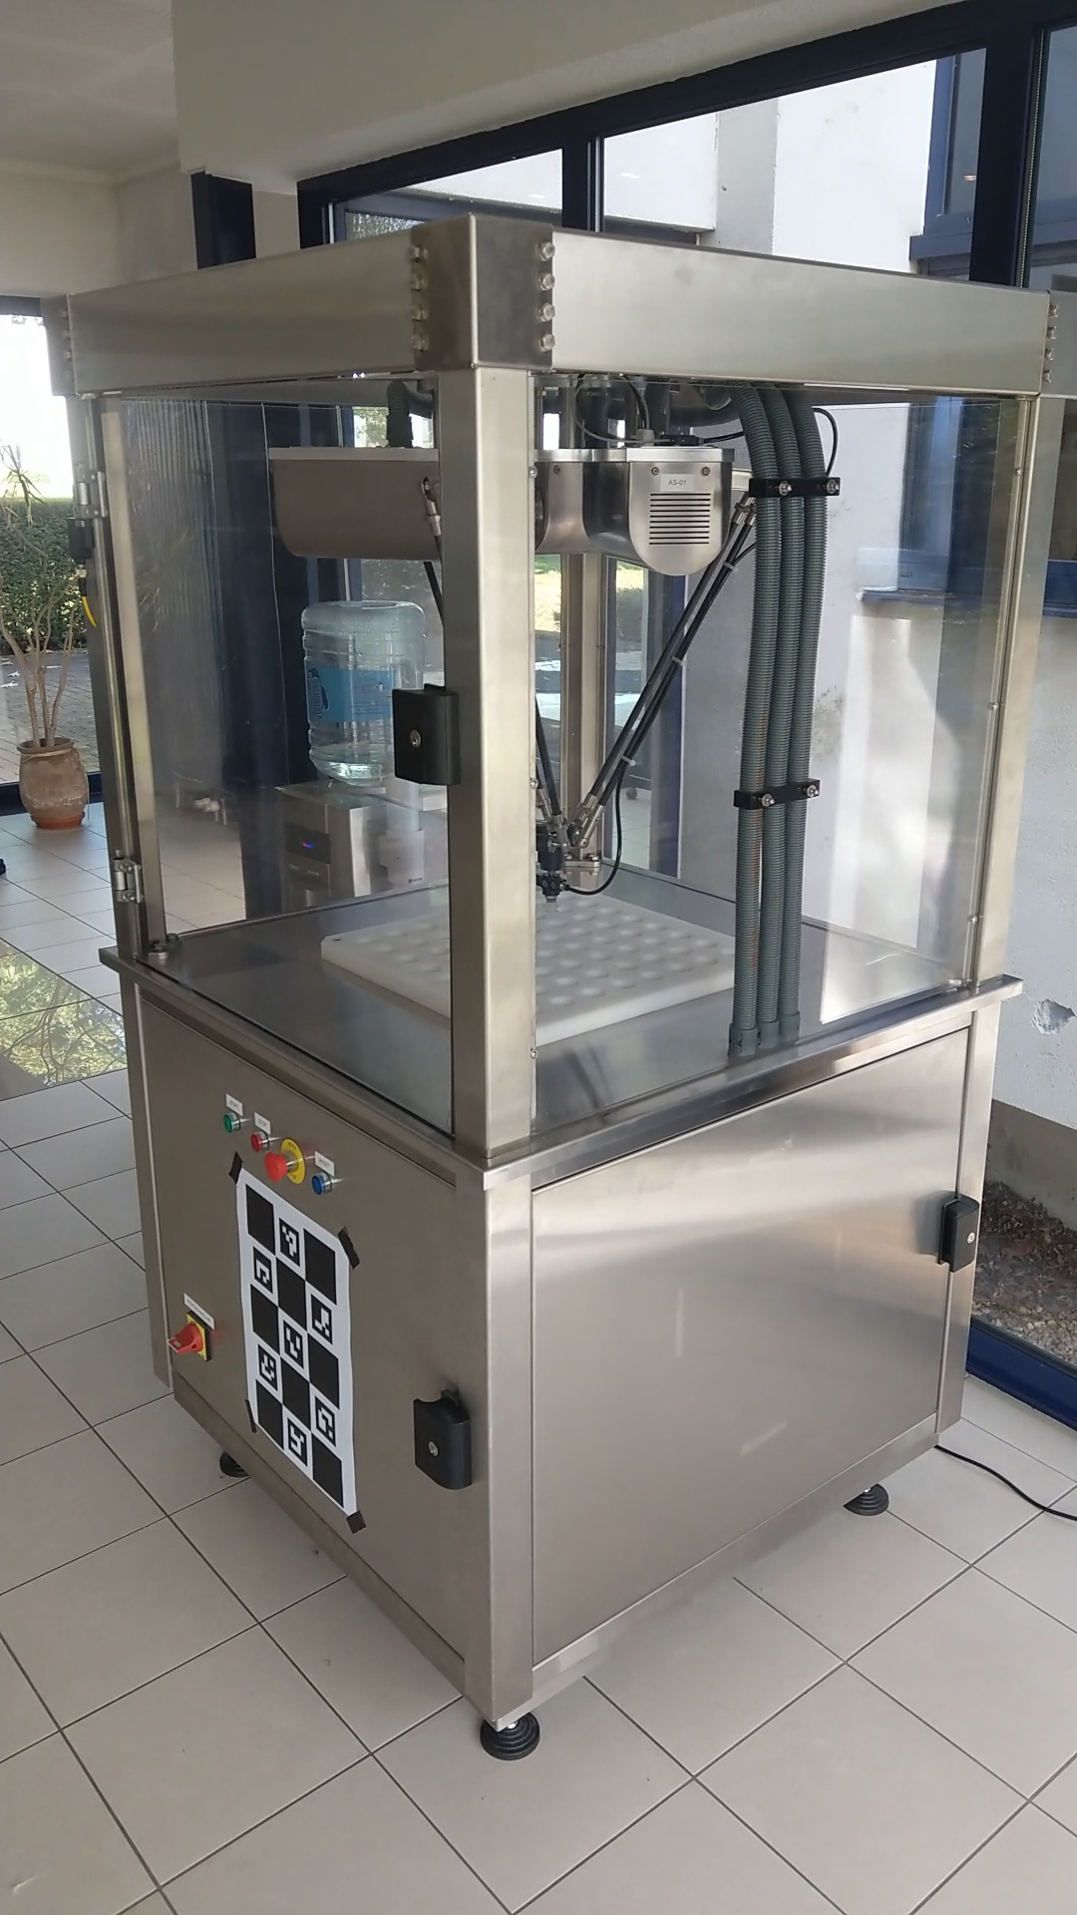

Slide 8
VR Revisualization
Capture
Images → positional information
Rendering:
Considers user’s position and view
Image is projected on a proxy geometry
Structured on a hemisphere
pos(x,y,z) and dir(Θ,Φ): sample_22.jpg
Notes:
Formule: figuurtje

Slide 9
Issues!
Large Dataset
In essence a directory with a lot of images ...
… and some additional small metadata
More viewpoints → denser sampling → more images
Entirely required before starting the experience
Performance Issues
HMD: 90Hz display (per eye) → 180 frames/second
Decoding images → typically software decoding
Bandwidth Issues:
Decoded raw image data → PCI transfer to GPU
Notes:
180 fps = worst case bij dense sampling of veel beweing
HW JPEG->recent /performance? Texture formaat?

Slide 10
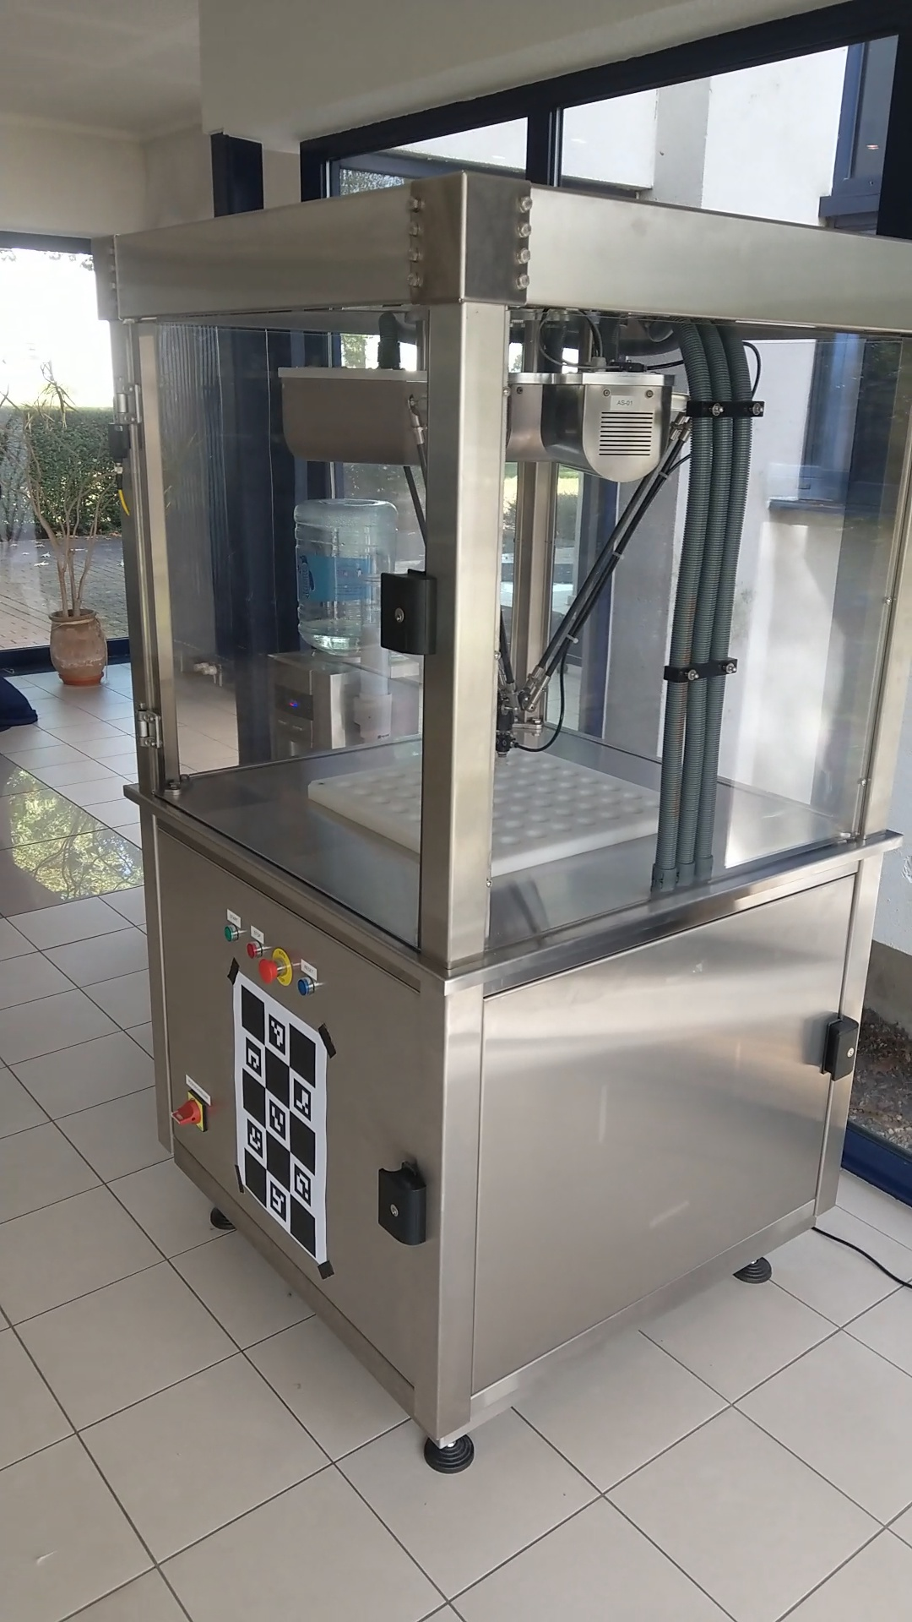
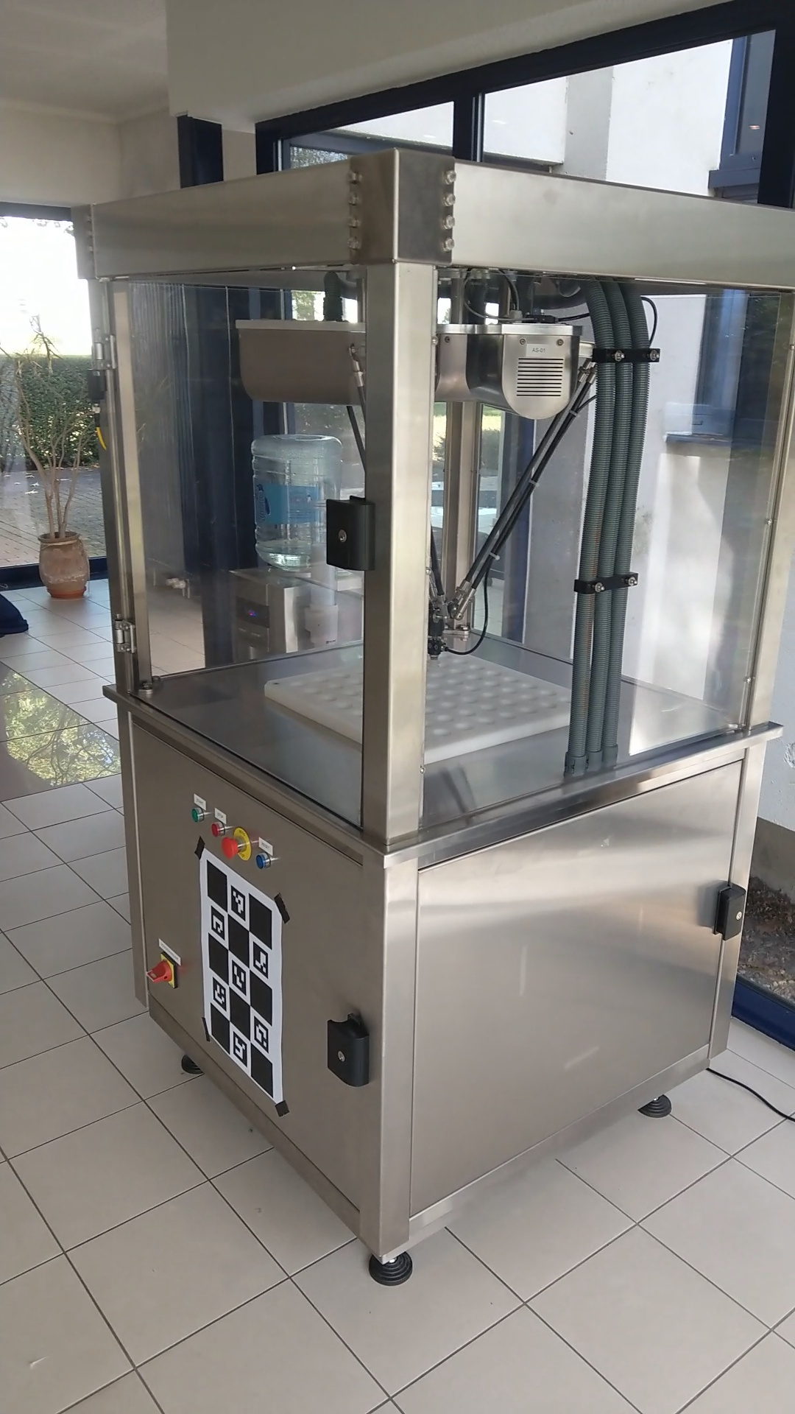
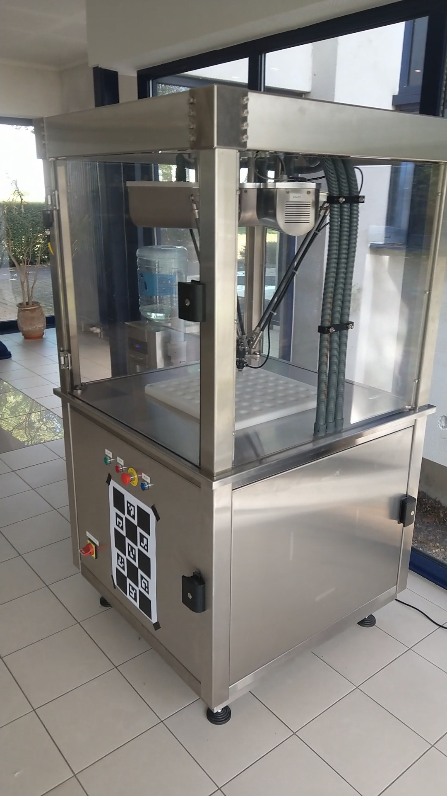
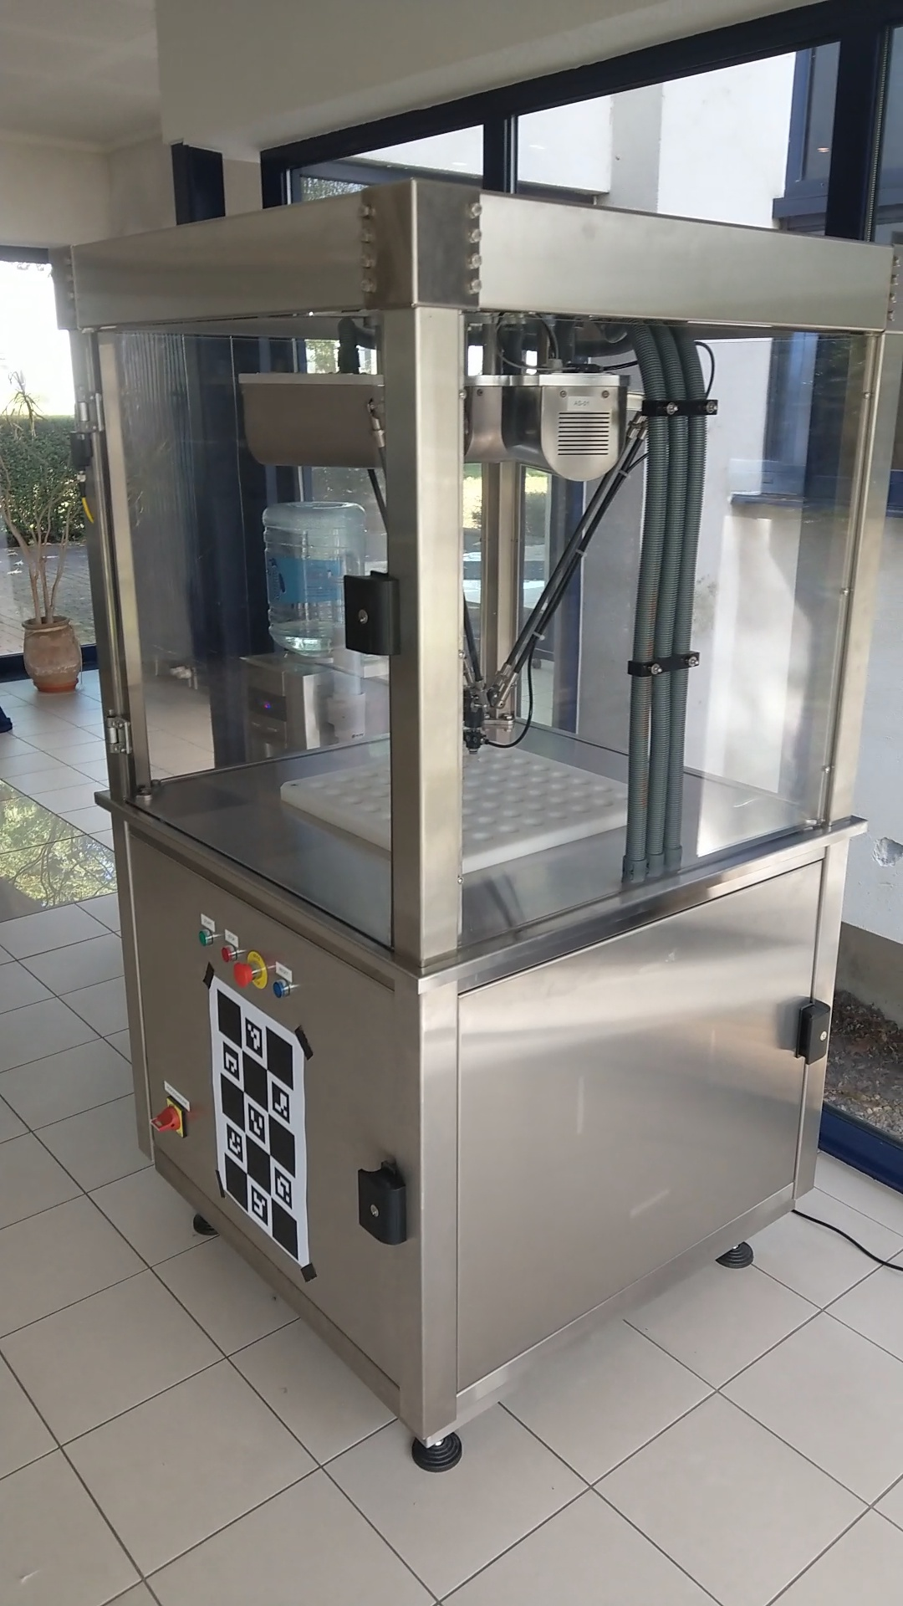
Redundant information
Notice how all samples only differ slightly
Dense sampling → more similar
Spatial Redundancy
Convert into temporal redundancy

Slide 11
Compressing redundancy
Use a video-codec (we opted for H.264):
I-frames: encode image sample on itself
P-frames: only contain changes w.r.t. earlier frames
→ Dataset can be represented as a single video
→ Video-decoding: hardware acceleration SIP core
Notes:
Motion vector: afbeelding / voorbeeldje (FFMPEG visualisatie) mappen op use-case
SIP Core =/= GPU

Slide 12
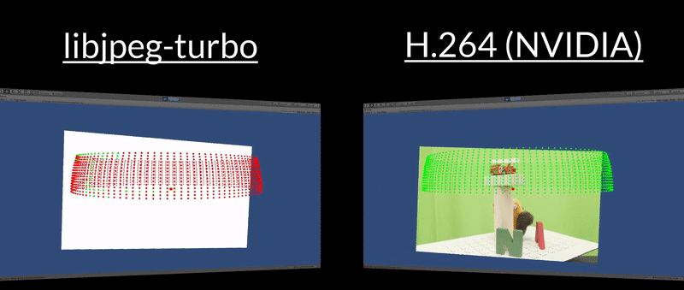
So Far...
We converted the dataset into a pseudo-video
Decoding Performance (3840x2160):
JPEG: ~ 55 ms V.S. H.264: ~ 4.9 ms
Dataset Size (1800 images @ 3840x2160):
JPEG: 5.45 GB V.S. 24 Mbps H.264 : 174.73 MB
About 30 times smaller, 10 times faster
Notes:
Recap: tussen slides met resultaten aanhalen
x keer groter / x kleiner / x keer sneller -> storage dedicated HMDs

Slide 13
From Offline to Online
How can we stream the video ?
Not going to reinvent the wheel: open standards exist
Dynamic Adaptive Streaming over HTTP (MPEG-DASH)
MPEG-DASH
Split video into Segments (e.g. 3 seconds)
Each Segment is available in multiple qualities
Streaming client determines desired quality
Depending on needs
Depending on network conditions
Notes:
offline to online

Slide 14
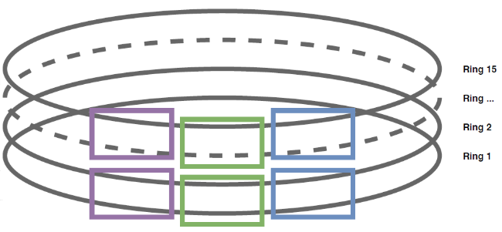
MPEG-DASH Segments
How do we structure the Segments?
Spatially related samples → same Segment
Impose window on data set
In this example: 15 concentric circles
Use one image in Segment as I-frame
All other images are P-frames

Slide 15
Encoding The Segments
Set a size for the segments (eg. 6 by 5)
Can be empirically determined depending on
data set
requirements
Choose an encoding pattern
Raster
Line Scan
Spiral
Notes:
6x5 afbeelding grid
pijlen -> raster/bidirectional
Testen gedaan: evaluatie

Slide 16
Data Required for Streaming
MPEG-DASH manifest (XML-based) containing:
References to meta data:
Stand-alone, human-readable files
References to actual data:
Multiple Representations (qualities) available
Notes:
Figuurtje / abstractie / simpele XML
Directly linked in DASH -> single file <-> video is segmented
Meta data verduidelijken

Slide 17
Simplified MPD Example
<MPD> <Period>
<!-- Video Data --> <AdaptationSet> <Representation segment="0-59" width="1920" height="1080" bandwidth="8M" /> <Representation segment="0-59" height="1080" bandwidth="4M" /> <Representation segment="0-59" height="720" bandwidth="2M" /> </AdaptationSet>
<!-- Meta Data --> <AdaptationSet id="md-info" mimeType="text/plain"> <Representation id="info.txt" /> </AdaptationSet> <AdaptationSet id="md-calibration" mimeType="text/xml"> <Representation id="calibration.xml" /> </AdaptationSet> </Period> </MPD>

Slide 18
Quality Adaptation Logic
How do we schedule Segments?
On demand is too late:
Decoding entire segment (#30 frames) takes some time
Downloading the segment over the network takes time
→ Doesn’t fit in a 5 millisecond slot (180fps)
Schedule in advance:
Use different heuristics …
… to schedule segments in advance and keep them on disk

Slide 19
Quality Adaptation Logic
Fast Fill
Fast moving user
Load a.s.a.p in LQ
Later, upgrade to HQ
Steady Expansion
Slow, observant user
Load vicinity in MQ+HQ
Later, upgrade to HQ

Slide 20
QAL (bis.)
Notes:
Animatie/ Filmpje / vergelijking tussen QAL
2 aparte : benadrukken Fast Fill (bandbreedte verlies) / Steady Exp. (sneller in HQ)
Use case per QAL verduidelijken

Slide 21
Conclusion & Future Work
Spatial Redundancy → Temporal Redundancy
Excellent compressional gains
Leverage existing …
Hardware
Codecs
Standards
Dynamic?
Different QAL?
Notes:
Omvormen: take-home
Verschillende scenes filmpje

Slide 22
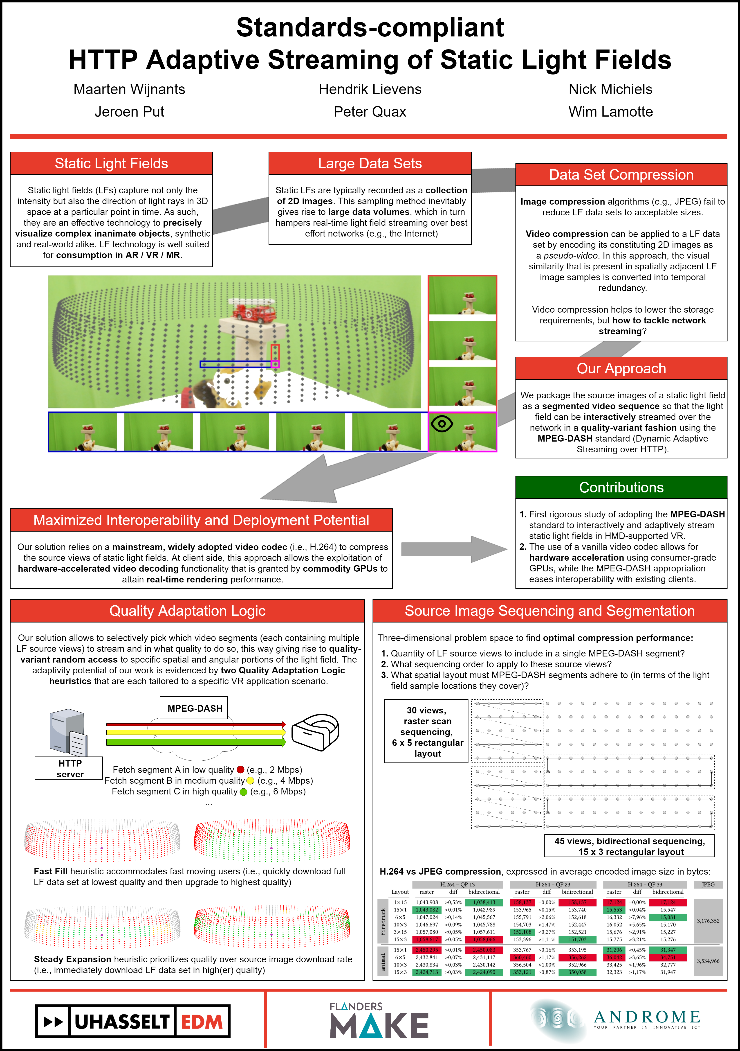
Questions or remarks?
Meet me at the poster session!

Slide 23
Simplified Pipeline
Separate Images
Pseudo-Video
Pseudo-Video
Separate Segments

