Slide 1
Web-Mediated Augmentation and Interactivity Enhancement of Omni-Directional Video in Both 2D and 3D
Maarten Wijnants Kris Van Erum Peter Quax Wim Lamotte

Slide 4
Video consumption experiences are
Passive
Static
Linear
Laid-back
Non-interactive

Slide 5
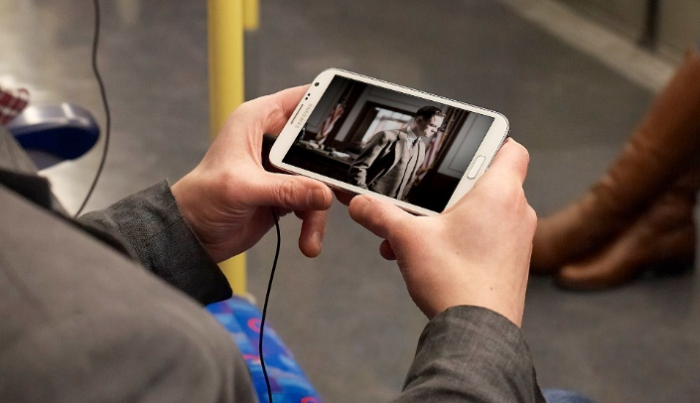

Slide 6
Augmented Video Viewing (AVV)
Factor in interactivity and dynamism in core fabric of video consumption process
Offer users interaction opportunities that go well beyond basic video playback control
Wijnants, M., Leën, J., Quax, P., and Lamotte, W. (2014). Augmented Video Viewing: Transforming Video Consumption into an Active Experience. In Proceedings of the 5th Multimedia Systems Conference, MMSys 2014, pages 164–167, Singapore, Singapore. ACM.

Slide 7
AVV Methodology
Embellish traditionally produced (passive) video material with interactive annotations that are exclusively realized using Web technologies
Out-of-the-box HTML5, CSS and JavaScript
Define structure and substance of interactive assets, their styling, and their dynamic behavior (e.g., spatio-temporal constraints)
Superimpose so-called overlays or hotspots on top of video playback
Closely integrates video with its interaction provisions
Each overlay is encoded as DIV node in HTML DOM
CSS z-index property dictates stacking order

Slide 8
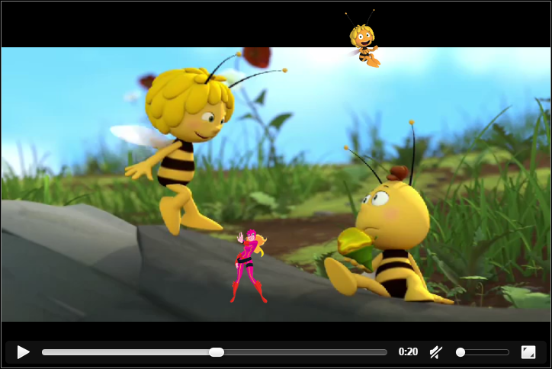
AVV Application Examples
Interactive storytelling (non-linear video)
Gamification (reaction-related gameplay for young children)
Wijnants, M., Leën, J., Quax, P., and Lamotte, W. (2014). Augmented Video Viewing: Transforming Video Consumption into an Active Experience. In Proceedings of the 5th Multimedia Systems Conference, MMSys 2014, pages 164–167, Singapore, Singapore. ACM.

Slide 9
Maps Augmented Video Viewing to the Omni-Directional Video format
Augmented ODV

Slide 10
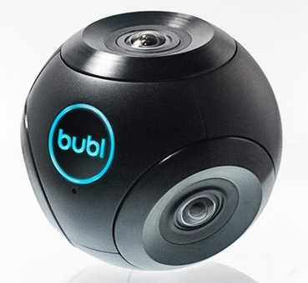
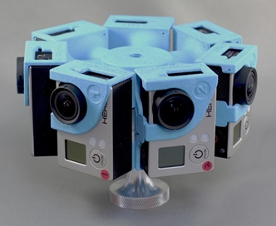
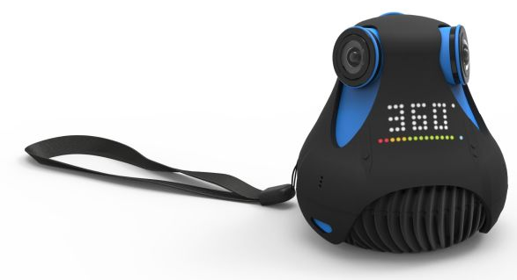
Omni-Directional Video (ODV)
Video footage with a 360 degree (i.e., cylindrical or spherical) Field of View
Typical ODV player implementations allow viewers to freely adapt their viewing angle inside the omni-directionally captured video scene

Slide 11
OUTLINE
ODV Web Player
Novel AVV Features
Augmented ODV
Showcases
Performance Evaluation
Conclusions

Slide 12
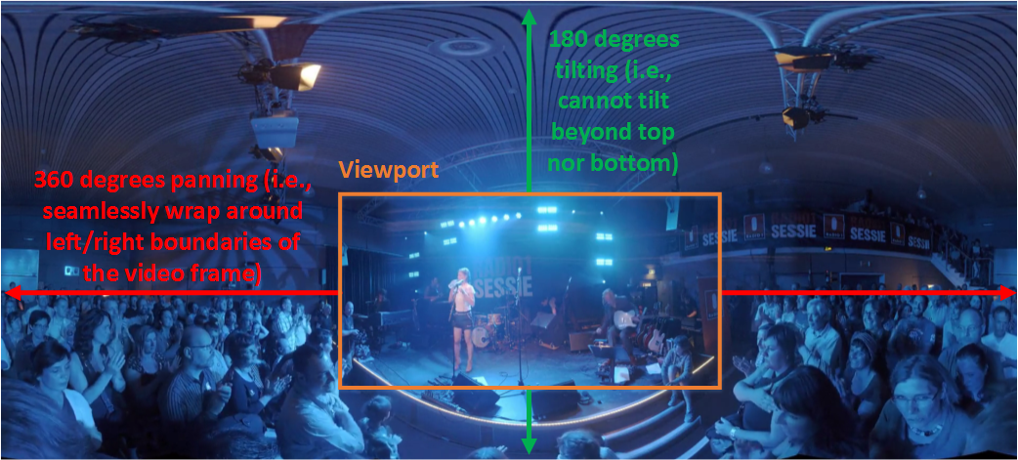
Functionality
The ODV viewer presents a spatially restricted viewport into 360 degree video scene
Viewport is controllable through Pan-Tilt-Zoom

Slide 13
Implementation
Pure HTML5 (i.e., no plug-ins)
Two distinct rendering modes
2D planar renderer
Directly crop viewport from equirectangular projection
Render viewport in standard HTML5 <canvas>
3D spherical renderer
ODV frames are integrally textured to the interior of 3D sphere rendered via WebGL
Users control a virtual camera positioned inside the sphere

Slide 14
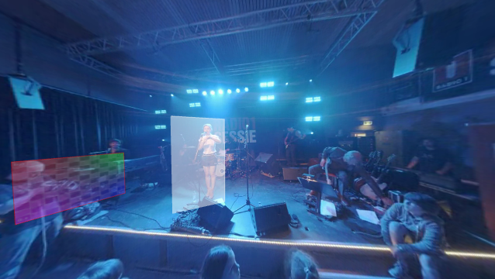
Visual Fidelity Comparison
2D planar
3D spherical

Slide 15
OUTLINE
ODV Web Player
Novel AVV Features
Augmented ODV
Showcases
Performance Evaluation
Conclusions

Slide 16
AVV Animation Provisions
AVV framework comprises animation facilities
Extensible family of interchangeable animation engines (1 per animation style)
Initial implementation included only a keyframing-like animation engine
Overlay movement via linear interpolation
Conceptually attach overlay to in-scene object
Animation engine that enables overlays to follow movement of subjects in video scene

Slide 17
Motion Tracking Animation Engine
Input = Cornerpin-based 2D tracking data as generated by off-the-shelf video editing software
E.g., Adobe After Effects (rotoscoping tool)
Captured movement information is applied to control both position and spatial extent of overlay element

Slide 18
Motion-Tracked Video Overlays
Render overlays on top of (mobile) in-scene video items

Slide 19
Reaction Video Overlays
Specification of parent/child relationship amongst individual overlay elements
Child’s spatial positioning is defined relative to that of another hotspot (i.e., its parent)
Child is typically visualized in response to user interaction with parent
Spatial behavior dictated by configurable settings
Absolute spacing between child and parent
High-level positioning preferences
Reaction overlays are only rendered at potential placement location in case sufficient screen real estate is available
Reaction overlays are never rendered partially

Slide 20
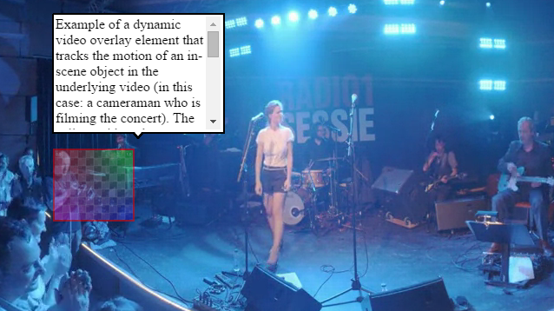
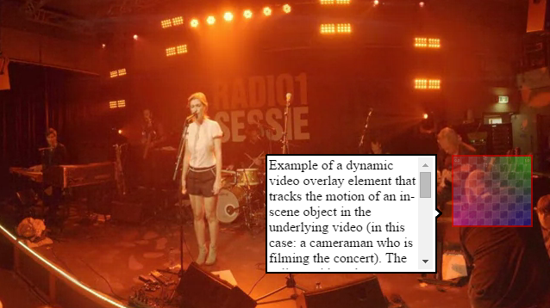
Reaction Video Overlays
Interplays well with both animated parent items and viewport modifications in the Augmented ODV player
Interesting application domain: call-out widget-like functionality

Slide 21
OUTLINE
ODV Web Player
Novel AVV Features
Augmented ODV
Showcases
Performance Evaluation
Conclusions

Slide 22
2D Planar Augmented ODV
Presents two-dimensional images to the user
AVV porting turned out relatively straightforward
Special attention for boundary cases
Hotspots must scale proportionally to applied zoom level
Apply scale function of CSS transform property to DOM item
Exclude from rendering
Adjust CSS clip property
Two discrete DIV items

Slide 23
3D Spherical Augmented ODV
Video is applied to curved surface in WebGL
No longer a notion of planar presentation of video frames
When drawing (flat) DOM elements as exogenous layer on top of this 3D scene, their graphical appearance would not blend in nicely with ODV footage
Two alternative solutions were developed

Slide 24
CSS 3D Transformations
Overlays remain represented by DOM items
Manipulated using CSS 3D transformations to position them on top of WebGL scene
Three.js JavaScript graphics library to install CSS 3D renderer in the HTML page
Spatially coincides with WebGL renderer (superimposed)
Overlay elements are “projected” onto sphere
2D video coordinates of outlining vertices plus depth information are expressed in spherical coordinate system
Spherical coordinates (r,θ,φ) mapped to Cartesian positions (x,y,z) in 3D space
Cartesian coordinates are fed to CSS 3D renderer

Slide 25
Overlays as WebGL Objects
Vertex outline of overlay is spherically projected
Calculated 3D coordinates are directly interconnected in the 3D scene by WebGL lines
Resulting shape filled with low-polygon 3D mesh
E.g., set background image for overlay
Equip constructed mesh with WebGL material
E.g., set background color for overlay

Slide 26
Overlays as WebGL Objects
Overlay as 3D object vs DOM item implications
No longer feasible to directly stylize hotspots via CSS or to define hotspot content via HTML
Requires manual parsing and translation to WebGL settings
Invalidates hotspot interaction handling by listening for DOM events
Raycasting-based picking solution
Outperforms CSS 3D transformations solution in terms of visual realism
Intertwines overlays and 3D scene in visually more convincing fashion

Slide 27
OUTLINE
ODV Web Player
Novel AVV Features
Augmented ODV
Showcases
Performance Evaluation
Conclusions

Slide 28
Augmented Concert Capture

Slide 29
Virtual Walkthrough
ODV-powered counterpart of Google Street View player
→ Complementarily highlight real-world items pointed out by human guide
→ Appropriately present informative call-outs to users

Slide 30
OUTLINE
ODV Web Player
Novel AVV Features
Augmented ODV
Showcases
Performance Evaluation
Conclusions

Slide 31
Performance Benchmark
Analyze computational complexity of Augmented ODV solution
Tested hardware platforms:
Mid-range desktop with GPU hardware acceleration
Low-cost laptop without GPU hardware acceleration
Google Nexus 7 tablet (2012 edition)
Google Chrome as execution environment
Variable benchmark parameters:
Spatial resolution of input ODV material
Output resolution of ODV player (i.e., viewport size)
2D planar vs 3D spherical Augmented ODV Web player

Slide 32
Performance Benchmark

Slide 33
OUTLINE
ODV Web Player
Novel AVV Features
Augmented ODV
Showcases
Performance Evaluation
Conclusions

Slide 34
Conclusions
Little evolution in types of experiences the video medium can deliver
Video consumption remains passive matter
Augmented ODV as a pragmatic solution to battle this stagnation
Overlay ODV footage with interactive elements rendered in Web standards-compliant manner to activate ODV consumption
All mechanisms build upon well-established Web standards
Eliminates steep learning curves in authoring process
Valorization potential showcased by 2 use cases
AVV philosophy in general and Augmented ODV in particular has bearing on plethora of application contexts and domains
Entertainment, online video-driven advertising, video-assisted remote tutoring

Slide 35
THANK YOU FOR YOUR TIME AND ATTENTION
Questions?

