Slide 1
TweetPos: A Tool to Study the Geographic Evolution of Twitter Topics
Maarten Wijnants, Adam Blazejczak, Peter Quax, Wim Lamotte

Slide 2
Introduction
SNSs have witnessed tremendous growth
High subscription count
They nowadays host a wealth of heterogeneous user-generated data
SNSs are real-life, real-time, crowd-sourced sensor systems or representative data providers that generate valuable, highly polymorphous data feeds [Sakaki et al., 2010]

Slide 3
Introduction
Mining and analyzing information shared by end-users through Social Media leads to valuable insights and knowledge
Revenue generation
Potential application domains:
Consumer behavior modeling, Consumer profiling
Intelligent recommendation systems
Population sentiment assessment
Market analysis
…

Slide 4
Introduction
TweetPos
Web-based tool for Twitter microblogging platform
Display and study geographic origin of tweets
Thorough analysis and mining of geo-spatial distribution of tweeted material over time
Uncover geographical evolution of tweet topic popularity
TweetPos offers all necessary measures to perform significant research about the geographical sources of Twitter data
Experimental results illustrate comprehensiveness and extensive applicability
Generic methodology
Cater to demands of a vast variety of consumer profiles

Slide 5
Outline
Related Work
TweetPos
Implementation
Evaluation
Results of two prototypical analyses
Conclusions
Future Work

Slide 6
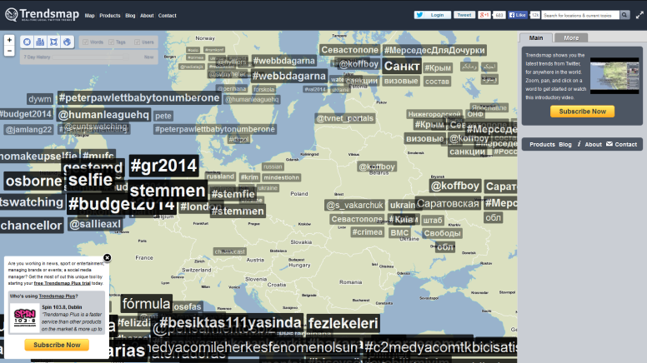
Related Work – Commercial Web Services
Trendsmap (http://trendsmap.com/)
Real-time, localized mashup of currently trending Twitter themes

Slide 7
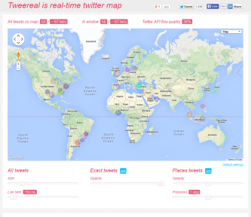
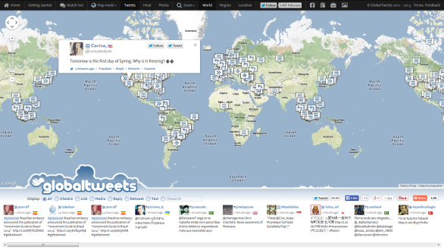
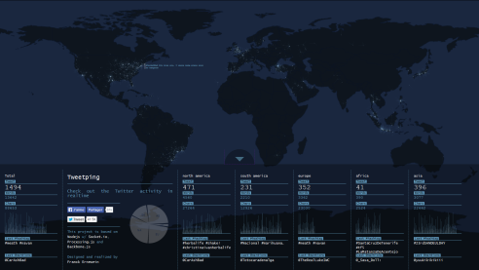
Related Work – Commercial Web Services
Real-time geographic visualization of tweets

Slide 8
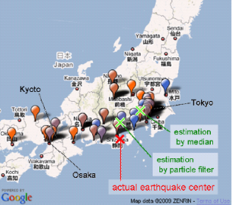
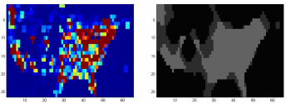
Related Work – Academic Research
Twitter as distributed sensor network to identify & locate events in the physical world [Boettcher & Lee, 2012] [Crooks et al., 2013] [Takahashi et al., 2011]
Earthquake detection and location estimation [Sakaki et al., 2010]
Social pixel/image/video approach [Singh et al., 2010]
Twitter-powered situation detection, spatio-temporal assessments and excitation energy capture

Slide 9
TweetPos
A web service for the analytical study of geographic tendencies in Twitter data feeds
Keyword or hashtag-based topic selection
Topic layering framework
Easily compare geographic trends of multiple subjects
Hybrid data harvest scheme
Combines representative sample of tweets from recent past with completely accurate set of present-day messages captured in real time
Grant insight in both historical and current tweet posting behavior
Analytical granularity
Accumulated data collections can be aggregated and studied on either a per-day or per-hour basis

Slide 10
TweetPos – Output Modalities
Maximal investment in graphical representations of crawled Twitter data
Topographic map
Heatmap-based visualization of the geo-spatial provenances and intensities of filtered Twitter messages
Line chart
Quantitative volume of compiled tweet archive
Textual tweet contents inspection
Integration with topic layering framework
E.g., uniquely colored map/chart overlay per layer
Temporal as well as spatial filtering
Output reacts dynamically (e.g., localization)
Animation engine (hourly, daily increments)

Slide 11
TweetPos

Slide 12
TweetPos - Scientific Contributions
Topic layering framework
Comparison features missing in most related work
If present, confined to exactly two topics (e.g., iScience Maps [Reips and Garaizar, 2011])
Data compilation
Only minority of related solutions grants insight in both historical and current tweet posting behavior
Data visualization
Combination of heatmap-based tweet topic intensity rendering, tweet volume diagram, and dynamic means to inspect textual tweet contents
Fosters unprecedented deep mining of (the geo-spatial evolution of) Twitter contributions

Slide 13
IMPLEMENTATION

Slide 14
Web-compliance, System Architecture
Completely web-compliant implementation
HTML and CSS for rendering the GUI and for handling page layout and style
Programmatic logic scripted in PHP & JavaScript
Maximal portability due to platform independence
Client/server network topology
HTTP server: Twitter interfacing, data filtering/compilation, data persistence
Level of abstraction

Slide 15
Data Ingestion, Data Storage
Data ingestion
Twitter Search API
Representative sample of tweets from past 7 days
7 parallel, finite PHP daemons (one per day)
Twitter Streaming API
Low-latency gateway to the global stream of tweets
One indefinite PHP daemon that runs a cumulative filter
Data storage
Fetched tweets are persisted in MySQL DB
“Cache & parse later” to guarantee lossless data input
Cache architecture and DB schema adopted from 140dev
Client requests are handled purely via RDBMS interactions (i.e., SQL queries)

Slide 16
EVALUATION

Slide 17
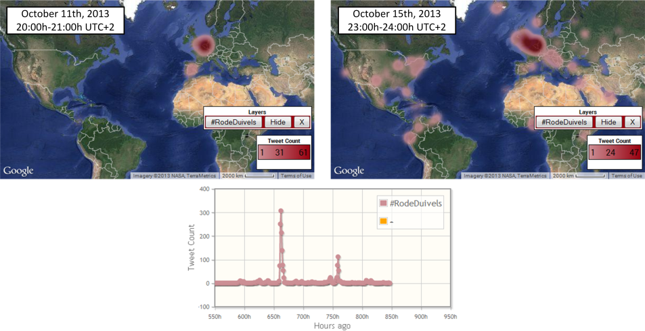
Test Case 1 - 2014 FIFA World Cup Qualifiers
Final two matches on Oct 11th and 15th, 2013
#RodeDuivels query (Oct 13th until 19th)
Streaming API
Two obvious peaks in tweet volume that nicely coincide with schedule of play
Some tweets embodying #RodeDuivels keyword emerged from non-Dutch speaking countries
Search API
Oct 11 tweets originated predominantly from Belgium, Oct 15 tweets have more worldwide distribution
Location-driven personalization of the tweeted contents

Slide 18
Test Case 2 - Game Console Comparison
Compare the attention the 3 next-gen gaming consoles receive on Twitter
Track #ps4, #xboxone, #WiiU with TweetPos
Nov 1st until Nov 16th, 2013

Slide 19
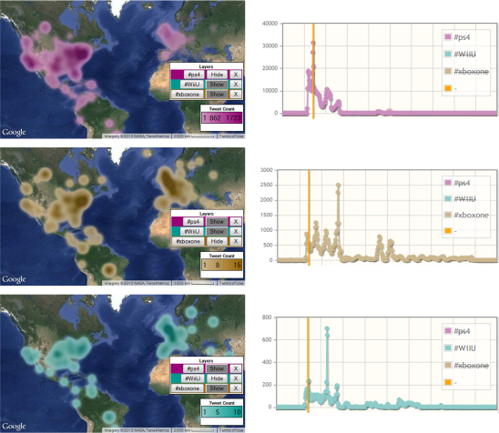
Evaluation – Game Console Comparison
Keyword visualizations might quickly conceal one another in multi-layer scenarios
Likely impairs analytical efficiency
Dynamically switch rendering of layers on/off

Slide 20
Evaluation – Game Console Comparison
Findings
Quantitative differences
Tweet count #ps4 >> #xboxone >>> #WiiU
Volume plot shows that XboxOne was at one point able to pierce the PS4’s Twitter hegemony
→ Clever marketing strategy: By retweeting a message from Xbox France, users could reveal the identity of the French “Xbox One ambassador”

Slide 21
Evaluation – Game Console Comparison

Slide 22
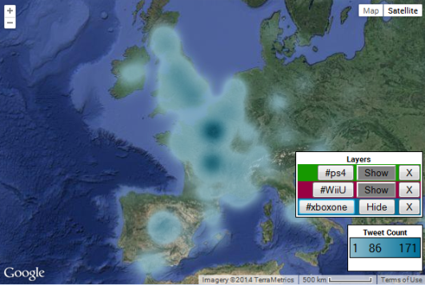
Evaluation – Game Console Comparison
The resulting (re)tweets primarily originated from Western Europe
→ Focused marketing campaigns tremendously increase brand visibility on social networks!

Slide 23
Conclusions
TweetPos
An mining tool to study geographic tendencies in Twitter data feeds
Exceeds related initiatives in terms of analytical feature variety and the synergistic benefits that stem from this holistic design
Emphasis on visual output modalities
Offer human operators an adequate graphical workspace that allows them to readily and conveniently assess geo-spatial trends in social media contributions
The validity, comprehensiveness and analytical effectiveness of TweetPos has been demonstrated via 2 example test cases

Slide 24
Future Work
Incorporate computer-mediated aids
Assist users in executing analytical tasks more efficiently and swiftly
Potential supportive technologies:
Visual pattern recognition & edge detection algorithms
Linguistic processing frameworks
Dynamic data delivery
Current implementation performs in bulk data transfer from server to client
High startup delay (directly proportional to data set size)
Suboptimal network bandwidth utilization
Experiment with a demand-oriented tx scheme
Relevant data is transmitted just-in-time

Slide 25
Thank you for your attention!
Questions?

