Slide 1
Service Quality Improvement and User Experience Optimization by Introducing Intelligence in the Network
Dissertation submitted in partial fulfillment of the requirements for the degree of Doctor of Philosophy in Computer Science at the transnational University of Limburg
Maarten Wijnants
Promotor: prof. dr. Wim Lamotte

Slide 2
Problem Statement
Current generation of transportation networks has been designed for passive bit hauling
Works fine for “traditional” applications
E.g., e-mail, web browsing, …
Over the years, distributed applications have become increasingly complex
E.g., inclusion of multimedia content
Imposes (performance) requirements

Slide 3
Problem Statement
Therefore a more active role from the transportation network desired
Provide performance guarantees → Quality of Service
Provide mechanisms for influencing user experience (the so-called Quality of Experience)
Current networks unfit for such an active role; 2 orthogonal solutions possible [Dovrolis 08]
Clean-slate paradigm
Design and deploy a new generation of networks with adequate, built-in QoS/QoE optimization support
Evolutionary approach
Maintain current networks and extend them with novel functionality where needed
Notes:
De QoS en QoE concepten zjn gelerateerd, daar het niet slagen in het aanbieden van de gevraagde Quality of Service typisch resulteert in een verlaagde efficientie van de applicatie, wat op zijn beurt een negatieve invloed zal hebben op de ervaring van de gebruiker. QoE == semantische variant van QoS

Slide 4
Problem Statement
Network Intelligence Proxy (NIProxy)
The NIProxy is an evolutionary solution for (QoS/)QoE optimization in IPv4-based networks
Intra-network framework
Completely compliant with the Internet
Objective = Improve the experience perceived by users of distributed applications
Methodology = Equip network with traffic engineering tools to enable active control over the network communication behavior of applications
Context-aware → Intelligence introduction in the transportation network
Notes:
De NIProxy is een intra-network framework, wat wil zeggen dat de NIProxy geinstalleerd moet worden op een component die zich in het netwerk bevindt.
De methodology bestaat er hierbij uit het communicatie netwerk te voorzien van gereedschappen waarmee netwerk trafiek beinvloed kan worden om aldus het communicatie netwerk in staat te stellen de manier waarop data gedistribueerd wordt actief te manipuleren, of anders gezegd om het netwerk in staat te stellen actief controle te nemen over het communicatie gedrag van gedistribueerde applicaties.

Slide 5
Outline
NIProxy
Conclusions and Future Research
Experimental Results
Stream Hierarchy Design
Experimental Setup
Video Transcoding Case Study
Discussion
Experimental Results
Stream Hierarchy Design
Considered Distributed Application
Rendering-Related Transmission
Example: Static Video Transcoding
Overview
Service Provision
Leaf Stream Hierarchy Nodes
Internal Stream Hierarchy Nodes
Stream Hierarchy Approach
Objectives
Network Traffic Shaping
Traffic Management
Context Introduction in the Network
Notes:
Hier zeggen dat ik slechts 2 experimentele evaluaties bespreek wegens tijdsgebrek; additionele evaluaties zijn te vinden in de dissertatie

Slide 6
Outline
NIProxy
Conclusions and Future Research
Experimental Results
Stream Hierarchy Design
Experimental Setup
Video Transcoding Case Study
Discussion
Experimental Results
Stream Hierarchy Design
Considered Distributed Application
Rendering-Related Transmission
Example: Static Video Transcoding
Overview
Service Provision
Leaf Stream Hierarchy Nodes
Internal Stream Hierarchy Nodes
Stream Hierarchy Approach
Objectives
Network Traffic Shaping
Traffic Management
Context Introduction in the Network

Slide 7
Context Introduction in the Network
NIProxy’s methodology centered around principle of introducing intelligence in the network
Accumulates contextual knowledge regarding
The transportation network
Quantitative network-related measurements and statistics
Acquired via active probing framework
The distributed application
Any application-related information which might be relevant/valuable during QoE optimization
Provided by the application
The end-user’s preferences and terminal
Represented via MPEG-21 UED standard

Slide 8
Traffic Management
NIProxy exerts collected context to engineer the data/packets that flows through the network
Conceptually: Improve the traffic handling capabilities of networks to enable QoE manipulation
2 complementary traffic engineering facilities
Network traffic shaping (NTS)
Enables coordination and orchestration of the bandwidth consumption behavior of applications
Multimedia service provision
Substrate for the hosting and execution of services on intercepted network traffic

Slide 9
Outline
NIProxy
Conclusions and Future Research
Experimental Results
Stream Hierarchy Design
Experimental Setup
Video Transcoding Case Study
Discussion
Experimental Results
Stream Hierarchy Design
Considered Distributed Application
Rendering-Related Transmission
Example: Static Video Transcoding
Overview
Service Provision
Leaf Stream Hierarchy Nodes
Internal Stream Hierarchy Nodes
Stream Hierarchy Approach
Objectives
Network Traffic Shaping
Traffic Management
Context Introduction in the Network
Notes:
Network traffic shaping (NTS) is the first traffic engineering facility that is provided by the NIProxy to enable IP-based networks to influence the QoE of users of distributed applications.

Slide 10
Objectives
Overall objective == Broker available bandwidth
Orchestrate bandwidth consumption of application
2 lower-level objectives
Ensure that distributed application respects its available bandwidth capacity
Prevents network congestion and all the detrimental effects that it evokes
Decide how bandwidth should be distributed among network flows that are involved in the execution of the distributed application
E.g., in case of throughput drop, how should network flow bandwidth assignment be reshuffled?
So that user QoE is maximized
Notes:
The NIProxy's accumulated contextual knowledge is in this case exploited to in-network orchestrate the bandwidth consumption of distributed applications.
First of all, the NTS framework needs to guarantee that the distributed application does not violate the bandwidth volume that is available for the dissemination of the network traffic which it induces. Failure to do so may result in over-encumbered network connections and hence network congestion and all the detrimental effects that it evokes (e.g., unpredictable network performance, increased latency, data corruption and packet loss, etcetera). These effects have a seriously negative impact on the quality of the data dissemination and hence presumably also on the experience of the end-user.
Stated differently, the second objective is to exploit the available bandwidth budget as effectively as possible, namely in such a manner that the QoE of the user of the distributed application is maximized.

Slide 11
Stream Hierarchy Approach
Organization of network flows in stream hierarchy
Captures relationships between network traffic (types) and other contextual knowledge
Internal nodes implement a certain bandwidth distribution procedure
Leaf nodes represent actual network flows
NTS operation is controlled by the types of internal nodes used and the tree layout
Once stream hierarchy has been constructed, performing NTS is as simple as appointing the correct bandwidth amount to root node
Notes:
The NIProxy implements network traffic shaping by organizing network flows in a stream hierarchy. The goal of this tree-like structure is to capture the relationships that exist between network traffic (types) and other contextual knowledge. The stream hierarchy supports both fine- and coarse-grained relationship expression, as relations can be defined on a per flow basis as well as using flow aggregates.
The body of the stream hierarchy is formed by internal nodes which each implement a certain bandwidth distribution strategy. As such, they dictate the bandwidth allocation process. Leaf nodes on the other hand do not provide any NTS functionality but instead represent actual network streams (e.g., a particular video flow).
The NIProxy's network traffic shaping operation is controlled entirely by the types of internal nodes that are used and the way these nodes are composed to model the general layout of the stream hierarchy. Once this layout has been constructed and assuming the stream hierarchy is kept up-to-date (e.g., newly initiated network ows are adequately incorporated in it), performing network traffic shaping simply amounts to appointing the correct bandwidth amount to the hierarchy root node. The internal nodes, commencing with the root node, will recursively distribute their assigned bandwidth value over their children according to the bandwidth distribution scheme which they implement. Eventually, portions of the total bandwidth capacity will reach one or more leaf nodes in the stream hierarchy, at which point this bandwidth amount will be reserved for the transmission of the network stream that is associated with the leaf node.

Slide 12
Internal Stream Hierarchy Nodes
Structure the hierarchy and steer BW brokering by designating BW to children in a specific manner
Multiple classes of internal nodes available
Mutex: Distributable BW allotted exclusively to child with largest still satisfiable bandwidth requirement
Priority: BW is partitioned statically in order of descending priority value (integer)
Percentage: Grants each child c its corresponding percentage value of BW:
WeightStream:
WeightData:
Notes:
The internal nodes structure the stream hierarchy and steer the bandwidth brokering process by designating bandwidth to their children in a specific manner.
Unfortunately I do not have time to go into the details of the operations of these two type of nodes. But what I would like to say is that the WeightData type was developed because it was empirically established that the WeightStream node is unfit to manage non-real-time network traffic and this has turned out to be caused by the presence of the maximal bandwidth consumption factor in the bandwidth distribution formula.

Slide 13
Leaf Stream Hierarchy Nodes
Correspond to an actual network flow
Multiple classes of leaf nodes available
Discrete: Defines discrete # of increasing BW levels
Toggle flow BW consumption between these levels
E.g., level 0 = off (0 BW), level 1 = on (max BW)
Very lightweight (nearly no computational overhead)
Well suited to represent real-time network traffic
Continuous: Sets BW usage to arbitrary value in a continuous interval
Introduces extra flexibility and dynamism
Requires adoption of resource-intensive and possibly computationally complex techniques (e.g., rate control)
Well suited for handling non-real-time data
Notes:
Contrary to internal nodes, leaf nodes do not provide any bandwidth brokering functionality. Instead, they embody an actual network streams (e.g., a particular video flow) in the stream hierarchy.
As is the case for internal stream hierarchy nodes, there also exist multiple leaf node classes. However, whereas internal nodes are categorized according to their bandwidth distribution approach, the classification of leaf nodes is based on their capabilities to control and modify the bandwidth consumption of the network stream which they represent.
Leaf nodes belonging to the discrete category define a discrete number of increasing bandwidth levels and are capable of toggling the bandwidth usage of the network flow which they represent between those levels. In its most rudimentary form, a discrete leaf node supports only two levels, which correspond to respectively a zero and maximal stream bandwidth consumption. This kind of discrete leaf node is in other words conned to turning its associated network flow off and on and can hence only effectively model single-quality network flows in the stream hierarchy. To be able to correctly manage scalable or multi-layer encoded network traffic, more advanced discrete leaf node implementations will typically be required which specify one or multiple intermediate bandwidth consumption levels that lie in between the extremes of turning the stream o and forwarding it at its maximal bitrate.
Discrete leaf nodes are very lightweight. They demand a minimal bookkeeping effort as the supported discrete levels and their corresponding bandwidth values need to be stored. The operation of this class of leaf nodes however does not require complex or time-consuming processing to be performed on the network flow which they are associated with. In particular, whenever a discrete leaf node is granted an amount of bandwidth by its parent in the stream hierarchy, it will exploit this bit budget to simply switch the embodied network flow to its largest satisfiable discrete bandwidth consumption level. This implies that discrete leaf nodes introduce nearly no computational overhead. They are therefore very well suited to represent real-time network traffic in the stream hierarchy, since such traffic is characterized by stringent reception delay constraints and hence needs to be received by the destination in a timely manner.
Unlike discrete leaf nodes, the class of continuous leaves is able to modify their associated stream's bandwidth consumption in a continuous manner.
Stated differently, these nodes define an entire bandwidth consumption range instead of a discrete number of bandwidth values and they provide functionality
to set their corresponding flow's bandwidth usage to an arbitrary value within this interval. In its most complete form, the lower bound of the bandwidth
range that is provided by a continuous leaf node equals zero, while the upper bound coincides with the associated stream's maximal bandwidth consumption
or the throughput of the destination's network connection, whichever is lower. When a leaf node of the continuous category is apportioned an amount of bandwidth by its parent in the stream hierarchy, its corresponding network flow will be forwarded at exactly this rate (given that the allocated bit budget is enveloped in the supported continuous bandwidth consumption interval).
Continuous leaf nodes are obviously more powerful than their discrete counterparts since they enable additional flexibility and dynamism to be introduced in the network traffic shaping process. This however comes at the expense of increased resource consumption and processing requirements. In particular, contrary to discrete leaf nodes, the operation of continuous leaves typically requires the adoption of resource-intensive and possibly computationally complex techniques like, for instance, mid-stream buffering, real-time transcoding and/or dynamic rate control. As a result, the continuous leaf node type is innately less tailored to the management of real-time network traffic. On the other hand, their provided functionality makes them obvious candidates for handling non-real-time data like a file transfer.

Slide 14
Outline
NIProxy
Conclusions and Future Research
Experimental Results
Stream Hierarchy Design
Experimental Setup
Video Transcoding Case Study
Discussion
Experimental Results
Stream Hierarchy Design
Considered Distributed Application
Rendering-Related Transmission
Example: Static Video Transcoding
Overview
Service Provision
Leaf Stream Hierarchy Nodes
Internal Stream Hierarchy Nodes
Stream Hierarchy Approach
Objectives
Network Traffic Shaping
Traffic Management
Context Introduction in the Network

Slide 15
Overview
NIProxy acts as service provision/delivery platform
Services applied on content flowing through network
Range of services is theoretically limitless
NIProxy services are context-aware and -adaptive
Attune operation to current context of use
Services correspond with plug-ins for the NIProxy software architecture
On-demand and at run-time loadable
Guarantees run-time extensibility of functionality
Collaboration between NTS and service provision
Services can query/supplement NTS strategies
Holistic solution: tools complement their strong points
Notes:
The NIProxy's second tool to manipulate network data dissemination, and hence user QoE, is Service Provision. The NIProxy can act as service provision and delivery platform. The provided services will be applied to the content that flows through the network (especially multimedia content). In other words, the NIProxy introduces the possibility to perform processing on traffic during its dissemination through the communication network (especially traffic which transports multimedia content).
The range of services that can be provided is theoretically limitless, spanning from completely generic to highly application-specific and from very lightweight to computationally complex.
Analogous to the network traffic shaping functionality, the multimedia service provision framework is context-aware and context-adaptive. This implies that NIProxy services can consult the NIProxy’s repository of contextual information and can attuning their operation to the current context of use, which will in turn ensure that the processing which they implement will actually lead to an improvement of the end-user experience.
Implementation-wise, the multimedia service provision framework adheres to a pluggable design. Services correspond with NIProxy plug-ins that can be on-demand and at-runtime loaded and unloaded. In other words, the functionality which is implemented by services can dynamically be plugged into the NIProxy when desired or as it is demanded by current contextual conditions and this can be done during NIProxy operation, so without requiring a reboot or without interrupting the service for currently managed hosts). Probably the most important advantage that is conferred by this design is that it allows the set of provided services to be at run-time modified and extended and that it as such guarantees run-time extensibility of the NIProxy’s supported functionality. This way, it becomes possible for the NIProxy to cope with heterogeneous conditions in dynamic networking environments without requiring a reboot.
A defining characteristic of the NIProxy is that it synthesizes its dual traffic engineering facilities in an interactive and collaboration-enabled manner. Instead of implementing the bandwidth brokering and service provision frameworks as isolated modules, an integrated design has been adopted that enables both techniques to cooperate during QoE optimization. To be more precise, services are able to query and even influence and supplement the bandwidth brokering strategies which the NTS mechanism draws up for NIProxy clients. The outcome is a holistic solution in which the individual components complement each other’s strong points and improve their QoE optimization potential. This in turn improves the QoE optimization potential of the NIProxy as a whole, as I will illustrate later on in this presentation when I will provide practical results.

Slide 16
Example: Static Video Transcoding
Introduces on-the-fly transcoding functionality to enable NIProxy to reduce bitrate of H.263 video
Static: All bitstreams exhibit identical video quality characteristics and have widely comparable bitrate
Configurable at service load-time
Generates new type of network traffic
Service informs NTS framework of traffic existence
Incorporates discrete leaf node in stream hierarchy
New node is made sibling of original video node
Service leverages its interface to the NTS framework to determine whether it should perform transcoding
Only if corresponding leaf is set to non-zero level
Notes:
The service introduces real-time H.263 video transcoding functionality in the NIProxy. The service in other words enables the NIProxy to lower the bitrate of H.263-encoded video by on-the-y reducing its quality parameters. The service is said to implement “static” transcoding since all bitstreams that are output by a certain instantiation will exhibit identical video quality parameters and will have widely comparable bandwidth requirements. The exact settings that will be used, can be configured at service load-time. Once an instance of this service is running however, altering the output video parameters becomes impossible. In the thesis, a dynamic counterpart has also been implemented which is not confined to a single output quality but instead supports video transcoding to a range of qualities and bitrates.
Instead of physically arriving at the NIProxy, transcoded video streams are automatically generated by the video transcoding service. This service in other words introduces a new type of network traffic of which the NIProxy is by default unaware. To inform the NIProxy of the existence of this new flow type and to ensure that it is taken into consideration during bandwidth brokering, it needs to be introduced in the stream hierarchy. The static video transcoding service therefore extends the stream hierarchy by including a new discrete leaf node for each distinct video flow that it processes. The new node is linked to the transcoded video stream and is added as a sibling of the node that represents the original version. The incorporated discrete leaf node defines two bandwidth levels which respectively correspond with a zero and maximal bandwidth consumption. The maximal bandwidth consumption of the transcoded video flow is determined on the basis of the target output bitrate that is set for the service instance. Once this incorporation has been completed, the NIProxy's network traffic shaping mechanism will start to take the provided information into account and can start making deliberate decisions about which video version to assign bandwidth to.
The figure exemplifies the stream hierarchy modification operations that are performed by the static video transcoding service. In the unmodified stream hierarchy, the Original Quality (OQ) of the video stream is represented by a subtree which consists of a Mutex internal node and a leaf node that corresponds with the actual network flow. In the updated stream hierarchy, the video transcoding service has incorporated an additional discrete leaf node to embody the Transcoded Quality (TQ) of the video flow; the new node was made a sibling of the original video node (i.e., OQ). In this example, an intermediate internal node of the Mutex type was relied on to relate the nodes which are linked to the original and transcoded video versions in the stream hierarchy. This approach might be a good practice in many situations in which multiple content versions are involved. Such variants namely differ in their encoding but otherwise transport identical content (e.g., in this case exactly the same video fragment); as a result, for bandwidth efficiency reasons, a destination will typically not want to receive multiple of these versions simultaneously. Such behavior can effectively be enforced by grouping the different quality variants of a single flow as the sole children of a Mutex node.
Conversely, the video transcoding service interpellates the NTS framework to determine whether it should apply its functionality to transiting data. More precisely, incoming video frames are transcoded if and only if consultation of the appropriate stream hierarchy indicates that the transcoded version of the video stream to which the intercepted frames belong is currently enabled (i.e., the discrete leaf node which represents the transcoded video version is set to its non-zero bandwidth consumption level).
As such, the static video transcoding service nicely demonstrates the interoperability potential of the NIProxy’s network traffic shaping and multimedia service provision functionality.

Slide 17
Outline
NIProxy
Conclusions and Future Research
Experimental Results
Stream Hierarchy Design
Experimental Setup
Video Transcoding Case Study
Discussion
Experimental Results
Stream Hierarchy Design
Considered Distributed Application
Rendering-Related Transmission
Example: Static Video Transcoding
Overview
Service Provision
Leaf Stream Hierarchy Nodes
Internal Stream Hierarchy Nodes
Stream Hierarchy Approach
Objectives
Network Traffic Shaping
Traffic Management
Context Introduction in the Network
Notes:
This concludes the more theoretical part of this talk. It is now time to look at some practical QoE optimization results.
In the first experimental evaluation that I will present, the NIProxy was leveraged to coordinate the bandwidth utilization behavior of a real-world Networked Virtual Environment application. Before discussing the NIProxy integration and the experimental evaluation, I will introduce the NVE and its defining characteristics. Important to note is that none of the NVE’s functionality was implemented by myself. My input was the introduction of the NIProxy to manage the NVE’s network communication behavior.

Slide 18
Considered Distributed Application
Network Virtual Environment (NVE) application
User communication via audiovisual chat
Real-time data dissemination (RTP)
Advanced rendering scheme [Jehaes 08]
Hybrid 3D rendering
Sophisticated Level of Detail (LoD) methods
Rendering-related data stored on file server
Is downloaded to clients in a unicast manner and on as-needed basis
Non-real-time data dissemination (TCP)
Notes:
The considered NVE is characterized by two main features. First of all, it assigns great importance to user communication and hence supports both live audio and video chat between users. This requires the exchange of real-time data over the communication network, since live audiovisual data is very sensitive to delay and needs to be delivered to the destination in time; Outmoded delivery renders the received data worthless and has hence a just as detrimental impact as lost data. This type of content is transmitted via RTP in the NVE application.
Another important feature of the NVE is its rendering scheme. In particular, as will be described in more detail in a minute, the application incorporates hybrid 3D rendering techniques as well as sophisticated Level of Detail (LoD) methods.
Finally, the NVE application enables users to populate the shared virtual world with custom, possibly self-made 3D content. Distribution of this user-provided data occurs through a dedicated le server, which disseminates the data to clients in a unicast manner and on an as-needed basis. As an example, when a user enters a certain part of the virtual environment which he has not visited before, the data that is required for the rendering of this region will need to be downloaded from the file server. The rendering scheme hence necessitates the dissemination of non-real-time data. In contrast to the audiovisual data, this type of network traffic does not impose strict demands on its delivery period, although in many situations it is still preferable to receive the transported content as soon as possible. On the other hand, while real-time network traffic can typically cope with small amounts of packet loss, non-real-time content should usually be delivered reliably and free of errors. Therefore, this type of content is transmitted from the file server to the client using TCP.
The considered NVE application was designed for a Local Area Network environment. As a result, its network communication scheme expects network bandwidth to be abundantly available. This is unfortunately still an unrealistic assumption for residential users. The goal of the NIProxy incorporation was hence to make the NVE suitable for an Internet setting.

Slide 19
Considered Distributed Application
Hybrid 3D rendering
Combines geometric & image-based rendering
Geometric rendering: Progressive Meshes (PMs) [Hoppe 96]
Base mesh, 1 or more enhancement layers
Enables progressive transmission
IBR: Relief Texture Mapped Objects (RTMOs) [Oliveira 00]
Images with depth-information
Warped during run-time
In terms of visual quality : geom rendering > IBR
In terms of size : geom data > IBR data
Notes:
The application uses a rather advanced rendering scheme which uses a hybrid geometric and image-based rendering approach. To perform the geometric rendering, the Progressive Meshes (PM) technique is exploited, which allows for 3D mesh simplification and refinement and hence enable the progressive transmission of the 3D models which populate the virtual world offered by the NVE. In more detail, at each PM step, the triangle count is doubled, which in turn results in a more detailed and sharp model visualization. The IBR rendering on the other hand is implemented using Relief Texture Mapped Objects (RTMOs), which consist of a collection of images with depth information that are warped during run-time in order to get an appropriate view based on the current camera position. In terms of visual output quality , geometric rendering will normally seriously outperform image-based rendering. It is important to note however that the size of IBR representations is much smaller compared to the data size of geometric models. As a result, their required transmission time is also much smaller.
On the other hand, geometric rendering is also much more computationally complex and hence time-consuming compared to image-based rendering.

Slide 20
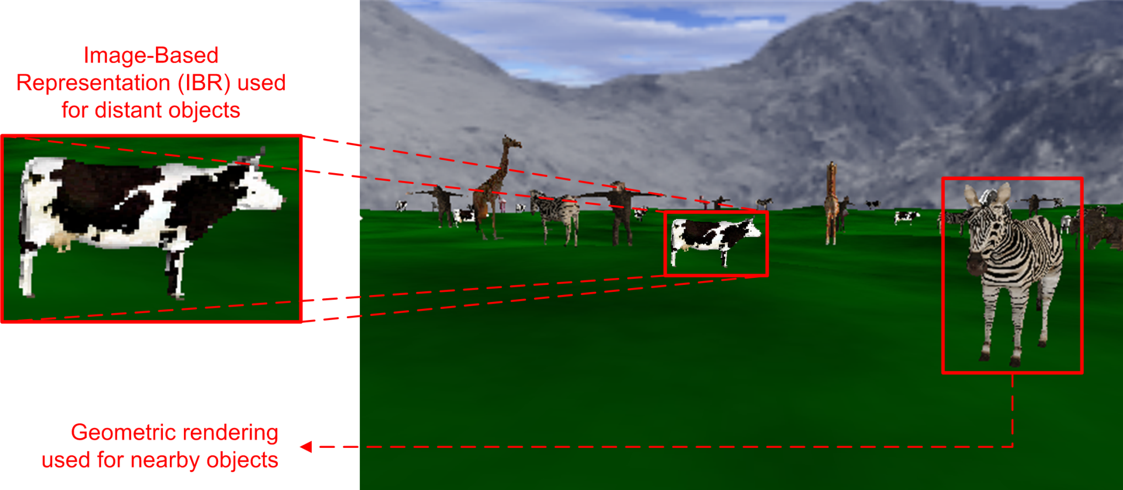
Considered Distributed Application
Level of Detail (LoD) manager
Selects most suitable representation for 3D objects
Considers scene priority, framerate (current/desired), distance to viewer (= model display size), …
Approach = PM for nearby, IBR for distant objects
Model representation switching is supported
Notes:
The NVE application encompasses a Level of Detail (LoD) manager which is responsible for selecting, on a per-client basis, the most suitable representation for each 3D object in the virtual world. When making these decisions, the LoD manager takes different factors into account, including the importance or the priority of the object in the virtual world, the framerate (i.e. assuring that geometric rendering does not cause the framerate to drop below a predefined threshold), distance of the model to the viewer, and so on. Generally speaking, the approach adhered to by the LoD manager is to select geometric rendering for nearby objects, while IBR representations are used for more distant objects. This way, the nearby objects, which are of course the most important ones for the user since he is more likely to start interacting with nearby objects as compared to more distant objects, are displayed at higher detail and fidelity. On the other hand, by using IBR for distant objects, the LoD manager is able to prevent the framerate from becoming too low. Important in this context is that model representation switching is supported, meaning it is for instance possible for an object that is being rendered using the IBR approach to switch to a PM representation if the importance of this object for the user increases and hence a more detailed rendering is beneficial.
The operation of the LoD manager is illustrated in this figure, where a relatively crowded virtual environment is visualized using the NVE's hybrid geometric/IBR rendering scheme. As can again be seen, the geometric rendering contains much more detail compared to the IBR version. However, as the RTMO representation is mainly exploited for the rendering of distant objects, the considered NVE's hybrid model representation solution introduces only a limited amount of degradation in terms of image quality.

Slide 21
Considered Distributed Application
Communication model assumes LAN setting
Networking issues in BW-constrained environments
Likely negatively impacts user QoE
Goal of NIProxy incorporation = Translate the application to a (BW-constrained) Internet setting
Regulate the dissemination of model data
Harmonize these transmissions with real-time audiovisual network traffic
Rendering subobjective
Provide user with initial view of virtual world ASAP
First stream RTMO representations
Progressively download geometric information to gradually improve visual accuracy
Notes:
A considerable disadvantage of the NVE application is its default communication model. In particular, the communication scheme is relatively simplistic and has been designed for a LAN setting. As a result, it assumes bandwidth to be abundantly available. Therefore, it might yield networking issues in case the NVE application is executed in bandwidth-constrained environments, like for instance an Internet setting involving residential users. These networking issues in turn are likely to negatively impact the QoE of the residential user.
The goal of the NIProxy incorporation was to manage the bandwidth consumption behavior of the NVE application so that it becomes suitable for use over the Internet. In contrast to LAN connections, contemporary residential Internet subscriptions are unfortunately still characterized by downstream throughput constrains. Therefore, to translate the NVE application to the Internet environment, an advanced bandwidth management solution was advocated that would enable more effective and interactive control over the downloading of model data that is required for rendering the world at client-side. Furthermore, the rendering-related transmissions needed to be harmonized with the real-time network traffic that is introduced by the NVE's audiovisual communication facilities since contention for network bandwidth between real-time and non-real-time traffic in constrained environments might yield issues, like for instance a wrongful penalization of the non-real-time traffic in terms of the amount of bandwidth which it can consume.
As a rendering-related subobjective, we wanted to provide the user with an initial view of the virtual world as soon as possible. Therefore, the strategy was devised of first streaming the low-detail image-based representations of objects in the virtual environment so that it becomes possible to quickly present the user a complete, albeit low-quality view of the world. The next step of the proposed solution involves the progressive downloading of more detailed representations (i.e., geometric information) on the basis of the current rendering need so that the visual quality of the view is gradually upgraded over time.

Slide 22
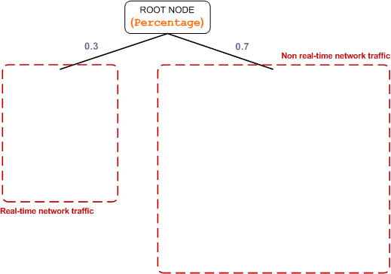
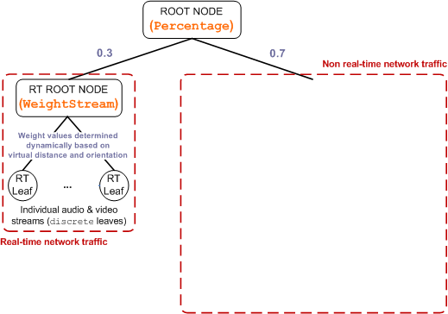
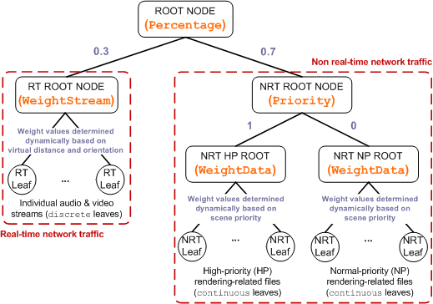
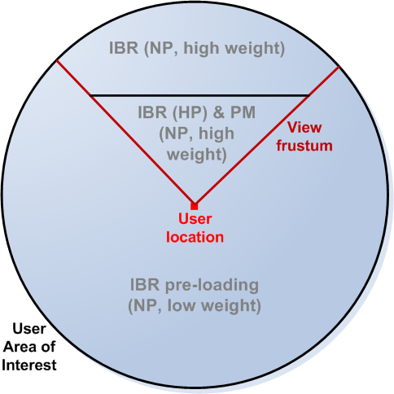
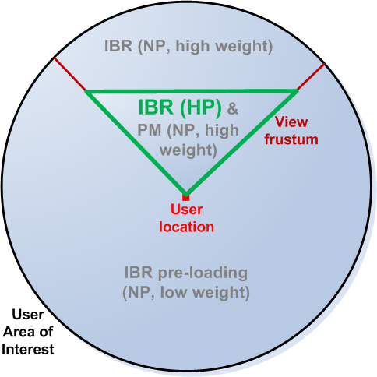
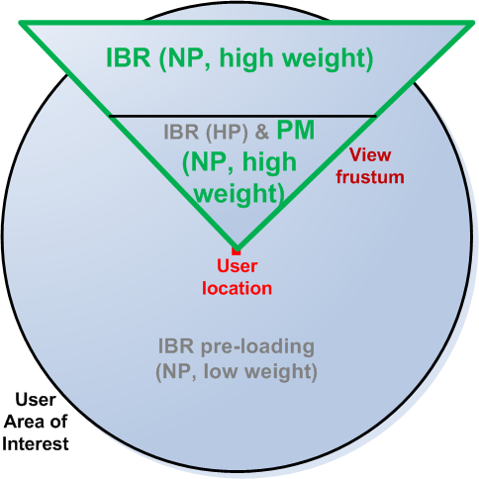
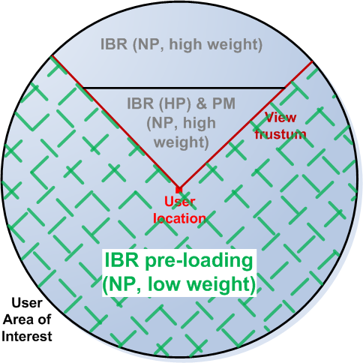
Stream Hierarchy Design
Convert requirements into appropriate stream hierarchy structure
Notes:
To be able to effectively orchestrate the bandwidth consumption of the NVE application, the requirements that are imposed by its distinct features needed to be translated into an appropriate layout for the client stream hierarchy. The structure that was decided upon is illustrated on the left hand side of this slide.
As can be seen, an internal node of the Percentage type was selected as root of the hierarchy and was used to discriminate between respectively the real-time and non-real-time network traffic that is induced by the NVE application. In more detail, it was determined that the real-time network traffic received 30 percent of the client's available downstream bandwidth, while 70 percent was reserved for the reception of non-real-time network streams.
A WeightStream node served as root of the real-time subtree in the stream hierarchy. All real-time (i.e., audio and video) network flows were represented as discrete leaves and were made direct children of this root. The discrete leaf nodes supported two discrete bandwidth levels and were hence confined to turning their associated stream off and on (as previously discussed). The weight values of these leaf nodes dynamically depended on the current importance of the audiovisual flow, which was determined by virtual distance as well as virtual orientation information.
The root of the non-real-time branch of the stream hierarchy on the other hand consisted of a Priority node and had two children, which were both of type WeightData. The leftmost WeightData node was intended to group together all High-Priority (HP) rendering-related files that need to be delivered to the client, whereas the rightmost functioned as root for rendering-related data having Normal-Priority (NP). A schematic clarification of how rendering-related data was exactly categorized and hence incorporated in the stream hierarchy is provided in the figure on the right.
As is shown, the HP part of the non-real-time subtree was used exclusively to receive IBR data and, more specifically, only the IBR data of those models that lay in the current viewing frustum and were therefore crucial for rendering a first view of the virtual environment. All other rendering-related les were clustered under the NP part of the non-real-time subtree. Each individual HP as well as NP rendering-related object was incorporated in the stream hierarchy as a continuous leaf node whose maximal bandwidth consumption equaled the amount of bytes that still needed to be delivered to the client. The allocation of weight values to these continuous leaf nodes was controlled by the scene priority of the rendering-related object with which they were associated. In turn, scene priority was determined by the NVE's LoD selection mechanism, which takes into consideration distance to the viewer as well as model display size. Furthermore, the NVE application performs pre-loading of IBR model data outside the frustum, but inside a circular Area of Interest (AoI) around the viewpoint. These data streams were placed under the NP branch and were given a low weight value to guarantee that their delivery did not hinder the reception of streams of higher priority.
The grouping HP root node had a higher priority value associated with it, compared to the NP root node. Consequently, the entire percentage of the client's available downstream bandwidth that is designated to the reception of non-real-time network traffic will first be exploited to receive the HP rendering-related files. Only if any bandwidth remains in excess, it will subsequently be granted to the NP branch of the non-real-time subtree.

Slide 23
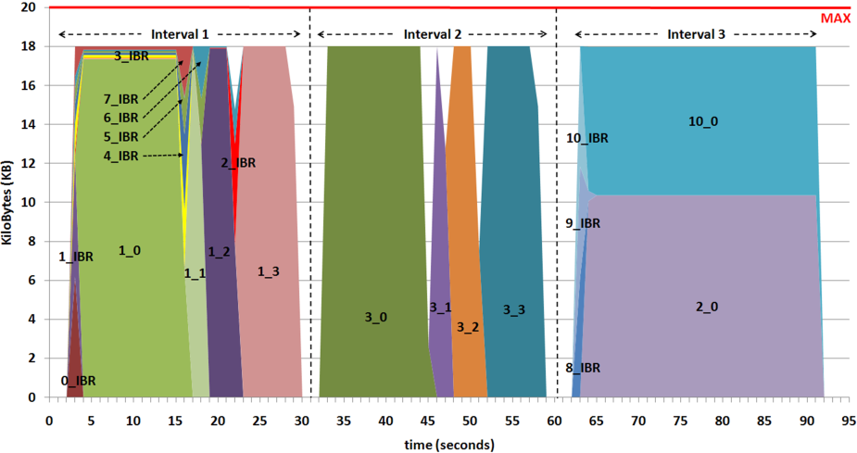
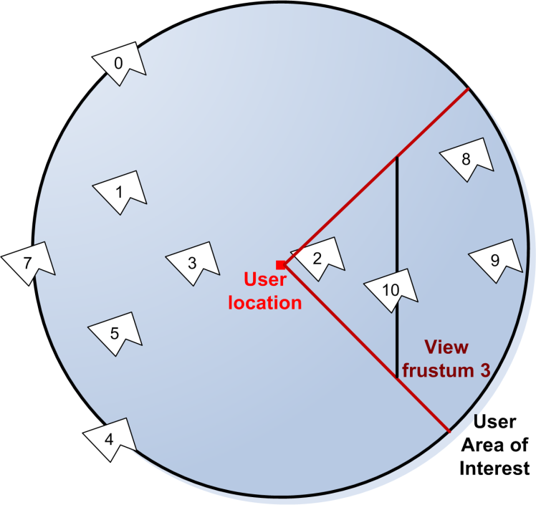
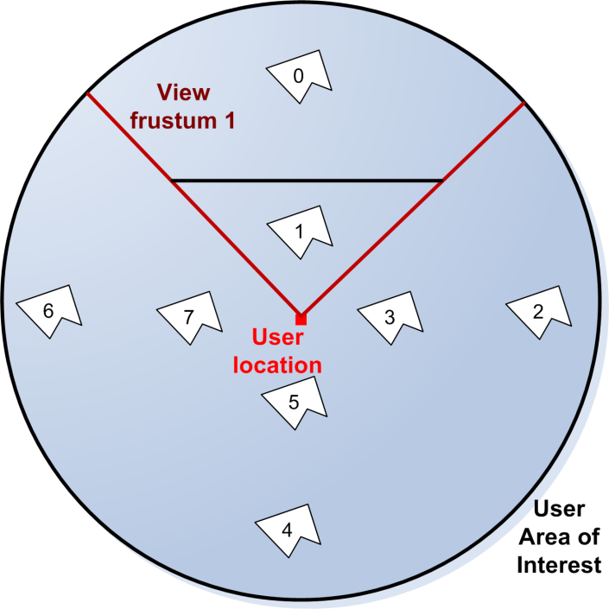
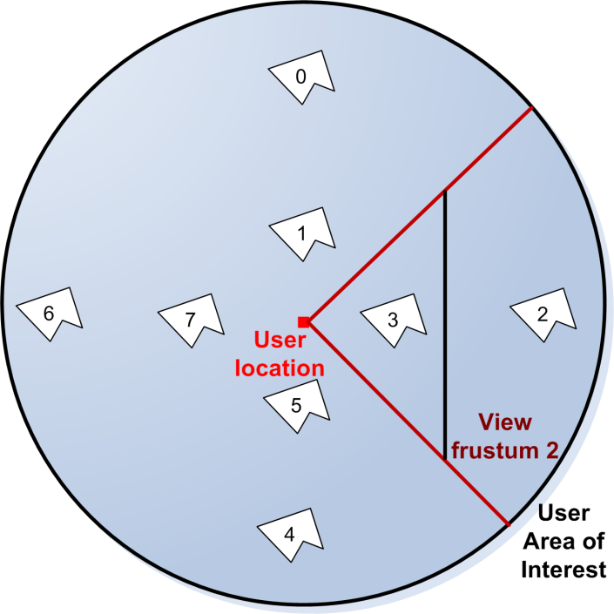
Experimental Results Minimalist Experiment
Limited model count & no real-time traffic
Notes:
The proposed bandwidth distribution strategy for the NVE application has been assessed via two distinct experiments in which the NIProxy was responsible for managing last mile data delivery to clients. The NIProxy was hereby deployed at the conceptual boundary between the core network and the managed client’s last mile network connection.
The initial experiment modeled a minimalist setup involving only a limited number of models and did not include real-time network traffic. By doing so, the client-side reception of non-real-time rendering-related data could be traced comprehensively and unambiguously. Besides constraining the model count, it was also decided to limit the downstream throughput of the client's access connection to an unrealistically low 20 KiloBytes per second (KBps) to allow for an intelligible analysis of the produced results. The results are visualized as a stacked graph at the bottom left of this slide, while the scene layout during the experiment will be shown on the right.
Looking at the scene layout information, it can be seen that at the beginning of the experiment, only objects 0 and 1 were positioned in the user's field of view. Object 0 was located relatively far from the user in the virtual world. In contrast, the virtual distance between the user and object 1 was relatively small. The NVE‘s rendering scheme consequently determined that solely IBR data was required for object 0, whereas IBR data as well as all PM levels needed to be delivered to the client for object 1. The network chart in Figure 9.6 discloses that for both objects, the high-priority IBR data was forwarded first, after which the delivery of object 1's PM levels was started, commencing with the base layer and continuing with 3 enhancement layers. The network trace also illustrates that, as soon as the RTMO representations of the objects in the view frustum were received successfully, the pre-loading of IBR data of non-visible objects began taking up a very small fraction of the available bandwidth.
After approximately 30 seconds, the user performed a 90 degree rotation in the virtual world (see new scene layout). As this rotation put both objects 0 and 1 outside the user's visible area, the weight values that were associated with both model streams were significantly reduced. On the other hand, the view frustum now contained objects 2 and 3, so their data needed to be propagated to the client at a higher weight and priority than before. Again, object 3 was close to the viewer and was given more weight, while only IBR data was required for object 2. Note from the network chart that, after the rotation, only the geometric data for object 3 was transmitted since the IBR files for both objects had already been received in the first interval of the experiment, during the NVE's IBR pre-loading phase for objects outside the view frustum. At the beginning of the second experiment interval, the renderer could therefore immediately present an initial view of the currently visible objects.
Finally, at around 60 seconds, a forward translation was performed to arrive at the scene layout which is depicted in the figure. The user's forward movement caused object 3 to fall outside the view frustum. At the same time, objects 2 and 10 were now marked for PM rendering, while objects 8 and 9 were added to the view at lowest resolution. The transmission of rendering-related
data continued as before, with the exception that now objects 2 and 10 needed to split the available client downstream bandwidth based on the weight values that were assigned to them by the run-time LoD selection scheme. The RTMO data for object 2 was already received during the first experiment interval, so it first had to wait for the transmission of the IBR models of objects 8, 9 and 10 to complete before it could continue with upgrading its own representational fidelity (through the reception of PM data).

Slide 24
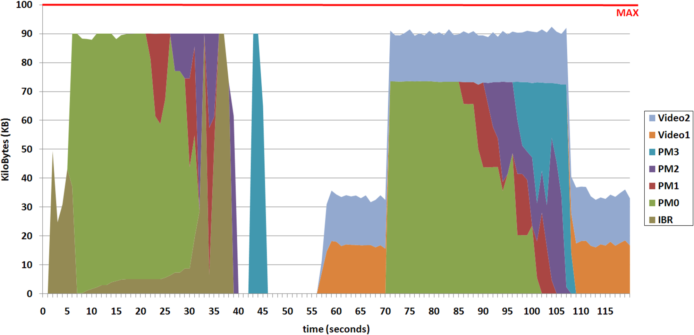
Experimental Results Representative Experiment
Densely populated scene
Contention from real-time traffic
Geometry
3D tx finished
IBR
IBR pre-loading
Video traffic
Contention
Notes:
The second experiment involved the transmission of a complex virtual scene and hence demonstrates how the proposed bandwidth management scheme behaves in lifelike situations. Furthermore, besides rendering-related data, the experiment required the simultaneous distribution of real-time video traffic. The client's downstream access bandwidth was in this case set to the more common value of 100 KBps.
The figure at the bottom of this slide again plots the yielded data reception at client-side. Due to the large number of virtual models that were involved in this experiment, the bandwidth usage of individual non-real-time data flows is no longer displayed. Instead, the graph visualizes the aggregate bandwidth which was consumed by each category of rendering-related data (i.e., IBR, compressed base mesh with texture data, PM L1, PM L2 and PM L3).
The network trace illustrates that at the start of the experiment, IBR data was given full priority so that the NVE application could quickly provide the user with an initial, low-quality view of the virtual world. Once these RTMO representations were completely received, model data was incrementally upgraded based on the geometric resolution levels that were selected by the NVE's LoD manager. After approximately 35 seconds, most PM data that was needed for the higher-fidelity rendering of objects in the frustum was delivered to the client and, as a result, the bandwidth amount that was assigned to the IBR pre-loading of models outside the user's field of view was drastically increased.
At around 55 seconds, two video sources entered the user's area of interest. Each video stream required a bandwidth of approximately 17 KBps. Recall that the NIProxy reserved only 30 percent of the total client downstream bandwidth for the reception of real-time network traffic. This amount did not suffice to simultaneously propagate both video streams, but since there was initially excess bandwidth from the non-real-time network traffic category, the real-time network flows were allowed to exceed their allocated bandwidth share; this is due to the two-phase operation of the Percentage internal node type.
Roughly 15 seconds later however, the user rotated 90 degrees in the virtual world, which caused model importance to alter due to the user's modified viewing direction. As a result, new geometric model data needed to be delivered to the client and hence competition for the available client downstream bandwidth between real-time and non-real-time network traffic was introduced. Due to this contention, the real-time network traffic now needed to conform to its appointed bandwidth percentage, which resulted in the NIProxy temporarily blocking one of the video streams to prevent the non-real-time network traffic from being denied its fair bandwidth share. In particular, during the contention period, the network flow for video 2 was retained to the prejudice of video 1 because of the former‘s higher scene importance and hence larger weight value in the client's stream hierarchy.
Only after the transmission of the 3D model data had finished, the simultaneous forwarding of both video streams was resumed.
Finally notice that a small fraction (i.e., 10 percent) of the client's downstream bandwidth capacity was even left unused in the experiment (and also in the previous one). This unallocated amount served as safety margin to guarantee a certain level of resilience to surges over which the NIProxy has no control in the bandwidth consumption of the network flows which constituted the traffic mix that was forwarded to the client. In this experiment, the overflow protection buffer successfully countered the slight variance in downstream throughput of the real-time video traffic and as such prevented these bandwidth consumption fluctuations from causing bandwidth capacity violations.

Slide 25
Discussion
Over-encumbrance of the client's access connection consistently prevented
NIProxy contributed to congestion avoidance
Optimal data reception at client-side
Rendering requirement captured successfully
Minimize time needed for rendering initial view
First stream image-based representations
Upgrade gradually with geometric data
Contention for client BW coped with successfully
Percentage hierarchy node type ensures fair share
Attained results are beyond reach of the NVE’s default network communication scheme
→ Likely yields network issues in BW-constrained settings
→ NIProxy mitigates issues and hence improves QoE
Notes:
The results produced during the two presented experiments comprehensively demonstrate the benefits and capabilities of the NIProxy's network traffic shaping functionality.
A first important observation is that over-encumbrance of the client's access connection was consistently prevented. Stated differently, no more traffic was forwarded to the NIProxy client than its network connection could handle. As such, the NIProxy delivered an important contribution to congestion avoidance on the managed client's access link. The outcome was that packet loss and packet latency were kept to a minimum throughout the experiments, which in turn resulted in the reception of the disseminated multimedia data at client-side under ideal circumstances. This in turn for instance led to an optimal playback of the received video traffic in the second experiment and hence a maximal viewing experience for the user.
Secondly, the requirements of the considered NVE application and, in particular, of its rendering scheme were successfully captured by the bandwidth distribution strategy that was implemented by the NIProxy. For instance, the presented network traces prove that, by assigning priority to the transmission of IBR data, the NVE's aim of quickly providing the user with an initial, albeit low-fidelity, view of the virtual world was satisfied. In particular, the low-detail image-based representations of objects in the virtual environment, which are small in size, were streamed first to the client, after which the view was gradually upgraded using more detailed representations (i.e., geometric information) that were downloaded based on the current rendering need.
Finally, the second experiment has indicated the NIProxy's ability to correctly deal with situations in which real-time and non-real-time network traffic contend for the downstream bandwidth that is available to the client. In particular, by employing a Percentage node to differentiate between real-time and non-real-time network flows in the client‘s stream hierarchy, both traffic categories received their fair bandwidth share throughout the entire experiment.
It is important to note hereby that the results that were attained by the NIProxy’s network traffic shaping framework are beyond the reach of the unmodified version of the NVE application. Due to the simplicity of the NVE’s default communication model, it might yield networking issues in environments where bandwidth is not abundantly available, like for instance an Internet setting involving residential users. These networking issues in turn are likely to negatively impact the QoE of the residential user. The experimental evaluation has confirmed that the NIProxy is able to mitigate these network-related problems, which in turn is expected to have a beneficial impact on user satisfaction.
So the important thing to remember from this evaluation is that the default implementation of the NVE application is likely to give rise to a suboptimal user QoE in an Internet setting, and that via the inclusion of the NIProxy, the QoE can be substantially improved. No formal user studies have been conducted to objectively confirm these findings, but the achieved experimental results are of such a magnitude that their beneficial influence on user QoE is intuitively evident.

Slide 26
Outline
NIProxy
Conclusions and Future Research
Experimental Results
Stream Hierarchy Design
Experimental Setup
Video Transcoding Case Study
Discussion
Experimental Results
Stream Hierarchy Design
Considered Distributed Application
Rendering-Related Transmission
Example: Static Video Transcoding
Overview
Service Provision
Leaf Stream Hierarchy Nodes
Internal Stream Hierarchy Nodes
Stream Hierarchy Approach
Objectives
Network Traffic Shaping
Traffic Management
Context Introduction in the Network
Notes:
The previous practical evaluation has focused exclusively on the NIProxy’s bandwidth brokering functionality and the options which this traffic engineering mechanism entails in terms of QoS provision and user experience optimization. To confirm that the NIProxy’s second traffic engineering tool, multimedia service provision, also holds promising possibilities in terms of QoE optimization, I will now briefly discuss a video streaming case study in which the previously described static video transcoding service will be leveraged to improve the last mile dissemination of the transmitted video data.

Slide 27
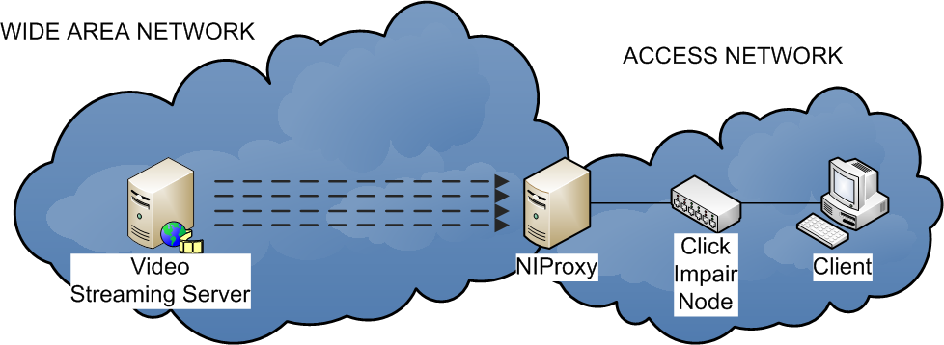
Experimental Setup
Emulated a WAN topology
Last mile throughput impairment via Click node
Server streamed 4 video fragments
NIProxy made use of static video transcoding service
Core/Access transition point
Can NIProxy react to throughput restrictions?
Notes:
Due to timing constraints, I can unfortunately not provide background information regarding the case study and I am forced to immediately jump to the discussion of the experimental setup.
In the case study, the following WAN topology was emulated. As you can see, the emulated network topology included a video streaming server, a client, one NIProxy instance and an impairment node that was based on Click technology. Via this latter component, the performance of the emulated network topology could be influenced. In particular, the Click node allowed the throughput of the last mile of the client's network connection to be manipulated.
As can be seen, the NIProxy instance was logically positioned on the transition point where the client's access link connected to the network backbone and hence fulfilled the role of access node.
In the experiment that I will discuss next, the multimedia server simultaneously streamed 4 video fragments to the client machine. Each fragment was transmitted over a separate RTP connection. As required by the bandwidth limitation on the last mile, the NIProxy performed network traffic engineering. The NIProxy instance hereby exploited its static real-time video transcoding service which I have discussed earlier. To recapitulate, this service enables the NIProxy to reduce the bitrate of H.263-encoded video fragments by decreasing the quality parameters of the video.
The objective of the experiment consisted of ascertaining whether the NIProxy succeeded in addressing and adequately reacting to the throughput restrictions that were imposed by the last mile.

Slide 28
Experimental Setup
Experiment consisted of 5 intervals
Downstream access bandwidth fluctuations
Applied by Click node
Discovered by NIProxy via network awareness
User-initiated shifts in stream importance
Video stream preference specification via GUI
Propagated to NIProxy as application awareness
Notes:
Due to varying last mile conditions and altering user focus, the experiment conceptually consisted of a succession of 5 discrete intervals. In particular, the transitions from the first to the second and from the fourth to the final interval were initiated by a modification of the available downstream access bandwidth. These throughput fluctuations were applied by the Click node that was incorporated in the access part of the emulated network topology and they were automatically discovered by the NIProxy thanks to its network awareness. The remaining interval transitions were caused by user-initiated shifts in video stream importance; in the experiment, users could specify video stream preference through the GUI of the client software. The relative video importance knowledge was propagated to the NIProxy instance by the client software in the form of application awareness.

Slide 29
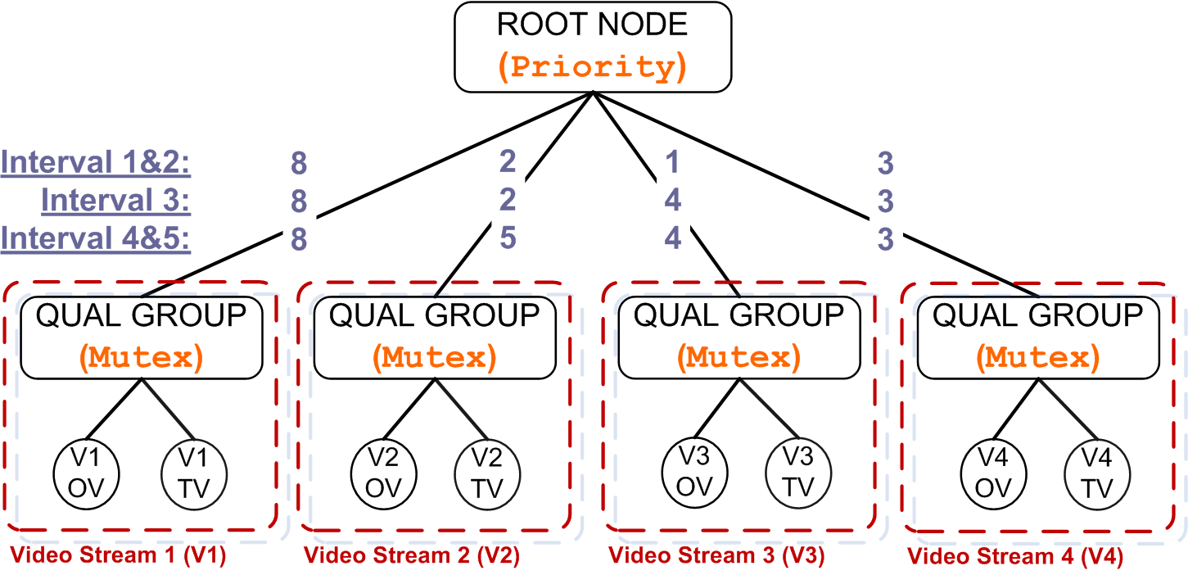
Stream Hierarchy Design
Stream hierarchy which steered last mile delivery
Priority values directly reflected user's input regarding relative stream significance
Each video flow incorporated as a subtree instead of single leaf due to static video transcoding service (rooted at Mutex node)
Notes:
This slide depicts the stream hierarchy which steered the last mile content streaming in the experiment.
As can be seen, an internal node of the Priority type was used to discriminate between the 4 involved video flows.
In the illustration, the priority values that were assigned to the different video sessions are grouped horizontally per experiment interval(s). These values were calculated so that they directly reflected the user's input regarding relative stream significance.
Also note that each video flow was incorporated in the stream hierarchy as a subtree instead of a single leaf node. This is explained by the fact that the NIProxy leveraged its (inbound) static video transcoding service during the experiment. As has been described earlier, each individual video flow was therefore represented by two discrete leaf nodes, of which one corresponded to the Original Version (OV) of the video stream (i.e., the video fragment as it was emitted by the streaming server), whereas the other was associated with the stream's Transcoded Version (TV) (i.e., the lower-quality variant that was generated by the static video transcoding service). Both video qualities were grouped together using an internal node of type Mutex to guarantee that at all times at most a single quality variant would be assigned bandwidth.

Slide 30
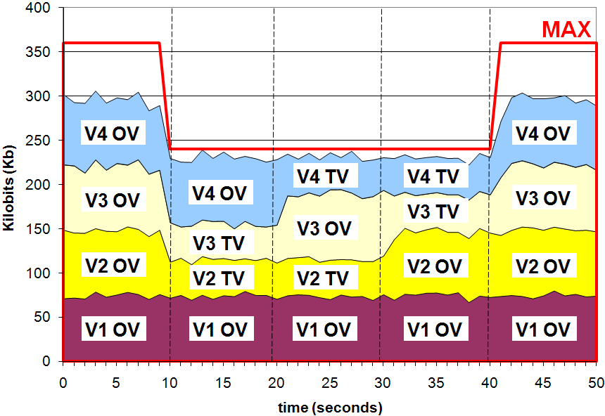
Experimental Results Last Mile Optimization
Enforced downstream access BW allocation
Lower-quality video version during bandwidth shorting
Most important video traffic at highest quality possible
→ Both NTS findings expected to be positive for QoE
→ Finding 1: Downstream access throughput respected
→ Finding 2: App aware → BW according to significance
→ Finding 3: QoE optimization potential service provision
→ Finding 4: NTS & vidtrans service collaboration
Notes:
The network trace depicted on this slide illustrates the downstream access bandwidth allocation that was enforced by the NIProxy during the experiment.
In this stacked graph, the dashed vertical lines separate the consecutive experiment intervals, while the red horizontal line indicates the downstream bandwidth capacity of the client's access link.
The trace first of all again indicates that the downstream last mile throughput was neatly respected throughout the test.
A second important observation is the influence of the NIProxy's application awareness on the network traffic shaping outcome. By mapping relative video flow importance to node priority values, application-related information was successfully captured in the client’s stream hierarchy. This in turn resulted in the bitrate of the least important video streams being reduced (by transcoding them to a lower quality) to preserve downstream access bandwidth for the forwarding of more relevant video flows. For instance, during the 3rd interval, V1 had the highest priority, followed by V3, V4 and finally V2. As a result, the client received the OV of video streams V1 and V3, but only the TV of video streams V2 and V4. At any time during the experiment, the client consequently received the video traffic which it considered most significant at that moment at the highest possible quality.
Both achievements can be attributed to the NIProxy’s NTS functionality and are intuitively expected to have had a beneficial influence on the QoE that was provided to the end-user.
Third, the experimental results exemplify the user QoE optimization options that are unlocked by the static video transcoding service and hence, through generalization, by the NIProxy's multimedia service provision platform. In the absence of such a service, shortage of client downstream bandwidth might force the NIProxy to mercilessly drop specific video flows on a quite regular basis. Now however, it becomes in such situations possible for the NIProxy to still forward (some of) the video streams which would otherwise have needed to be discarded to the managed client, albeit in a lower quality. Although no formal user inquiry was conducted, it seems intuitively apparent that the ability to deliver a lower-fidelity video stream instead of no video at all is likely to appeal to (at least a considerable subset of) users of distributed applications. In any case, if the video transcoding behavior and its implications on the bandwidth brokering outcome would not be desired by a particular person, it can easily be disabled for this user as NIProxy services are applied on a per client basis.
Lastly, the experimental results exemplify the possibility for the NIProxy’s dual traffic engineering facilities to collaborate and the positive implications that this collaboration unlocks in terms of QoE optimization. Video transcoding is only performed in case it fits in the current bandwidth brokering strategy. This implies that the QoE optimization benefits that are associated with the video transcoding service are not solely the merit of the functionality that this service implements but, just as importantly, also of its correct interaction with the NTS process. As such, they have exemplified that the NIProxy's integrated approach with regard to traffic engineering results in QoE optimization performance and prospects that transcend potential achievements when both mechanisms are applied independently.
These experimental results confirm that the NIProxy succeeded in managing and coordinating the last mile delivery of content to its destination in the video streaming case study. The NIProxy component successfully exploited its network traffic shaping and multimedia service provision tools to regulate the last mile data delivery in such a manner that the receiving user's QoE was optimized.
Finally, it is worth noting that, although the video transcoding service has been illustrated in a case study in which only video traffic was involved, it can just as well be exploited in more complex scenarios involving other types of network traffic as well.

Slide 31
Outline
NIProxy
Conclusions and Future Research
Experimental Results
Stream Hierarchy Design
Experimental Setup
Video Transcoding Case Study
Discussion
Experimental Results
Stream Hierarchy Design
Considered Distributed Application
Rendering-Related Transmission
Example: Static Video Transcoding
Overview
Service Provision
Leaf Stream Hierarchy Nodes
Internal Stream Hierarchy Nodes
Stream Hierarchy Approach
Objectives
Network Traffic Shaping
Traffic Management
Context Introduction in the Network
Notes:
Now that the results of 2 example practical evaluations have been presented, it is time to present the overall conclusions and suggest a number of directions for future research.

Slide 32
Conclusions
Active role requested from transportation network
Provide mechanisms for influencing user experience
Network Intelligence Proxy: Framework for (QoS/)QoE optimization in IPv4-based networks
Introduces intelligence/context in the network
Traffic engineering (conceptually: improve traffic handling capabilities of network)
Network traffic shaping & service provision
Integrated design
Practical results confirm validity of approach and demonstrate that NIProxy enables QoE improvement
Notes:
In recent years, an active role is increasingly demanded from the transportation network. In particular, it is more and more expected that the network incorporates mechanisms which enable it to influence the experience and satisfaction of users of distributed applications.
I have presented the Network Intelligence Proxy, a software framework that enables (QoS/)QoE optimization in IPv4-based transportation networks. As its name suggests, the NIProxy's methodology is centered around the principle of introducing intelligence or contextual knowledge in the networking infrastructure. Based on its accumulated contextual knowledge, the NIProxy engineers the network traffic that passes through it and as such improves the traffic handling capabilities of the transportation network in which it has been incorporated.
The first traffic engineering technique that is supported by the NIProxy is network traffic shaping (NTS), which implies that the NIProxy enables the in-network orchestration of the bandwidth consumption behavior of distributed applications.
The NIProxy's second tool to manipulate network data dissemination, and hence user QoE, is service provision. The NIProxy incorporates a substrate for the hosting and execution of services on intercepted network traffic.
A defining characteristic of the NIProxy is that it synthesizes its dual traffic engineering facilities in a single framework and that it does so in an interactive and collaboration-enabled manner.
Practical results have confirmed the validity of the NIProxy’s methodology and have demonstrated that the NIProxy enables improvement of the experience and satisfaction of users of distributed applications.

Slide 33
Future Research
Scalability investigation
Perform profiling study to determine client limit
Consider user preferences & terminal context in non-dedicated settings
Algorithms for NIProxy positioning in network
Mobile QoE management
QoE mediation executed on mobile hardware
QoE optimization via device pairing (wireless)
Evaluation & validation
Subject QoE attempts to qualitative user study
Notes:
Finally, some suggestions for possible future research.
A first potential topic of future work is scalability investigation. Submitting the NIProxy to a profiling study is likely to yield valuable information regarding the overhead of various system components and might reveal the upper bound of the number of users that can be simultaneously supported by a single NIProxy instance.
Secondly, it might be interesting to profoundly experiment with the NIProxy’s third type of contextual knowledge, namely information regarding the end-user’s preferences and the characteristics of his terminal. In particular, the NIProxy already supports the collection of this type of information (by means of the MPEG-21 UED standard), but the added value and potential of this type of context with regard to QoE optimization has thus far been exclusively investigated in pilot studies and isolated test environments. Considering and exploiting this context category in realistic, non-dedicated settings has yet to be done.
Third, an area where there is still room for additional investigation is NIProxy deployment. The NIProxy needs to be incorporated in the transportation network and it might be interesting to develop algorithms to automatically determine where in the network topology NIProxy components should be introduced so that optimal results are achieved.
The just described adjustments would require only relatively limited modifications and could hence be achieved in the short term. There is however also room for more drastic (and therefore longer-term) technological improvements and extensions.
A first example of such a long-term research goal is to use the NIProxy to develop a hierarchical or layered solution for QoE optimization. The idea is to construct an overlay network in which the constituting NIProxy instances are not just peers of each other, but instead are hierarchically structured according to parent/child relationships. In the envisioned solution, the NIProxy nodes in the undermost echelon manage end-users and their network traffic and hence assume the role and perform the tasks that have been described in this dissertation; in contrast, nodes higher up the hierarchy govern a number of NIProxy elements from the layer directly underneath. Such a layered approach is expected to open up additional possibilities in terms of QoE research.
A final potential direction for technical future research in the long term is mobile QoE management. In all the experimental evaluations that have been presented in this dissertation, the NIProxy was deployed at a certain location inside the transportation network and remained stationary from that point on. Introducing mobility into this equation is expected to unlock a plethora of additional research options. In particular, it is envisioned that QoE mediation is executed on mobile hardware such as laptops or powerful smartphones. As the mobile node roams around, it performs QoE arbitration in each of the environments in which it ends up by allowing devices to pair up with it.
All future research possibilities that I have described thus far are concerned with technological issues and aspects. Besides technical topics of future research, there however also lie possibilities in terms of evaluation and validation. It might be very valuable to subject the QoE optimization attempts that are implemented by the NIProxy to formal user studies and other usability research methods so that qualitative feedback regarding their impact could be collected.

Slide 34
Questions

