Slide 1
A Pragmatically Designed Adaptive and Web-compliant Object-based Video Streaming Methodology Implementation and Subjective Evaluation
Maarten Wijnants Gustavo Rovelo
Peter Quax
Wim Lamotte

Slide 2
Frame- or block-based video coding
Divide bitrate over constituting frames and then over constituting blocks via RD optimization
Subdivide video frames into macroblocks and exploit ME and MC
Agnostic to semantics of underlying visual scene
copyright Blender Foundation - www.sintel.org - Own work, CC BY 3.0

Slide 3
Object-based video coding and streaming
Exploit semantic knowledge of objects appearing in scene
Independently encode and stream individual objects (including scene background)
Re-composite visual scene based on objects

Slide 4
Advantages
Potentially improves encoding efficiency
Increased options for end-user interactivity
Personalization opportunities in video streaming
Enables novel application formats
E.g., interactive storytelling
Additional versatility in video streaming process
Deliberately distribute streaming bitrate budget over background and foreground object(s)
Could benefit the perceptual quality of the streamed video

Slide 5
Object-based video in MPEG-4
Explicit support for Video Object (VO) coding
Both natural and synthetic
Bitstream syntax provisions
Shape, motion and texture information per VO
Has witnessed limited adoption
Due to its disruptive nature
Breaks traditional video processing workflow (both en- and decoding-wise)
Hardware and software support implications

Slide 6
Proposed Solution
In contract, our approach is a pragmatic one
Maintains compliance with
Traditional video compression (e.g., H.264)
Contemporary streaming paradigms (e.g., MPEG-DASH)
Prevailing Web standards
Advantages
Warrants seamless, low-cost integration in existing workflows
Inherits advantages of encompassed traditional codec and streaming method (e.g., MPEG-DASH scalability)
Re-use of existing infrastructure
Re-use of existing hardware or software support

Slide 7
OUTLINE
Concept and Methodology
Client-side Implementation
Subjective Evaluation Setup
Subjective Evaluation Results
Conclusions

Slide 8
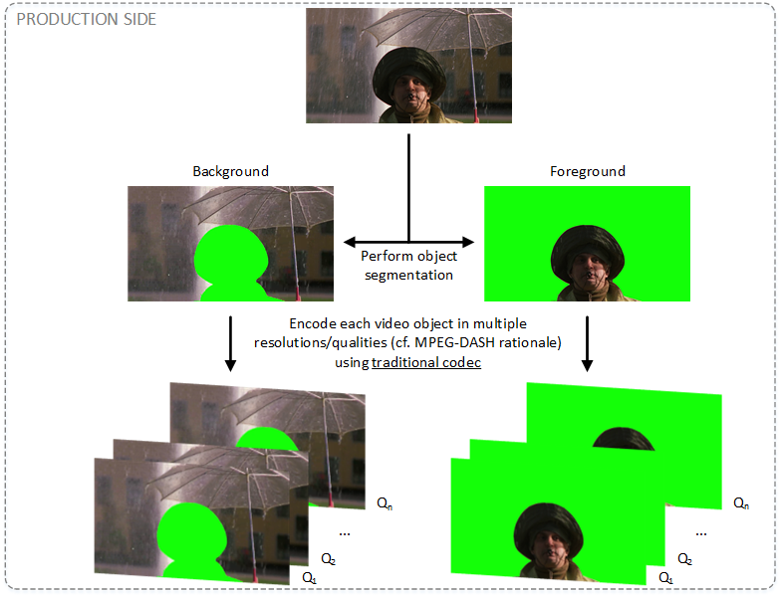
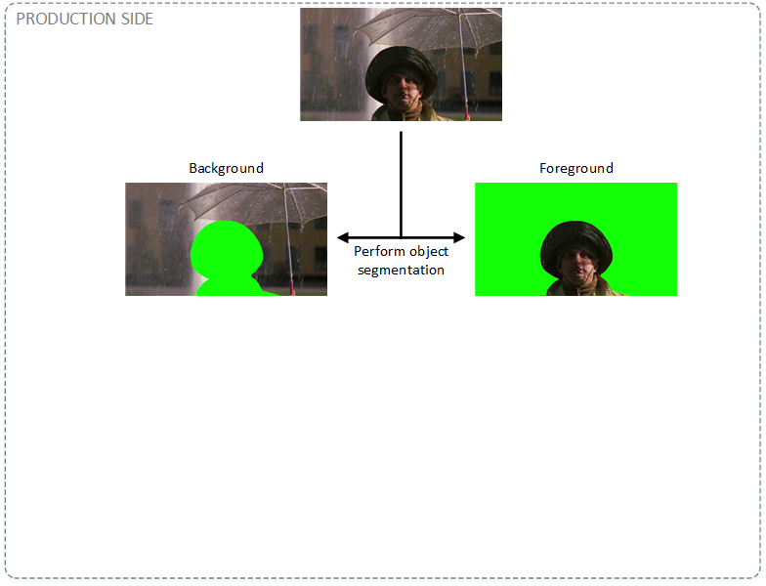
Methodology

Slide 9
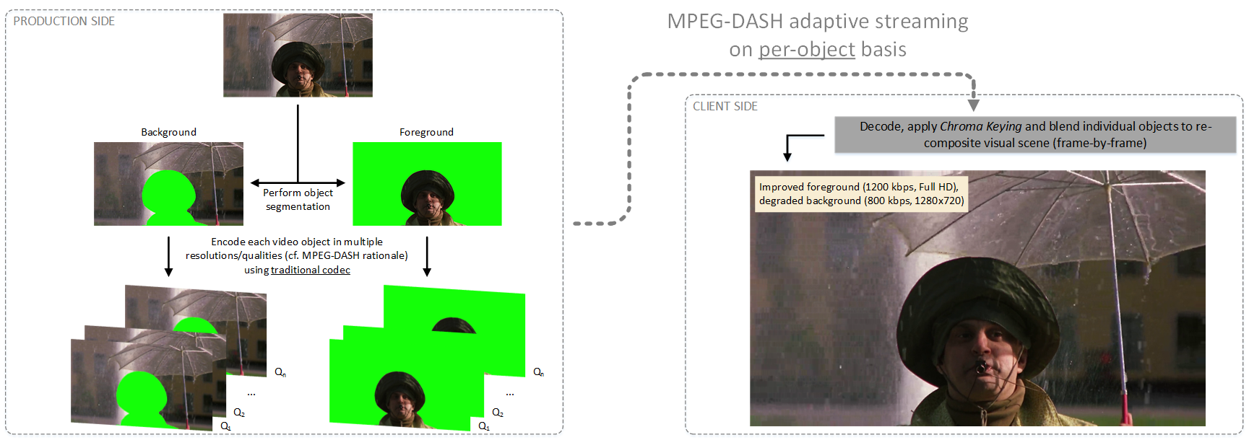
Methodology
Extra degree of freedom in terms of streaming quality control
Trade off back- for foreground object(s) in terms of allocated streaming bitrate

Slide 10
OUTLINE
Concept and Methodology
Client-side Implementation
Subjective Evaluation Setup
Subjective Evaluation Results
Conclusions

Slide 11
Client-side Rendering & Playback
Media Source Extensions

Slide 12
Impact of Color Contamination
Client-side chroma keying module operates on video data that has undergone lossy compression
Lossy coding causes imperfect preservation of color information
Color bleeding at object segmentation edges
Opacity data is no longer binary
Some of the chroma value denoting transparency might spill into composition
Contour around object in recomposited scene

Slide 13
Alpha Mask Optimization
Alpha mask as a complementary means to convey pixel opacity metadata
Alpha mask baked into video object representation
Video object boundary shifted outwards
Tightly fitting alpha mask

Slide 14
OUTLINE
Concept and Methodology
Client-side Implementation
Subjective Evaluation Setup
Subjective Evaluation Results
Conclusions

Slide 15
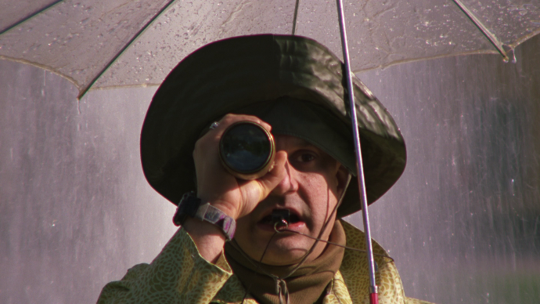
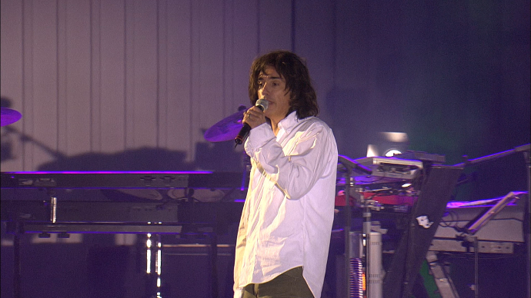
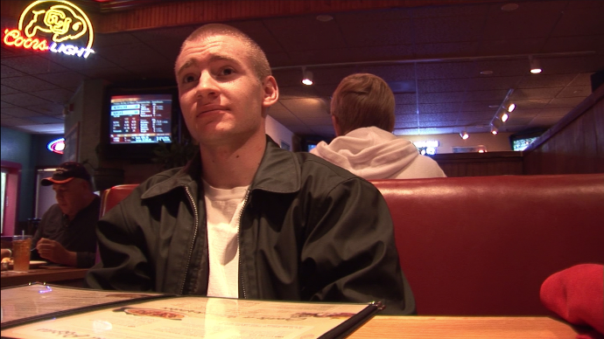
Content Corpus
3 publicly available video fragments
Full HD spatial resolution
Duration between 8 and 10 seconds
Free of shot transitions
Available in raw YUV422 format
If present, audio track was dropped
Content-wise quite similar
Captain
Concert
Poolhall

Slide 16
Content Preparation
3 discrete bitrate levels per video fragment
Low, medium, high
Each bitrate transition results in clearly discernible quality difference
Content samples were segmented into foreground object (i.e., actor) and background
Bitrate distribution over back- and foreground

Slide 17
Content Preparation
Impact of practical quality adaptation considerations
No temporal resolution scaling was applied
Factor in spatial resolution manipulation despite object alignment issues it might introduce
Foreground in Full HD, background in 1280x720 (except for concert background)
Intrinsically mask perceptual errors by streaming background integrally, without foreground cut-out
Content samples in their different quality settings were rendered to file (per streaming method)
Content preparation amounted to 27 pre-rendered videos

Slide 18
Content Preparation
6 videos (3 unprocessed and 3 foregrounds)
VBR encoded using H.264 Main profile
According to pre-defined target bitrates
Temporally divided into 2 sec MPEG-DASH segments
Object-based material was streamed via proposed methodology and processed using both CK and AM
Resulting output was losslessly screengrabbed and then encoded using H.264 High profile
Non-object-based footage underwent same processing
Final outcome = 27 video clips

Slide 19
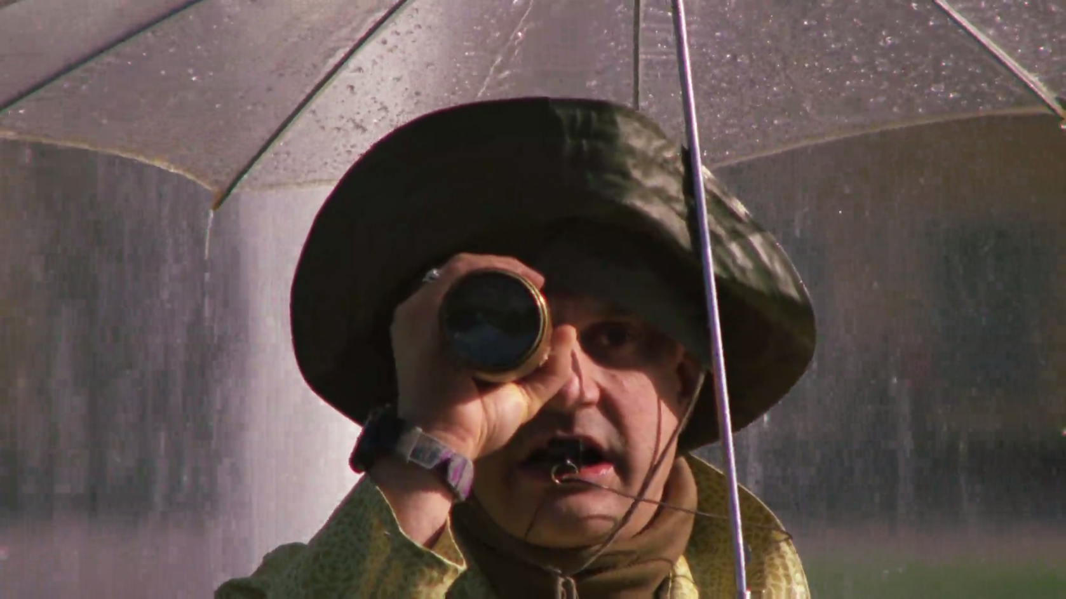
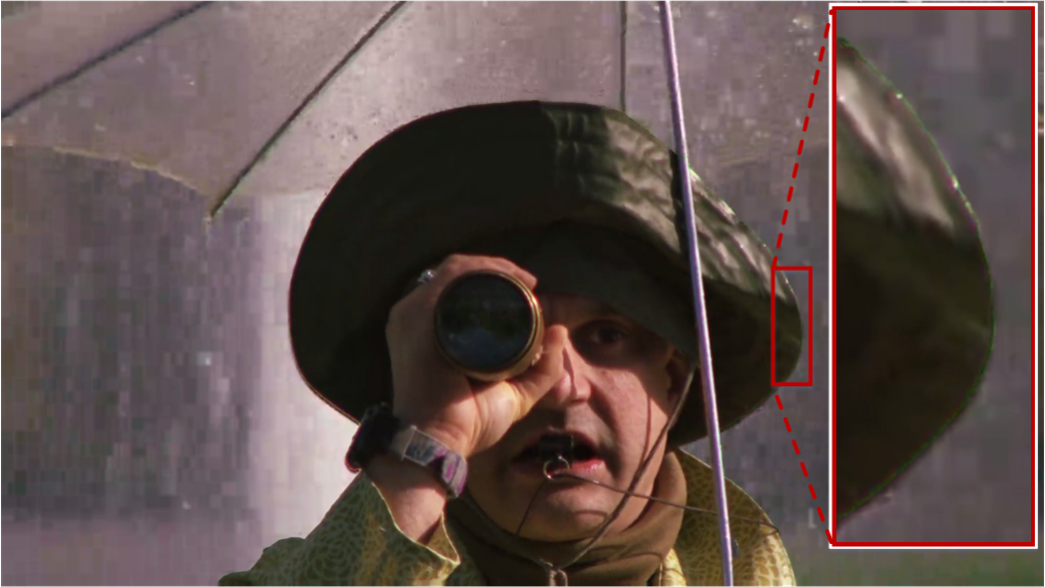
Content Preparation
Traditional
Chroma Keying (CK)
Alpha Mask (AM)

Slide 20
Content Preparation

Slide 21
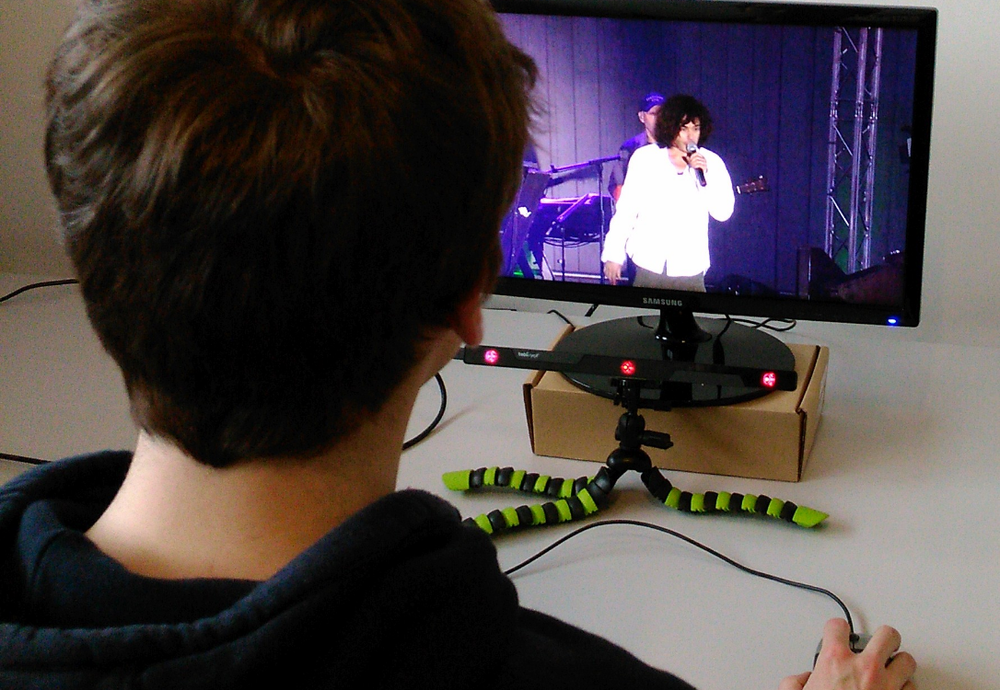
Subjective Assessment Methodology
User study applying ITU-T P.910 Pair Comparison
Mutually compare 2 video stimuli presented as a pair
Full-factorial within-subjects experimental design
Apparatus
Dedicated room
Desktop PC with 22’’ Full HD monitor
27 prepared video stimuli hosted locally
Optical gaze tracker
PC test executed in Google Chrome

Slide 22
Subjective Assessment Methodology
Pre-test phase
Survey about demographics
Hand-written instructions about test procedure
Training session with 5 representative test conditions
Actual test
Assess 57 pairs in total
54 meaningful pairs (pairing videos with same bitrate and content, yet different streaming technique, in both possible orders)
3 control conditions (pairing two identical videos)
Sequential presentation of paired stimuli, 2 second intermission
“I prefer the second video over the first” (5-point Likert scale)
Pair presentation order was counterbalanced across users
Observation via live IP camera feed
Structured post-experiment interview
Explain and discuss the 3 tested streaming techniques

Slide 23
Participants
18 users (4 female)
Most test users had a technical background
One test user was a graphical designer
All participants were screened
(Corrected-to-)normal visual acuity
Absence of color vision deficiencies

Slide 24
OUTLINE
Concept and Methodology
Client-side Implementation
Subjective Evaluation Setup
Subjective Evaluation Results
Conclusions

Slide 25
Statistical Analysis
3 independent variables
Content (i.e., video fragment)
Bitrate
Presentation order
1 dependent variable
Preference with regard to 3 compared streaming techniques (TR vs CK vs AM)
Repeated measures ANOVA method or Kruskal-Wallis non-parametric test
Depending on whether Bartlett’s test revealed a violation of the homogeneity of variances
Pairwise t-Test with Bonferroni corrections as post hoc method

Slide 26
Statistical Results
AM versus TR
No significant main effect of independent variables on users’ preference for either of the involved streaming techniques (ANOVA)
CK versus TR
Significant main effect of the bitrate factor on streaming technique preference (ANOVA)
Post hoc analysis: no significant differences among 3 bitrates
AM versus CK
Significant main effect of the content factor on streaming technique preference (ANOVA)
Post hoc analysis: statistically significant differences between
Captain and poolhall
Concert and poolhall

Slide 27
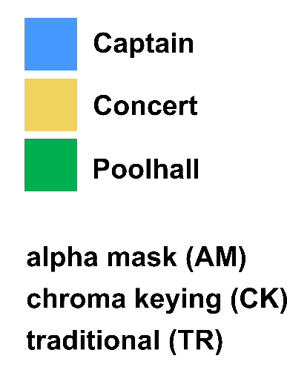
Statistical Results

Slide 28
Statistical Results

Slide 29
Reliability of Subjective Results
2 data reliability measures included in experimental design
3 hidden control conditions
Only 1 strong preference for one of the compared videos
Average preference value of 0.48±0.53
Permuted streaming technique presentation order
Little intra-subject variation
Only 161 out of total 486 cases yielded inconsistent ratings
Average rating difference was -0.16±1.19

Slide 30
Post-experiment Interview Feedback
Participants interpreted their role in the experiment to be that of a video quality assessor
Although we asked them to express their preference
Active search for visual artefacts
If present, favor video stimulus with fewer artefacts
Recognized types of visual artefacts
General video blockiness
Object contours
Overly noticeable differences between back- and foreground quality
→ Hurt appreciation of tested object-based video sequences
→ “Results would be different if simply watching videos at home in relaxed atmosphere”

Slide 31
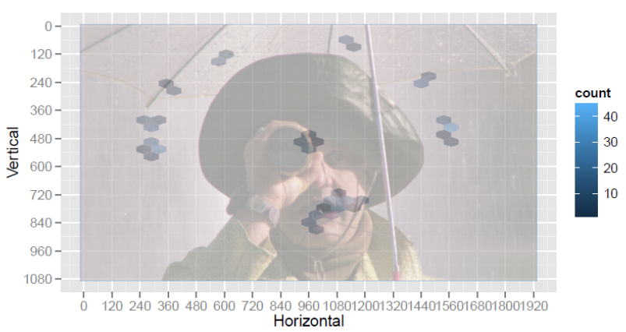
Objective Gaze Analysis
Participants’ active scanning behavior is objectively confirmed by gaze tracking data
E.g., object contour artefact scanning

Slide 32
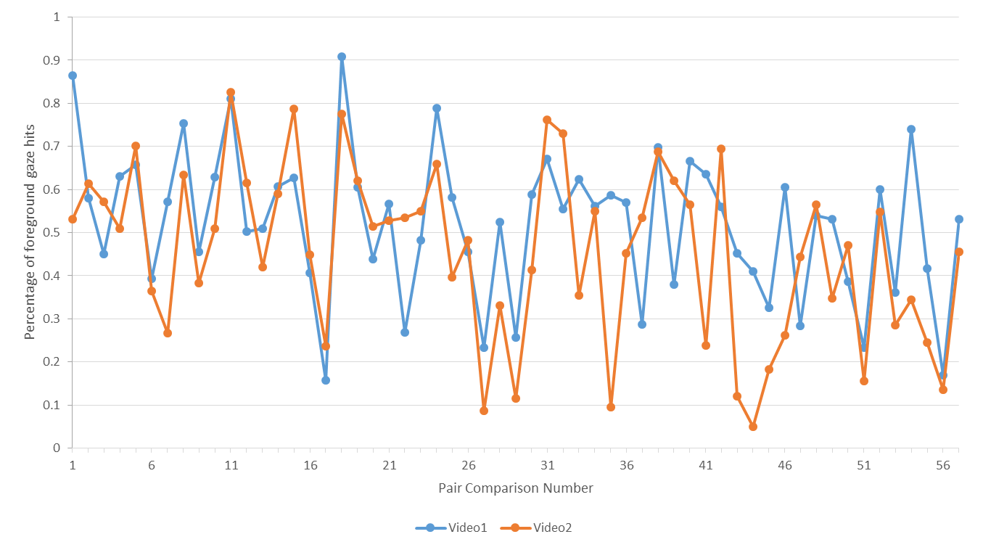
Objective Gaze Analysis
Focus shift from fore- to background as experiment progressed

Slide 33
Discussion
Exhibited gaze behavior defies the premise of the proposed object-based streaming method
Exclusion of audio from content samples might also have hurt the popularity of object-based approach
All participants were receptive to object-based approach
Could independently devise at least 1 use case in which the proposed methodology could prosper
E.g., a fashion show

Slide 34
OUTLINE
Concept and Methodology
Client-side Implementation
Subjective Evaluation Setup
Subjective Evaluation Results
Conclusions

Slide 35
Conclusions
Object-based streaming methodology that unlocks additional degrees of freedom in video streaming
Pragmatic design that maintains full compliance with
Traditional video compression (e.g., H.264)
Contemporary streaming paradigms (e.g., MPEG-DASH)
Prevailing Web standards
Comparative subjective evaluation with 18 test users
No statistically significant differences with traditional streaming
We tested the “worst-case” scenario
Structurally elicited qualitative feedback hints at scenarios where our approach holds capacity to improve on traditional streaming in terms of user-perceived video quality

Slide 36
THANK YOU FOR YOUR TIME AND ATTENTION
Questions?

