Slide 1
An Eco-friendly Hybrid Urban Computing Network Combining Community-based Wireless LAN Access and Wireless Sensor Networking
Maarten Wijnants - Wim Lamotte
Hasselt University – EDM – iMinds | firstname.lastname@uhasselt.be
Nicolas Letor – Chris Blondia
University of Antwerp – iMinds – PATS | firstname.lastname@ua.ac.be
Eli De Poorter - Dries Naudts - Stijn Verstichel - Bart Lannoo - Ingrid Moerman
Department of Information Technology – iMinds – Ghent University | firstname.lastname@intec.ugent.be
Nelson Matthys - Christophe Huygens
iMinds–DistriNet - Department of Computer Science – KU Leuven | firstname.lastname@cs.kuleuven.be

Slide 2
An Eco-friendly
Hybrid
Urban Computing
Network Combining
Community-based WLAN Access
and Wireless Sensor Networking
Integration of technology and computational power in public environments
Involves aspects from
Pervasive computing
Embedded computing
Internet of Things (IoT)
Hybrid network consisting of 2 tiers
Separate yet interfaced with each other
Wi-Fi crowdsourcing
City residents are encouraged to share their wireless Internet connection
Guarantees city-scale access to digital information and Internet-based services
Helps satisfy people’s continuously burgeoning desires and requirements with regard to ubiquitous information access and digital service consumption
Number of sensors deployed in the city
Enables dynamic aggregation of relevant environmental measurements and real-time status tracking of physical objects
Scaffolds development of value-added end-user applications that are consumable through the community-powered access network
Societal attention for environmentalism and ecological sustainability is nearly becoming common practice
Minimize ecological impact of products and services
Network includes measures to reduce environmental footprint of WSN subsystem
Energy conservation

Slide 3
Outline
Architectural Design
Composing Technologies and Features
WSN Architecture
Sensor Design and Hardware
Community-based Wi-Fi Access
Green Intelligence for Eco-friendly WSNs
Application Framework
Proof-of-Concept Deployment
Example Urban Services
Conclusions

Slide 4
Architectural Design
Integrated urban computing environment
Multiple WSNs
Community Wi-Fi network
Back-end server LAN
Intelligent “green” middleware

Slide 5
Architectural Design
Wireless Sensor Network
Capture information about physical space
Transmit measurements to back-office

Slide 6
Architectural Design
City-wide community-sustained Wi-Fi network
Acts as uplink for WSNs
Provides Internet access for end-users
Cluster of wireless Access Points owned by volunteer citizens or governmental agencies

Slide 7
Architectural Design
Back-end server LAN
Persistent storage of WSN observations
Centralized access to WSN data for authorized external parties
Via relational DB
Community manager and controllers for WLAN mobility solution

Slide 8
Architectural Design
“Green” intelligence
Distributed sensor reasoning framework
Green WSN middleware
Distributed approach
Limited intelligence on WSN nodes
Local optimum
Back-office coordinator
Global optimum across all WSNs

Slide 9
Outline
Architectural Design
Composing Technologies and Features
WSN Architecture
Sensor Design and Hardware
Community-based Wi-Fi Access
Green Intelligence for Eco-friendly WSNs
Application Framework
Proof-of-Concept Deployment
Example Urban Services
Conclusions

Slide 10
WSN Architecture
Involves heterogeneous types of devices
Sensor nodes sense physical environment
Lack routing functionality to reduce complexity
Sensor routers provide multi-hop capabilities
IPv6 Routing Protocol for Low-Power and Lossy Networks (RPL)
Sensor gateway serves as sensor node uplink
Internet access via community-based Wi-Fi network
Communication-wise exclusive use of standardized IEEE and IETF network protocols
E.g., IEEE 802.15.4 and 6LoWPAN
Sensor data transported to back-end via IETF CoAP (specialized RESTful web transfer protocol)

Slide 11
Sensor Design and Hardware
Radio operates in 169 MHz frequency band
Recently reallocated by European Commission
Far less hindrance of obstacles & weather effects
Lower dynamic link failures and boosted tx range
Backward compatibility with legacy sensor nodes via secondary 868 MHz RF transceiver

Slide 12
Community-based Wi-Fi Access
Individual city-wide Wi-Fi community APs (CAPs)
Wi-Fi sharing cfr Fon
Geographically clustered into Virtual Access Areas
All VAAs share one SSID
Virtual Private Ad Hoc Network (VPAN) overlay
Securely connects CAPs with back-end servers
Management and coordination in back-office

Slide 13
Community-based Wi-Fi Access
End-user connects to CAP with Wi-Fi terminal
No specialized software
Mobility solutions allow free roaming while consuming information
Seamless intra-VAA session handover among constituting CAPs
Transparent inter-VAA handover
Slight service interruption

Slide 14
Green Intelligence for Eco-friendly WSNs
Distributed sensor reasoning framework
Configures sensor nodes for ecological operation
Primarily in terms of energy expenditure
Implemented at two separate levels
Limited reasoning on individual sensor nodes to determine local energy consumption optimum through direct manipulation of proprietary low-level attributes
Holistic reasoning on back-end coordinator to enforce a global optimum for each WSN as a whole
Example configurable parameters include polling frequency, sleeping strategies, tx power, etcetera
Sensor model designed as extension of the W3C Semantic Sensor Network Ontology

Slide 15
Green Intelligence for Eco-friendly WSNs
Component and Policy Infrastructure (CaPI)
Combination of component-based runtime and policy-driven management framework
Components are coarse-grained, service-like functional units
Policies are fine-grained scripts that encapsulate specific rules to govern runtime behavior of the sensor
Allows for cost-effective reconfiguration and reorientation of WSN software over time
Dynamic deployment of CaPI components and policies is controlled by the back-end
Results in significant flexibility, removes need for expensive replacements of sensor software image and yields meaningful energy and operational savings

Slide 16
Application Framework
Facilitates development of urban services
Separation of concerns design
Clean division between sensor networks and services
Relational database is enacted as go-between
CoAP-based RESTful interface for sensor data storage
HTTP-based RESTful interface for database querying
Numerous advantages: simplified security, obsoletes IPv4/v6 protocol translation, declarative programming, …
Besides bare sensor measurements, DB maintains
Hardware, software and network characteristics of WSNs
Fed to green sensor intelligence via D2R engine
Service-dependent information (scaffolds execution)

Slide 17
Outline
Architectural Design
Composing Technologies and Features
WSN Architecture
Sensor Design and Hardware
Community-based Wi-Fi Access
Green Intelligence for Eco-friendly WSNs
Application Framework
Proof-of-Concept Deployment
Example Urban Services
Conclusions

Slide 18
Proof-of-Concept Deployment
Comprehensive Proof-of-Concept roll out in Ghent
Belgian city with population of ~250.000 people
Involved sensor hardware : ~50 sensor nodes
Involved Wi-Fi hardware
At least 10 CAPs, divided in 2 or 3 VAAs
~2 square kilometers Wi-Fi coverage
Back-office: VAA Controllers (1 per VAA) and 1 VPAN Agent, Dimensioning Controller, Community Gateway
Objectives:
Confirm technological validity of proposed architecture
Evaluate qualitative features of dual design and services

Slide 19
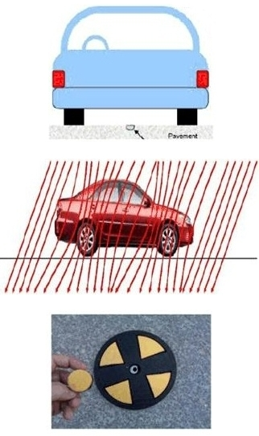
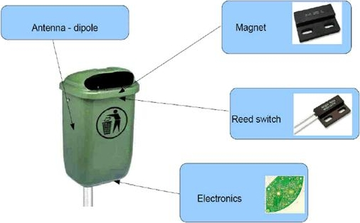
Proof-of-Concept Deployment
Emphasis on monitoring 2 distinct physical properties
Depending on involved property, different sensors mounted on sensor board
Car parking spaces
Measure distortion of earth’s magnetic field in 3 spatial axes
Deployed within “speeddisk”
Garbage bin lid opening
Magnet-activated reed switch

Slide 20
Outline
Architectural Design
Composing Technologies and Features
WSN Architecture
Sensor Design and Hardware
Community-based Wi-Fi Access
Green Intelligence for Eco-friendly WSNs
Application Framework
Proof-of-Concept Deployment
Example Urban Services
Conclusions

Slide 21
Personal Parking Assistant (PPA)
Outdoor parking control service for hand-helds
Dynamically visualizes vacancy information pertaining to parking locations near a certain destination
Promising tool to alleviate the burden of searching for an available parking spot
Direct revenue for end-users
Witness an improvement of their urban life
Indirect benefit for the municipality stakeholder
Positive impact on people’s perception of commuting
Gains insight in parking patterns within their territory
Could be exerted in future urban planning initiatives

Slide 22
Garbage Bin Tampering Monitor (GBTM)
Public garbage bins for small-size litter disposal via a hole in their lid
Cover needs to be removed to empty the dustbin
Operation strictly reserved for municipal employees
Garbage bin sensor records lid opening/closing
Sensor observations and timestamps stored in DB
Web-based interface allows measurement retrieval
Objectives and advantages
Facilitate detection of illegal activities (e.g., vandalism)
Optimize garbage collection routes and timetables

Slide 23
Outline
Architectural Design
Composing Technologies and Features
WSN Architecture
Sensor Design and Hardware
Community-based Wi-Fi Access
Green Intelligence for Eco-friendly WSNs
Application Framework
Proof-of-Concept Deployment
Example Urban Services
Conclusions

Slide 24
Conclusions
Proposed dual urban computing infrastructure integrates wireless sensing with community Wi-Fi
The WSN architecture realizes physical sensing
City-scale crowdsourcing of Wi-Fi access points guarantees pervasive Internet access
Accommodates ubiquitous client-side digital service delivery
Multi-faceted nature yields an end-to-end solution
Operational chain spans from data registration at IoT node level all the way up to end-user service consumption via Wi-Fi
Ecologically inspired measures (energy minimization)
Example urban services offer taste of myriad of enabled innovative and value-added services

Slide 25
Thank You for Your Attention
Questions?

