Slide 1




An Optimized Adaptive Streaming Framework for Interactive Immersive Video Experiences
Maarten Wijnants
Peter Quax
Gustavo Rovelo Ruiz
Wim Lamotte
Johan Claes
Jean-François Macq

Slide 2





Multitude of video streaming services …

Slide 3
Current Streaming Practices and Beyond
Traditional video content
  Up to Full HD resolution
Video sequences are treated as monolithic entity
Novel video formats
  Ultra-high-definition (UHDTV) including 4K and up
  Panoramic video
  Omni-Directional Video (ODV) or so-called 360° video
Immersive and interactive consumption contexts

Slide 4
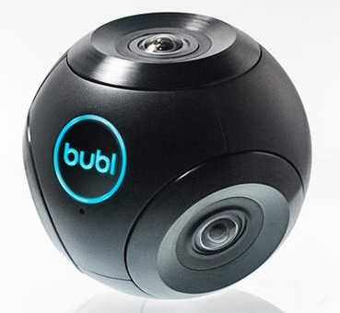
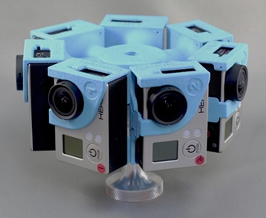
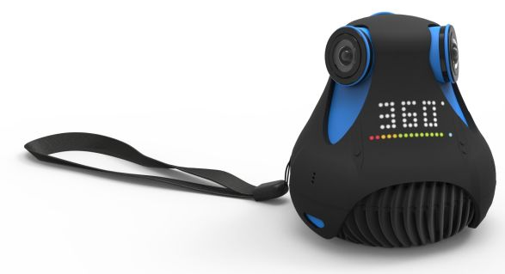
Omni-Directional Video (ODV)
Video footage with a 360 degree (i.e., cylindrical or spherical) Field of View

Slide 5
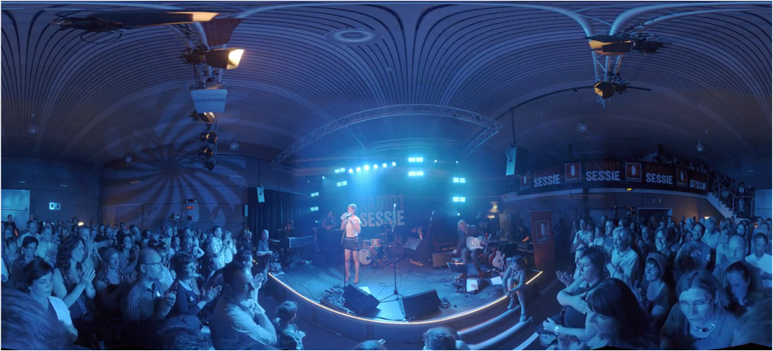

Slide 6
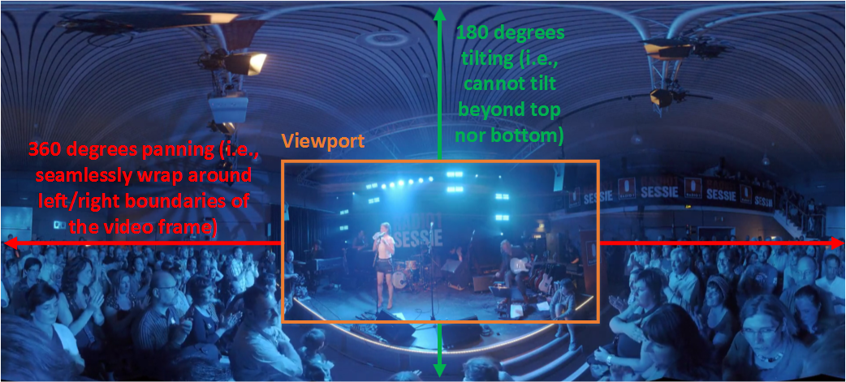
ODV Viewport Manipulation via Pan-Tilt-Zoom (PTZ)

Slide 7
Current Streaming Practices and Beyond
Traditional video content
  Up to Full HD resolution
Video sequences are treated as monolithic entity
Novel video formats
  Ultra-high-definition (UHDTV) including 4K and up
  Panoramic video
  Omni-Directional Video (ODV) or so-called 360° video
Immersive and interactive consumption contexts

Slide 8
Immersive and Interactive Video
Hand control of entire flow of the video experience over to the end-user
  Virtually “paste together” short video sequences
  User influences the order in which video chunks are presented
  Gives rise to Non-Linear Video (NLV) scenarios
Video counterpart to Google Street View
  Video chunks as replacement for still imagery

Slide 9
Immersive Video Streaming Challenges
Video footage with high spatial resolution
Only part of video coverage is displayed (e.g., ODV viewport)
Dynamic, user-controlled sequencing of video fragments
Need for an advanced streaming framework
Based on MPEG-DASH, a standardized HTTP Adaptive Streaming (HAS) solution

Slide 10
OUTLINE
Immersive Experience Graph
Media Pre-Fetching
Framework Implementation
Experimental Evaluation
Conclusions

Slide 11
Immersive Experience Graph
Captures temporal relationships between constituting media chunks
  Chunks are concatenated to form experiences
  Chunks consist of one or more MPEG-DASH segments
Directed graph
  Edges represent (collections of related) chunks
  Nodes encode decision points in experience playback
Presentation of relevant interaction options to the user during the experience

Slide 12
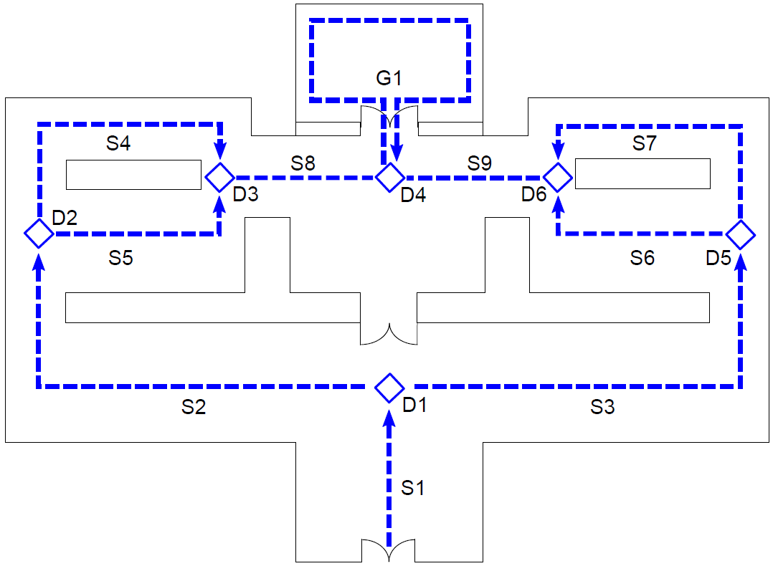
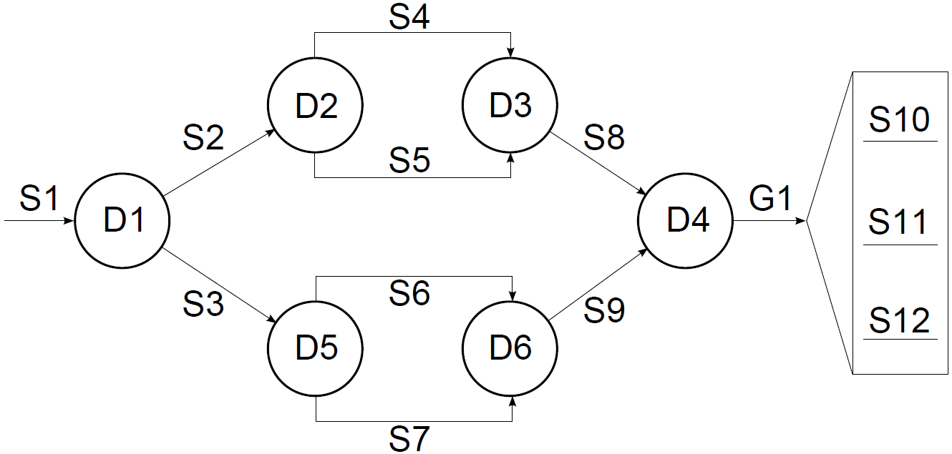
Temporary exhibition hall
Museum
walkthrough map (simplified version)
Each S corresponds with a video capture of a distinct temporary exhibition
Corresponding Immersive Experience Graph

Slide 13
OUTLINE
Immersive Experience Graph
Media Pre-Fetching
Framework Implementation
Experimental Evaluation
Conclusions

Slide 14
Media Pre-Fetching
Chunk transitions are subject to startup delay
  Client-side content buffering to afford viewers a seamless experience (wrt playback smoothness)
Steered by immersive experience graph
  Pre-fetch (initial segments of) future chunks associated with outgoing edges of choice node
  Variations in start time of the pre-caching process are supported
    E.g., pre-fetch at beginning of playback of primary stream
    E.g., postpone pre-fetching until threshold in primary stream’s playback timing has been reached
Strategy design pattern ensures customizability

Slide 15
OUTLINE
Immersive Experience Graph
Media Pre-Fetching
Advanced Streaming Use Cases
Framework Implementation
Experimental Evaluation
Conclusions

Slide 16
Tiled Streaming Support
Scalable solution for streaming high-res content
Immersive Experience Graph can describe spatial relationship of tiles (via “group” edges)

Slide 17
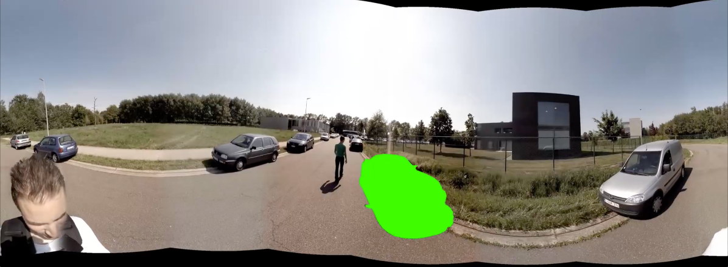

Multi-Depth-Layer Streaming
Extract (pseudo-)depth information from immersive imagery
  Foreground, background, intermediate layers
Improve streaming performance by allocating priorities
to depth layers
Supported via chunk grouping feature

Slide 18
OUTLINE
Immersive Experience Graph
Media Pre-Fetching
Advanced Streaming Use Cases
Framework Implementation
Experimental Evaluation
Conclusions

Slide 19
Implementation
Software architecture is conceptually divided into set of back- and front-end components
Back-end encapsulate majority of functional logic
  Scene handling, MPEG-DASH streaming, media quality adaptation, bandwidth management, pre-caching, …
  Implemented in JavaScript
Front-end acts as media player
  Media decoding, media rendering and user interfacing
  Qt application for desktops, HTML5-based Web application, app for mobile platforms, …
Platform independent and highly portable solution

Slide 20
General Workflow
BandwidthEstimation module gauges downstream bandwidth capacity
Estimated bandwidth is communicated to installed BandwidthDistributionLogic module
  Divides bandwidth among currently registered network streams according to concrete strategy it implements
QualityAdaptationLogic module converts bandwidth allocation to MPEG-DASH quality on per stream basis
Scheduler module HTTP fetches Media Segment(s) in the calculated quality

Slide 21
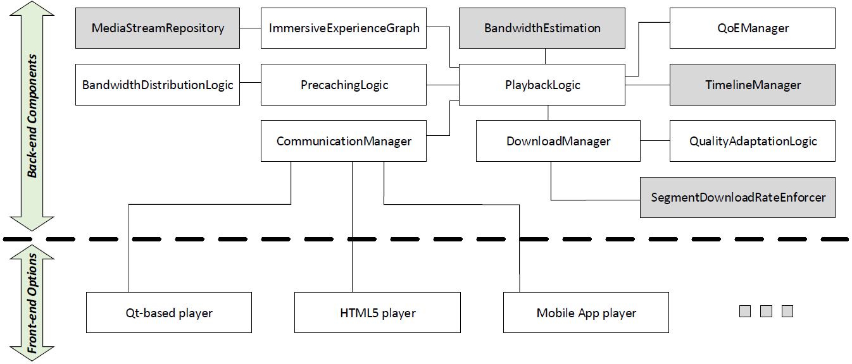
Software Architecture
Reusable back-end implementation
  Quick development of heterogeneous user-facing front-ends
Highly modular design
Attention for extensibility and configurability

Slide 22
OUTLINE
Immersive Experience Graph
Media Pre-Fetching
Advanced Streaming Use Cases
Framework Implementation
Experimental Evaluation
Conclusions

Slide 23
Experimental Setup
Chunks of about 50sec
  Encoded in 7 distinct qualities (Rep1 to Rep7)
  2sec MPEG-DASH Media Segments
  10sec minBufferTime
1 primary and 2 pre-fetching streams
65 / 35 percent BW for primary / pre-fetch traffic
  Upgrade to 100 percent if other stream category is void
  Linear BW breakdown within categories
Primary streams exploit FillSteady schedule
  AlwaysLowest / BestFit QAL in fill / steady state
Pre-fetch streams exploit Fill schedule
  AlwaysLowest QAL

Slide 24
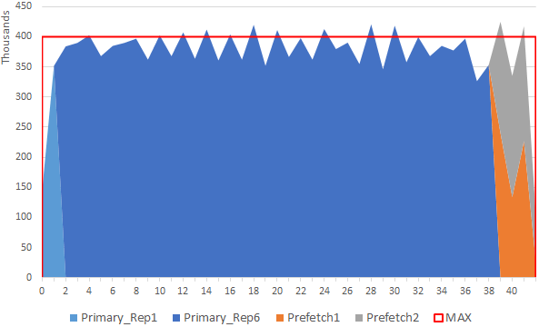
Pre-Fetch at End of Primary (Const BW)
Pre-fetching completes well in time before the playback of the currently active stream finished

Slide 25
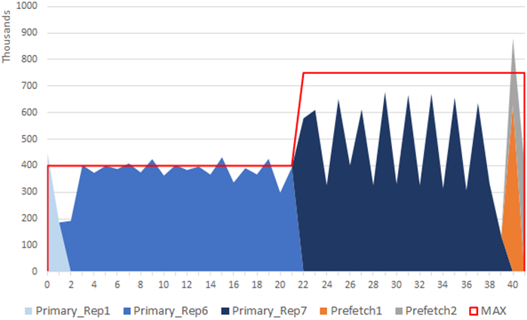
Pre-Fetch at End of Primary (Var BW)
Upgrade to higher quality for the active stream + shorter pre-fetching operation

Slide 26
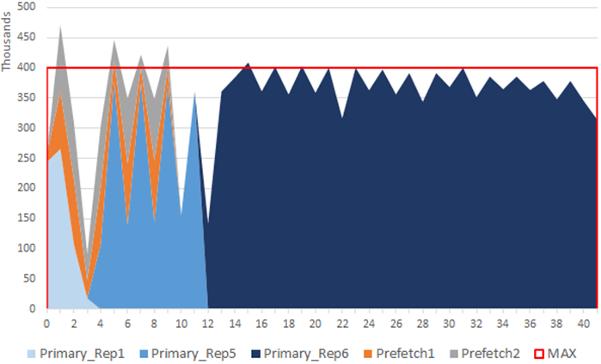
Pre-Fetch at Start of Primary (Const BW)
Bandwidth contention causes active stream to temporarily be fetched in lower quality during steady state

Slide 27
OUTLINE
Immersive Experience Graph
Media Pre-Fetching
Advanced Streaming Use Cases
Framework Implementation
Experimental Evaluation
Conclusions

Slide 28
Conclusions
Immersive video poses streaming challenges
  E.g., caused by high spatial resolution
MPEG-DASH-based streaming framework
  Optimized HTTP Adaptive Streaming of immersive video
Platform independent solution that is extensible with respect to usage scenarios
  Readily integrate advanced streaming optimizations
Experimental results validate the bandwidth consumption behavior of our framework

Slide 29
THANK YOU FOR YOUR TIME AND ATTENTION
Questions?

