Slide 1
Overlay Network Based Optimization of Data Flows in Large Scale Client-Server-based Game Architectures for Deployment on Cloud Platforms
Peter Quax, Robin Marx, Wouter Vanmontfort, Maarten Wijnants, Wim Lamotte

Slide 2
Rationale
Networked Virtual Environments
MMOGs, Collaboration, Simulation
Problem of scalability
Initial cost of infrastructure
Popularity
Bandwidth
Clients, Servers

Slide 3
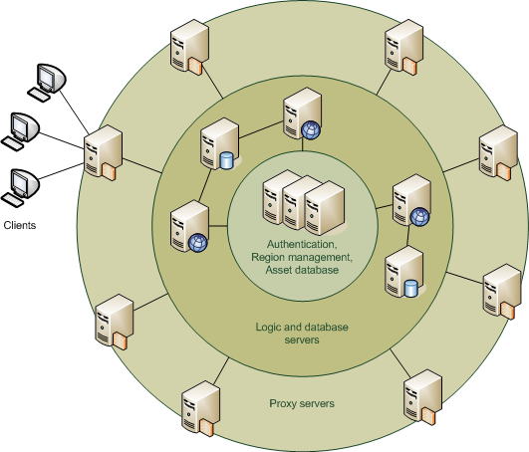
ALVIC-NG
Scalable back-end infrastructure for NVE
Generic 3 tier architecture
Proxy servers
Logic servers
Region management
system

Slide 4
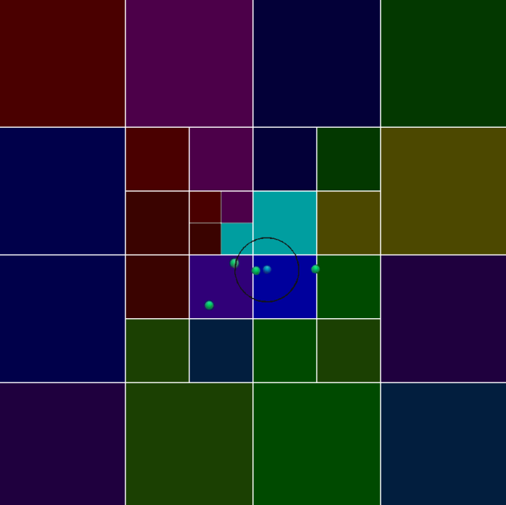
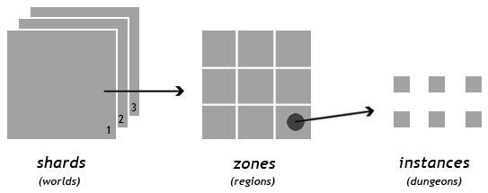
ALVIC-NG
Cloud platform
Shards, zones, instances
Dynamic spatial subdivision
Zoning

Slide 5
Zoning
World subdivided into separate areas
Each zone assigned to a logic server
Multiple zones per logic server
Dynamic: split / merge
Coarse bandwidth scalability
Data from current (and neighboring) zones
More fine grained control: AoI

Slide 6
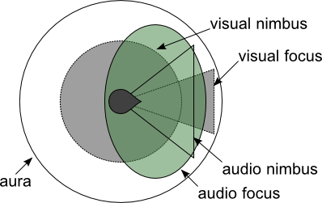
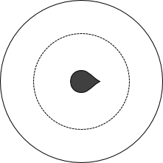
Area of Interest
Aura/nimbus/focus
Extensions
Shapes
Stream/entity type
advanced
simple

Slide 7
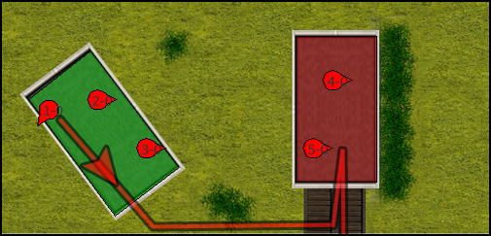
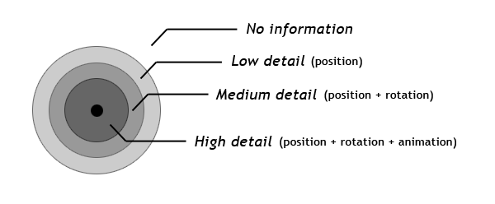
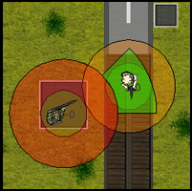
AoI-API
AoI-API
Separate library
InterestDefinition
Multiple shapes
Many usage scenarios
Dynamic adjustments
LoD

Slide 8
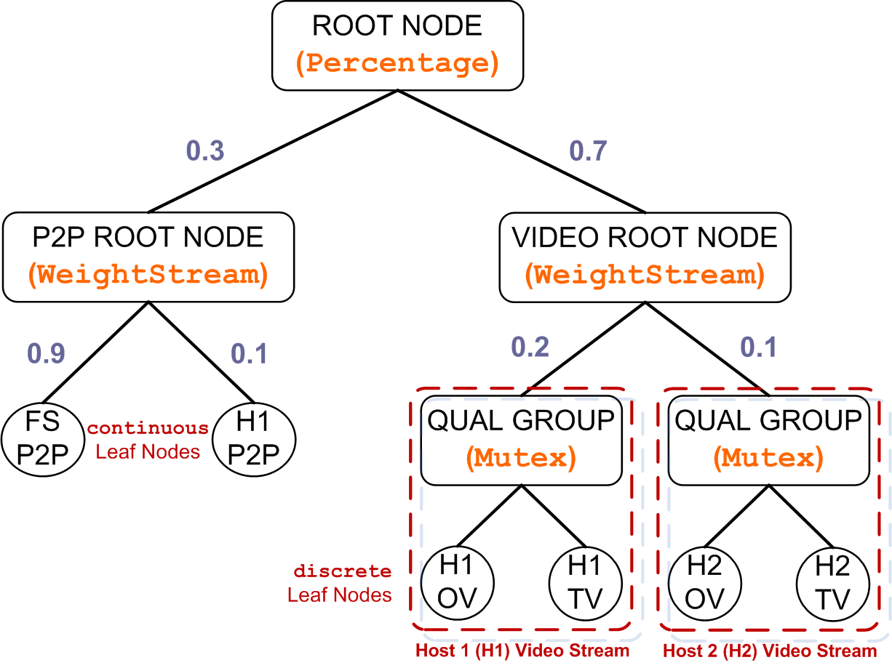
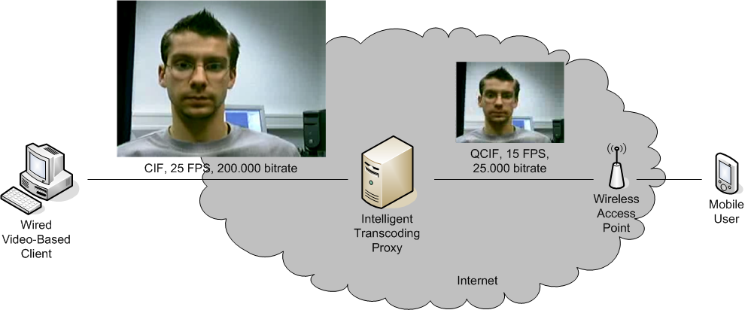
NIProxy
Network Intelligence Proxy
Provide network traffic shaping
Improve QoE
Stream hierarchy
Bandwidth shaping tree
Internal nodes implement bandwidth distribution strategy
Non-transparent

Slide 9
Combination
Integrate NIProxy into ALVIC-NG
Previously standalone
Mainly bandwidth shaping functionality
Server vs. Client side bandwidth shaping tree
Available client vs. server bandwidth
Filtering
Pass packets to AoI-API
Bandwidth shaping tree with InterestDefinitions

Slide 10
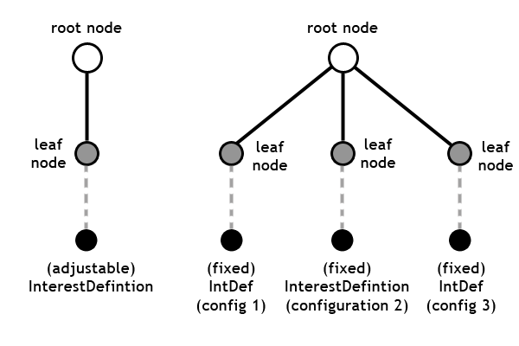
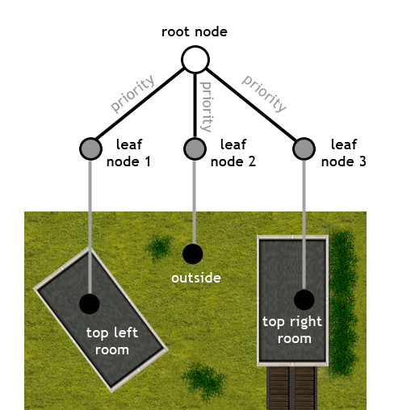
AoI Bandwidth shaping tree

Slide 11
Experiments
Multiple experiments conducted to validate viability
Small scale
Medium scale
Large scale
Sniper example
Scenario
Heuristics
Best and worst case

Slide 12
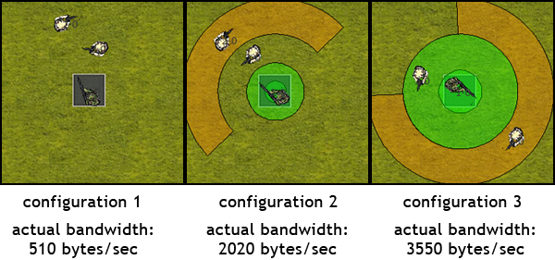
Sniper example

Slide 13
Sniper experiment
Configuration number | Heuristic bandwidth estimation
 | Best case | Worst case
0 | 0 | 0
1 | 530 | 6000
2 | 2040 | 2040
3 | 3600 | 300

Slide 14
Sniper experiment

Slide 15
Sniper experiment

Slide 16
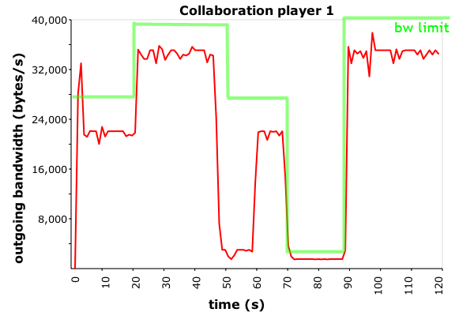
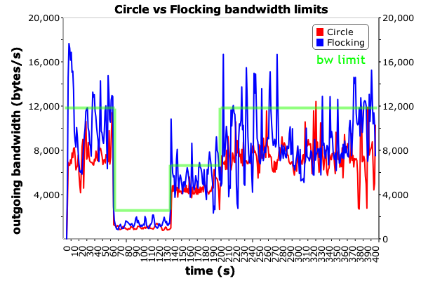
Other experiments

Slide 17
Conclusion & Future work
Combination of ALVIC-NG, NIProxy logic and AoI-API is viable approach
Reduces bandwidth consumption
Fine grained control
Better QoE
Optimize proxy servers/ALVIC-NG and algorithms
Repeat large scale experiments
Thorough study of migration to cloud platforms (in progress)
Further investigate bandwidth – consistency trade-off

Slide 18
Questions
http://www.uhasselt.be/edm
wouter.vanmontfort@uhasselt.be

