Slide 1
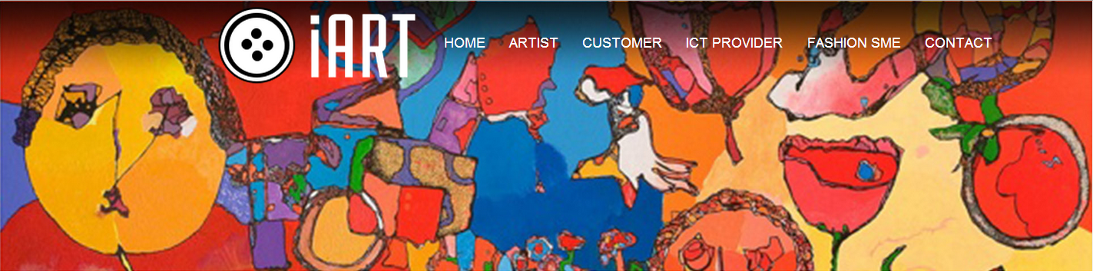


ICT-18-2014
Consumer-oriented ICT Solutions for creative SMEs providing Art in Bespoke Fashion
Art in Bespoke Fashion
  TIWC 2016 Poznań

Slide 2

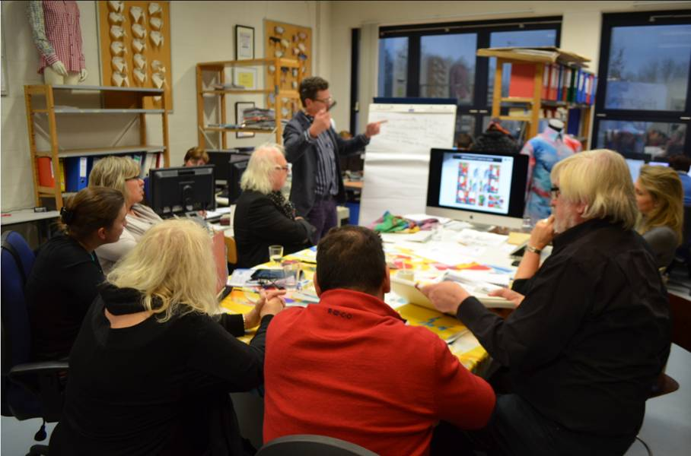
iArt Fashion Kick-Off Meeting – Bivolino.com, Diepebeek, January 15&16 2015

Slide 3
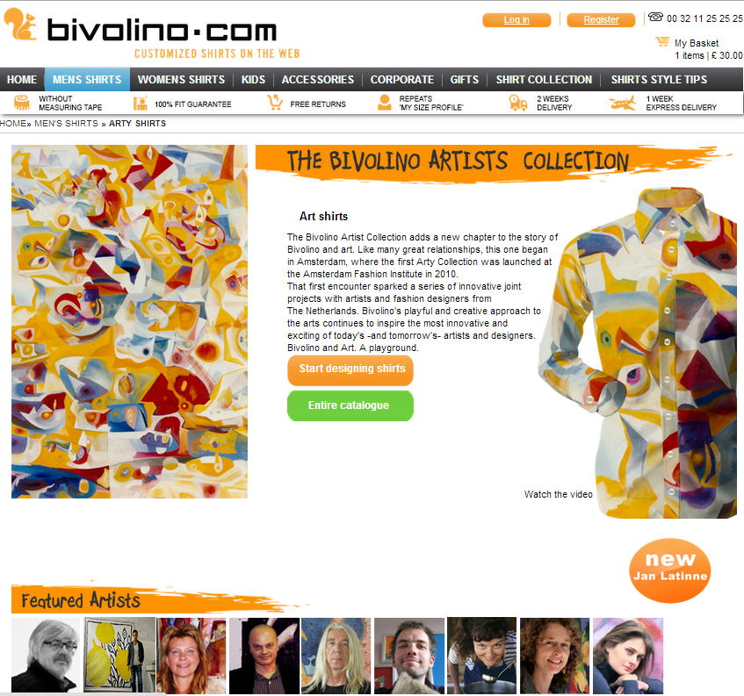
INTRODUCTION
The main objective of the iART project is to bring visual art into bespoke clothing so as to make apparel products more valuable compared to other garments in the market and to support artists to exploit their work.

Slide 4
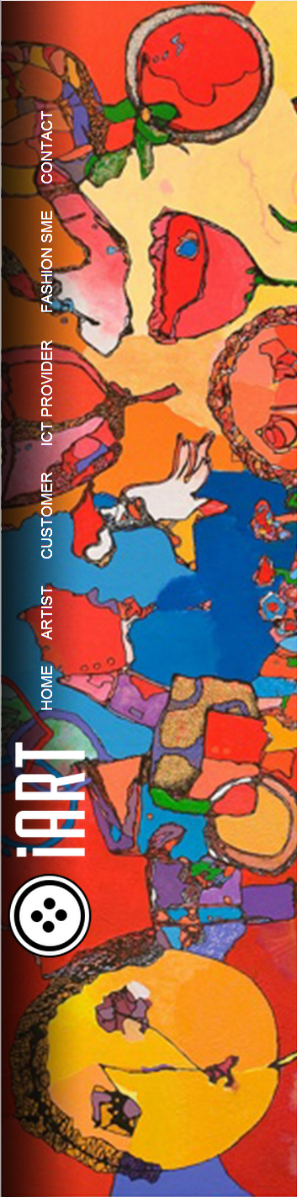

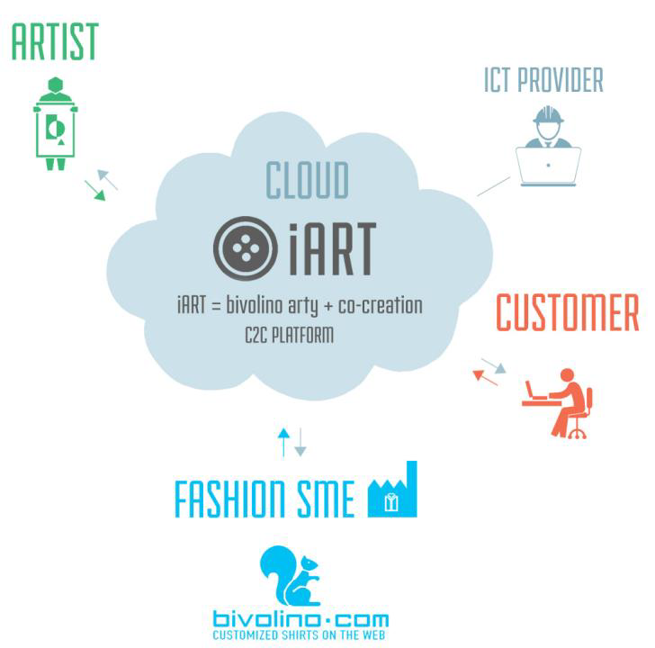
Art into bespoke fashion through B2C e-platform
iART =bivolino arty + co creation B2C PLATFORM

Slide 5

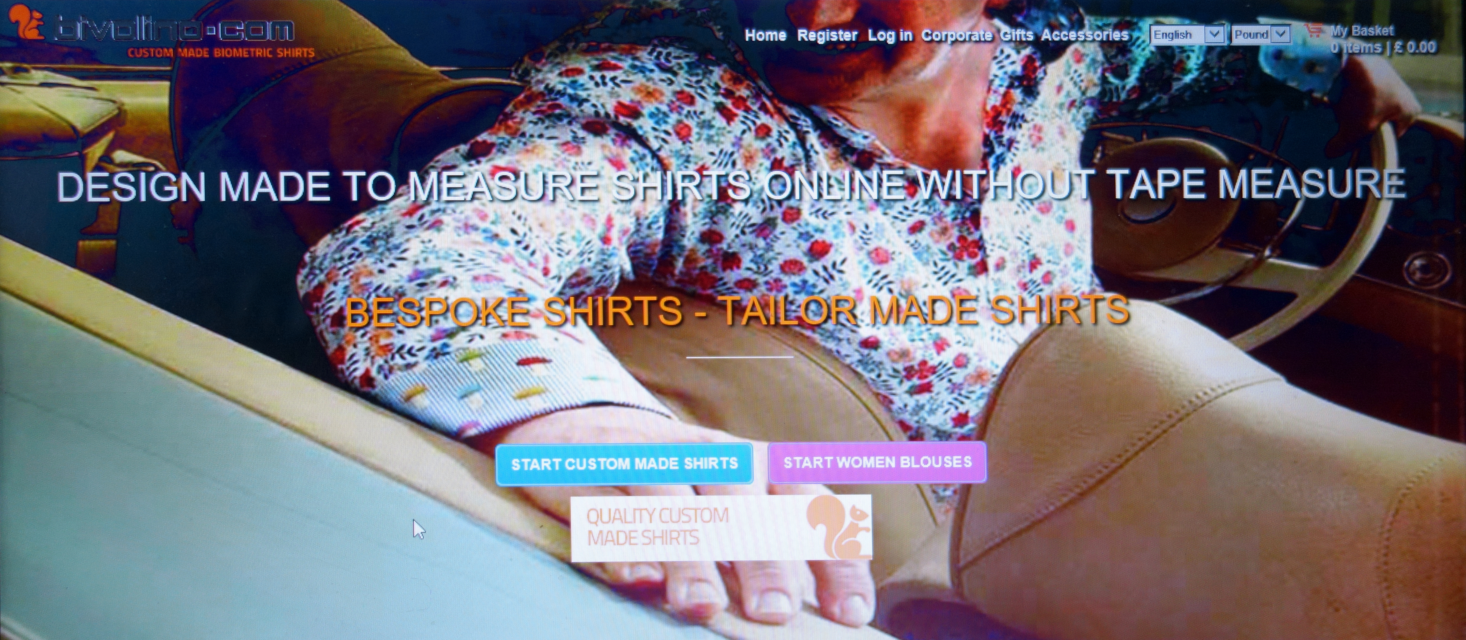
The idea of the project is based on a B2C internet shop (Bivolino.com)
with custom made shirts, and its customer oriented web page.

Slide 6
MATERIALS AND EXPERIMENTAL METHODS
Move to real-time online rendering (fabric draping), so as to speed up and increase the flexibility of the whole process from artist design over fabric creation to customized bespoke shirts and other garments (fabric rendering on 2.5D/3D clothing configurator).
Upgrade of the configuration toolkit from 2.5D to 2.5D/3D by including shadowing and rotating features without the need of plug-ins easy extension of the catalogue to clothing accessories and nightwear fitting with the shirts.
Building of a B2C platform enabling co-creation and user generated art content, and development of an Advanced Artist Interface (AAI) with artist cockpit.

Slide 7
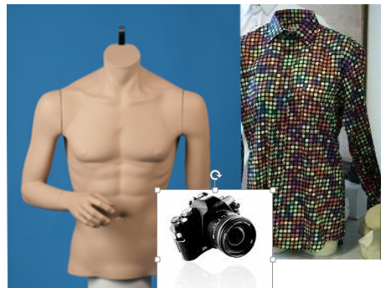
MODEL ACQUISITION
(a)
(b)
(c)
Model acquisition of a shirt. (a) Color-coded pattern. (b) Photo shoot of the shirt printed with color-coded pattern. (c) Digital image of the shirt with all colorized dots identified.

Slide 8
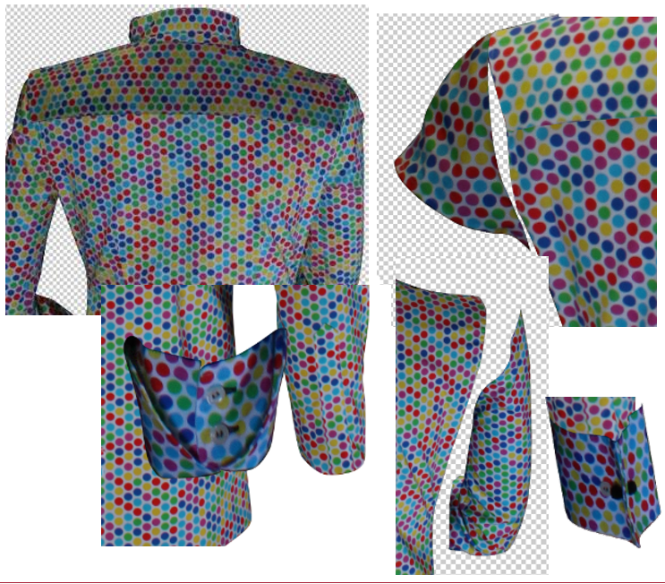
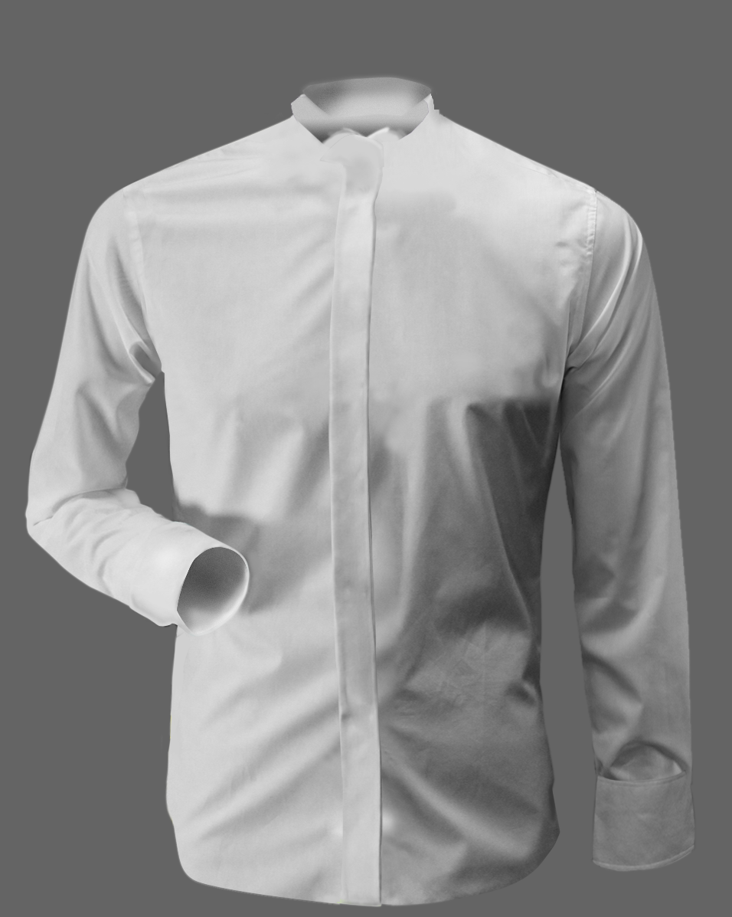
MODEL ACQUISITION contd.
(d)
(e)
(d) Segmentation into different pieces. (e) Shadow map.

Slide 9
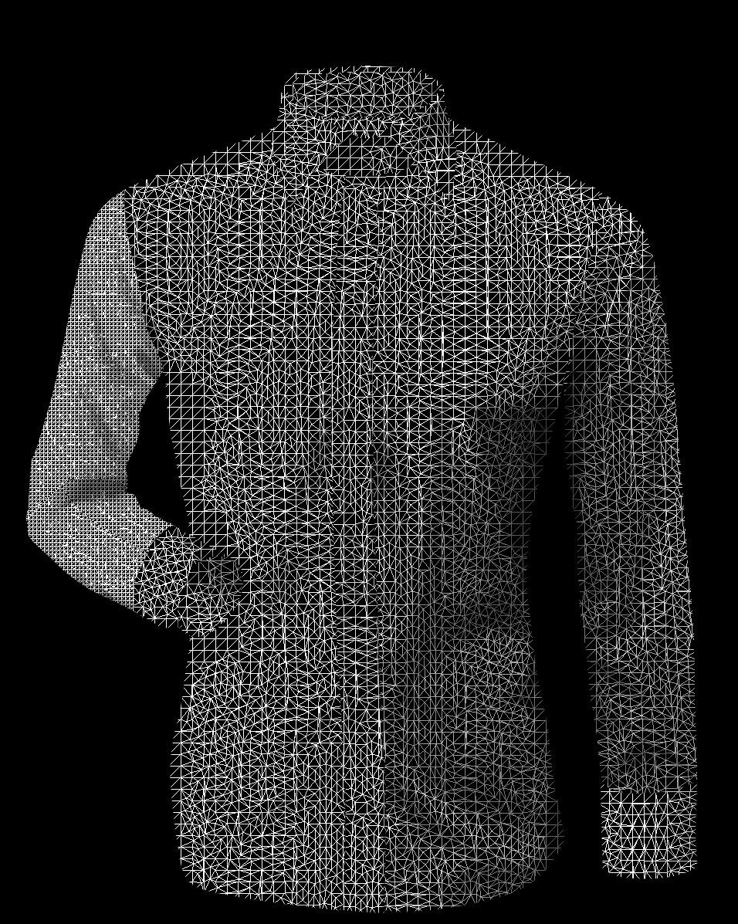
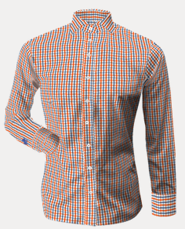
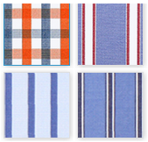
RENDERING
(b)
(a)
(c)
Rendered shirt model.
(a) Mesh model. (b) Virtual patterns. (c) Rendered shirt with shadows.

Slide 10
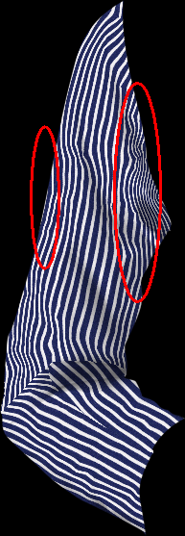
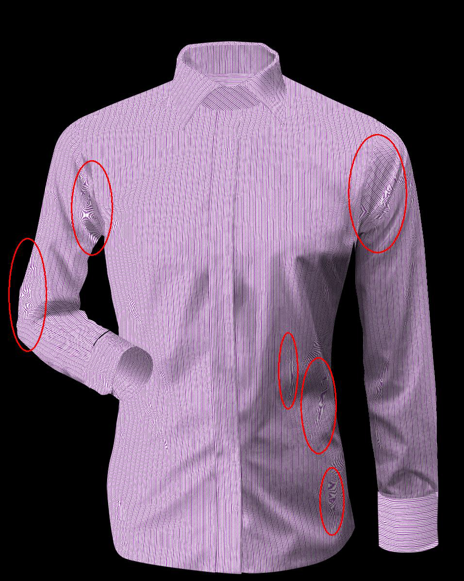
OPTIMIZATION
OF THE COLOR-CODED MODELS
(a)
(b)
(a)
(b)
Example of jaggedness or spatial aliasing.
(a) Small undersampled repeatable pattern
(2,08 cm x 0,64 cm; 59 pixels x 18 pixels).
(b) Final rendering suffering from jagged
edges and jagged interior lines.
Example of unwanted Moiré patterns. (a) Very small repeatable pattern (0,81 cm x 0,74 cm; 23 pixels x 21 pixels) featuring fine parallel lines. (b) Final rendering suffering from Moiré patterns.

Slide 11
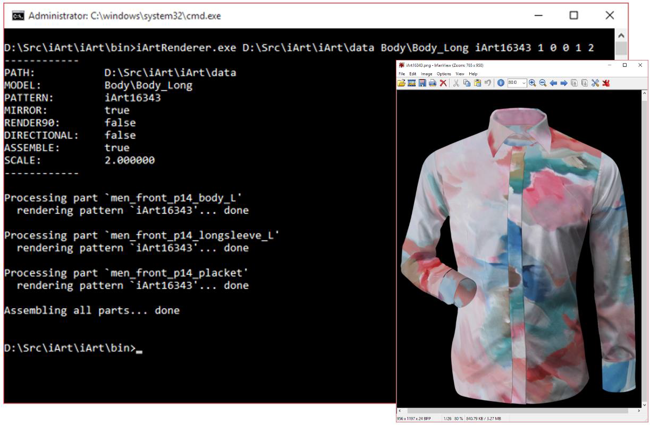
REAL-TIME DESIGN PREVIEW
Example of rendering a model using a specific pattern.

Slide 12
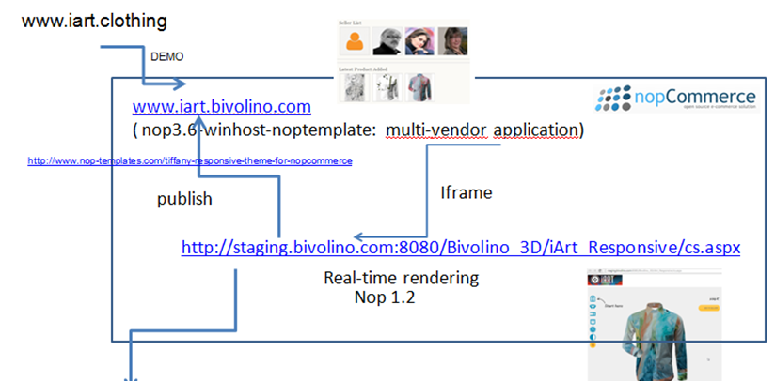
UPGRADING THE CONFIGURATION PANEL FROM 2.5D TO 3D

Slide 13
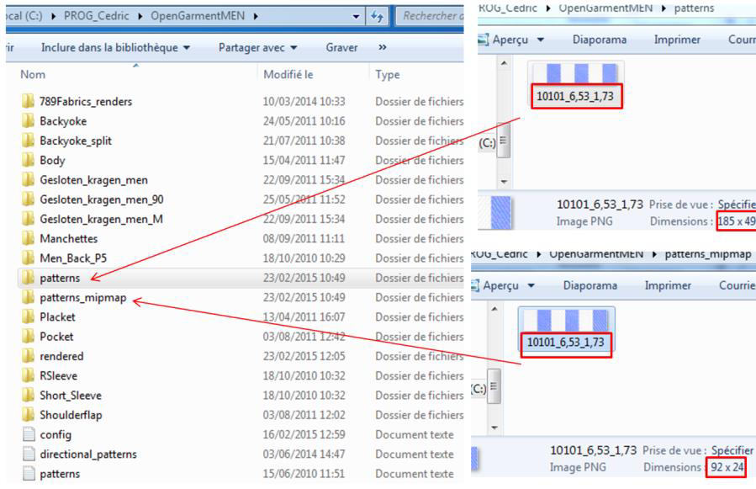
UPGRADING THE CONFIGURATION PANEL FROM 2.5D TO 3D
Location of patterns and models following a folder and file naming convention.

Slide 14
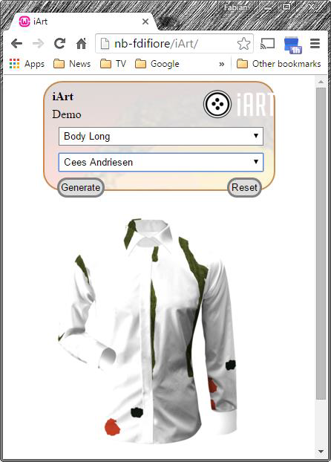
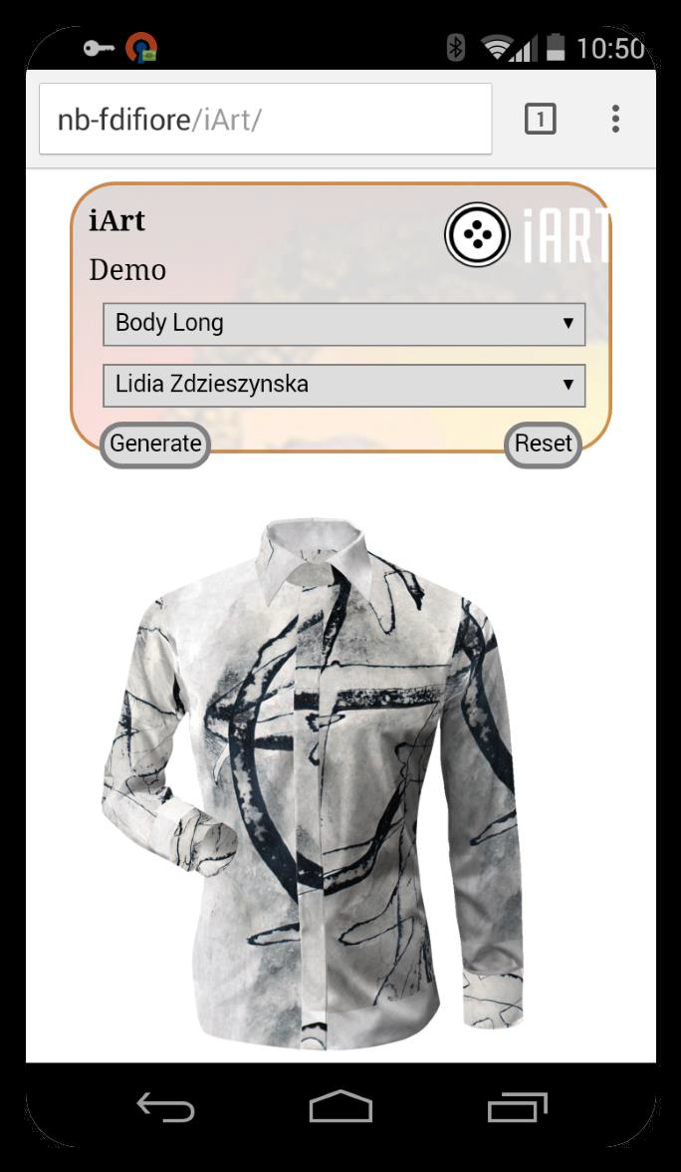
SERVER- BASED CONFIGURATOR
(a)
(b)
Examples of server-based configurators in action.
(a) Server-based example #1 of Table 1 shown on a desktop environment.
(b) Server-based example #2 of Table 1 shown on a mobile device.

Slide 15

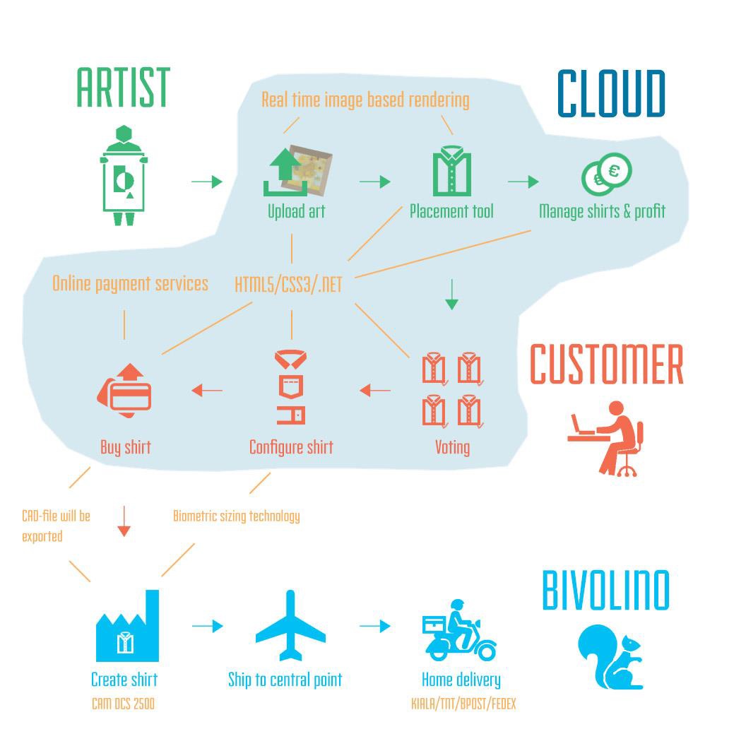
Structure of the iART platform

Slide 16
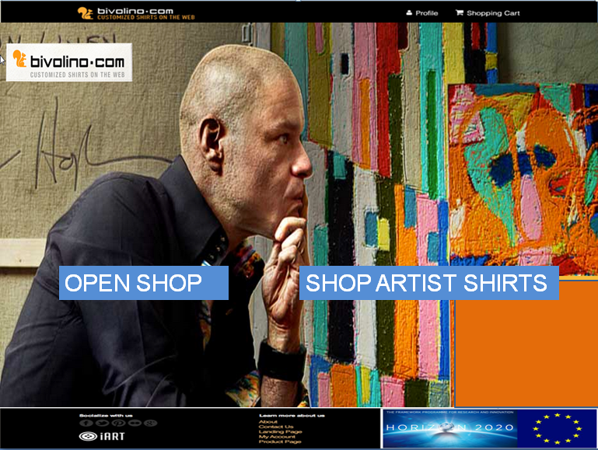

Slide 17
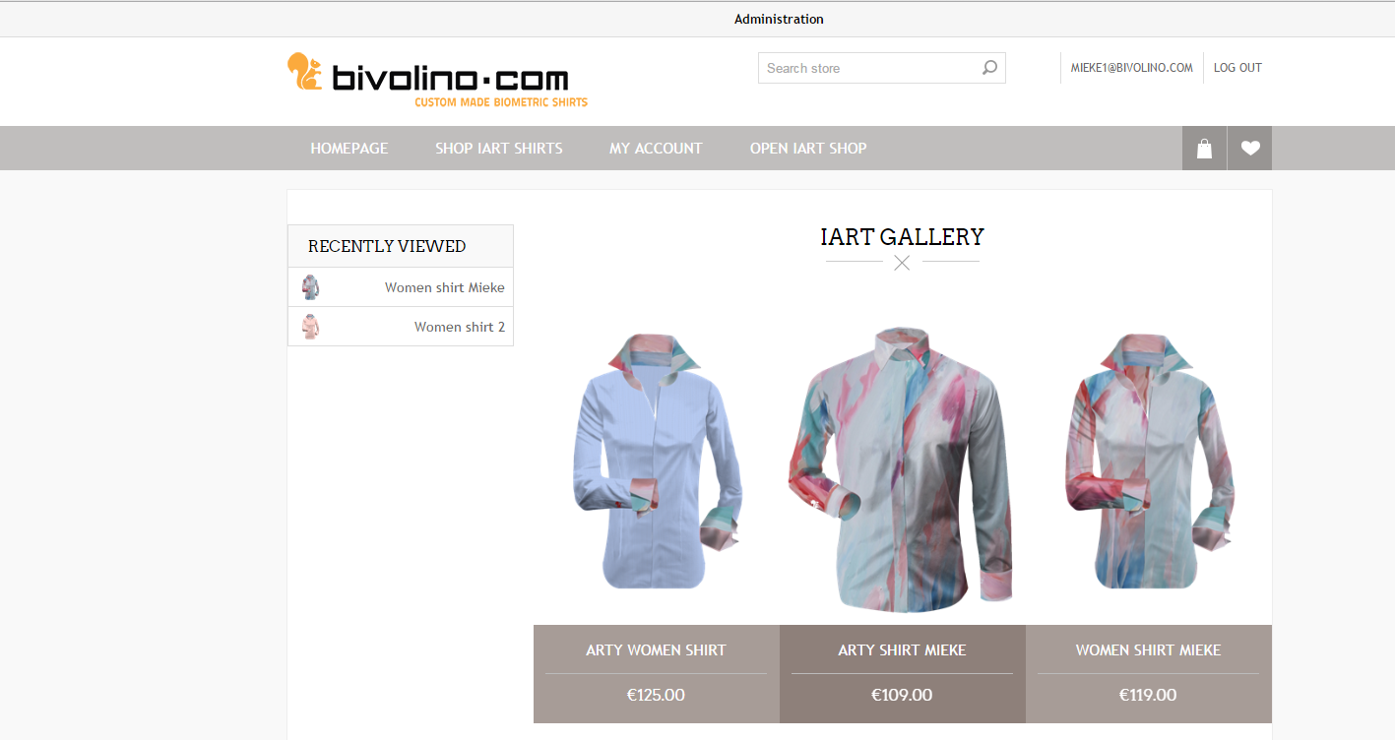
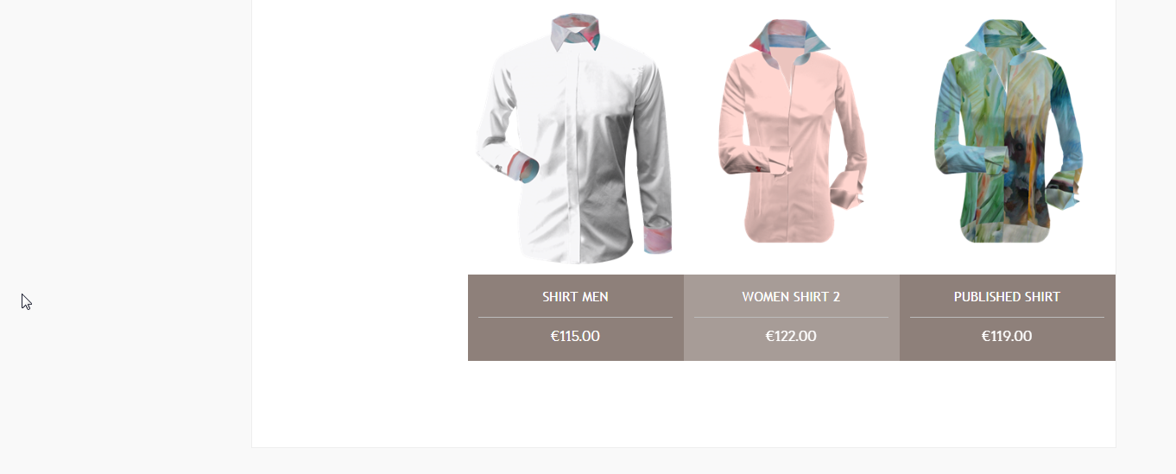

Slide 18




E-marketing channels
Bivolino.com
→ Feedback to bivolino
from either configID/galleryID
+customer name+adress details
, to produce &deliver the shirts
cpc+cps
Via product feed/listings for Gallery
Via iframe for 3D
3D
Gallery
gal1
B2C
gal1
cpc+cps
Via product feed/listings for Gallery
Via iframe for 3D
gal1
Share/publish
gall100
Share-button
Referral
Price comparison sites( beslist) cpc
Affiliate networks ( cfr tradetracker) cps
Eshops ( cfr department stores : bijenkorf (cps , (amazon) cpc
Social Media
+blogs
Redirect
Redirect
E-marketing channels
with external sso + checkout process
Etailer-Marketplace.com
( bivolino or b2c bivo-shops opens shop)
Iframe
listing
3D
Gallery
Baur.de
Amazon.de( encrypted email)
SYSTEM INTEGRATION: open API
Reflection : for gall-shirts, ‘standard sizes’
Sso+basket integration

Slide 19
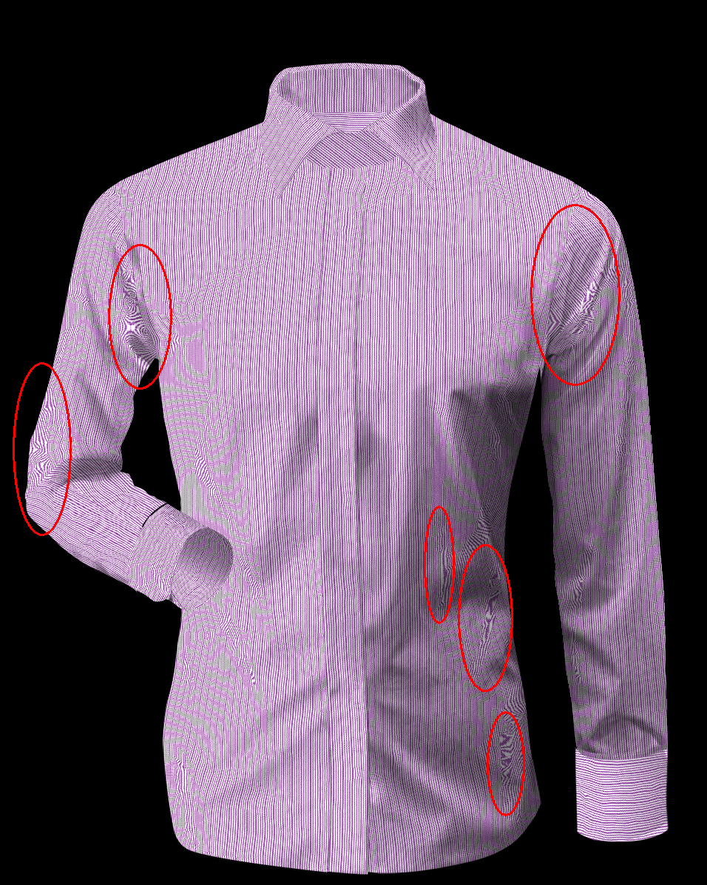
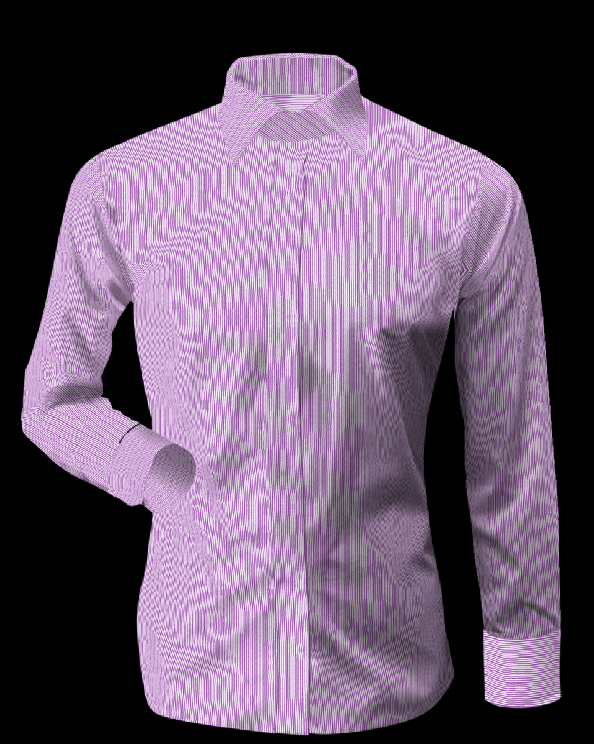
RESULTS
Optimisation of the existing color-coded input models and shadow maps;
the rendered results no longer suffer from jagged edges or unwanted moiré patterns when fine regular patterns are involved.

Slide 20
RESULTS
GARMENT INTERFACE
& PLACEMENT TOOL
Offline rendering tools and offline batches (rendering, scaling) have been transformed to independent solutions available as an option of server configuration. The results of this tool enable the artist to visually assess in “real-time” how a new print design would fit to a given item.

Slide 21
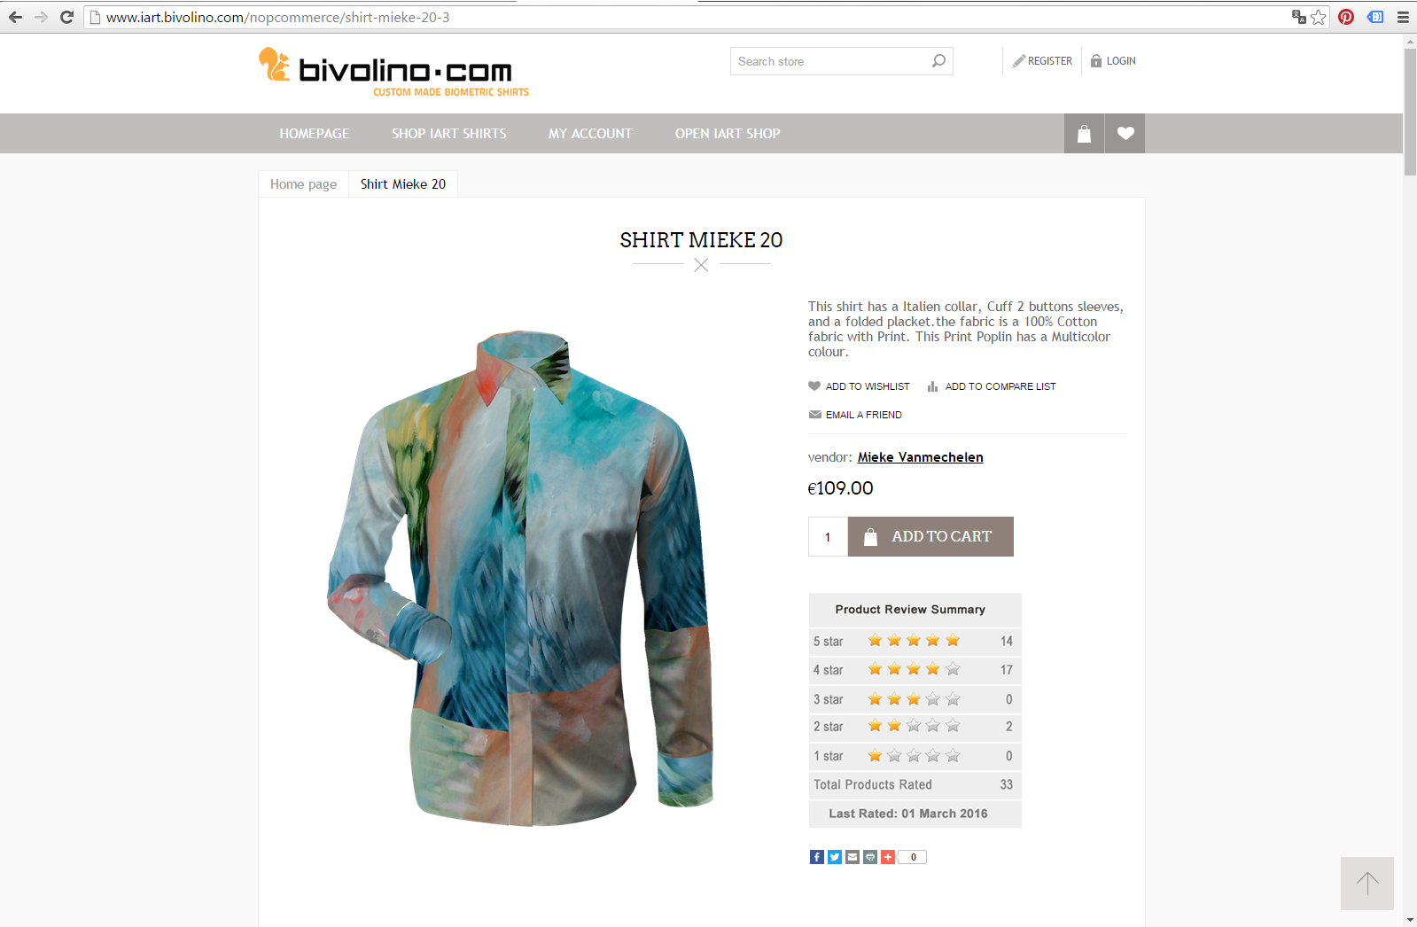
RESULTS
RESULTS
RESULTS
Establishment of a B2C platform for creative cooperation (iART Shop – http://www.iart.bivolino.com) with a user generated content, creating a user interface where the artist can embed new patterns, create collections, monitor messages, or count the consumer votes, and a consumer interface with commenting, evaluating and voting options.

Slide 22
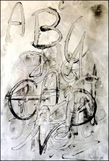
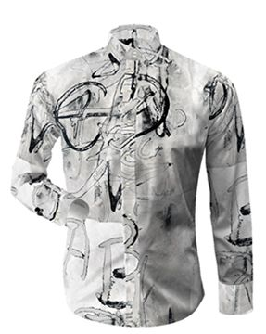
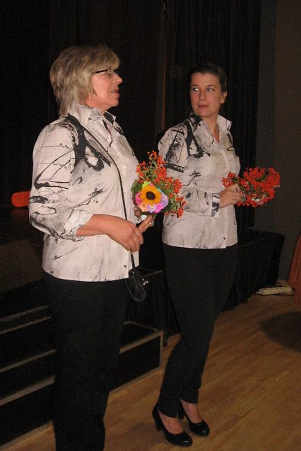
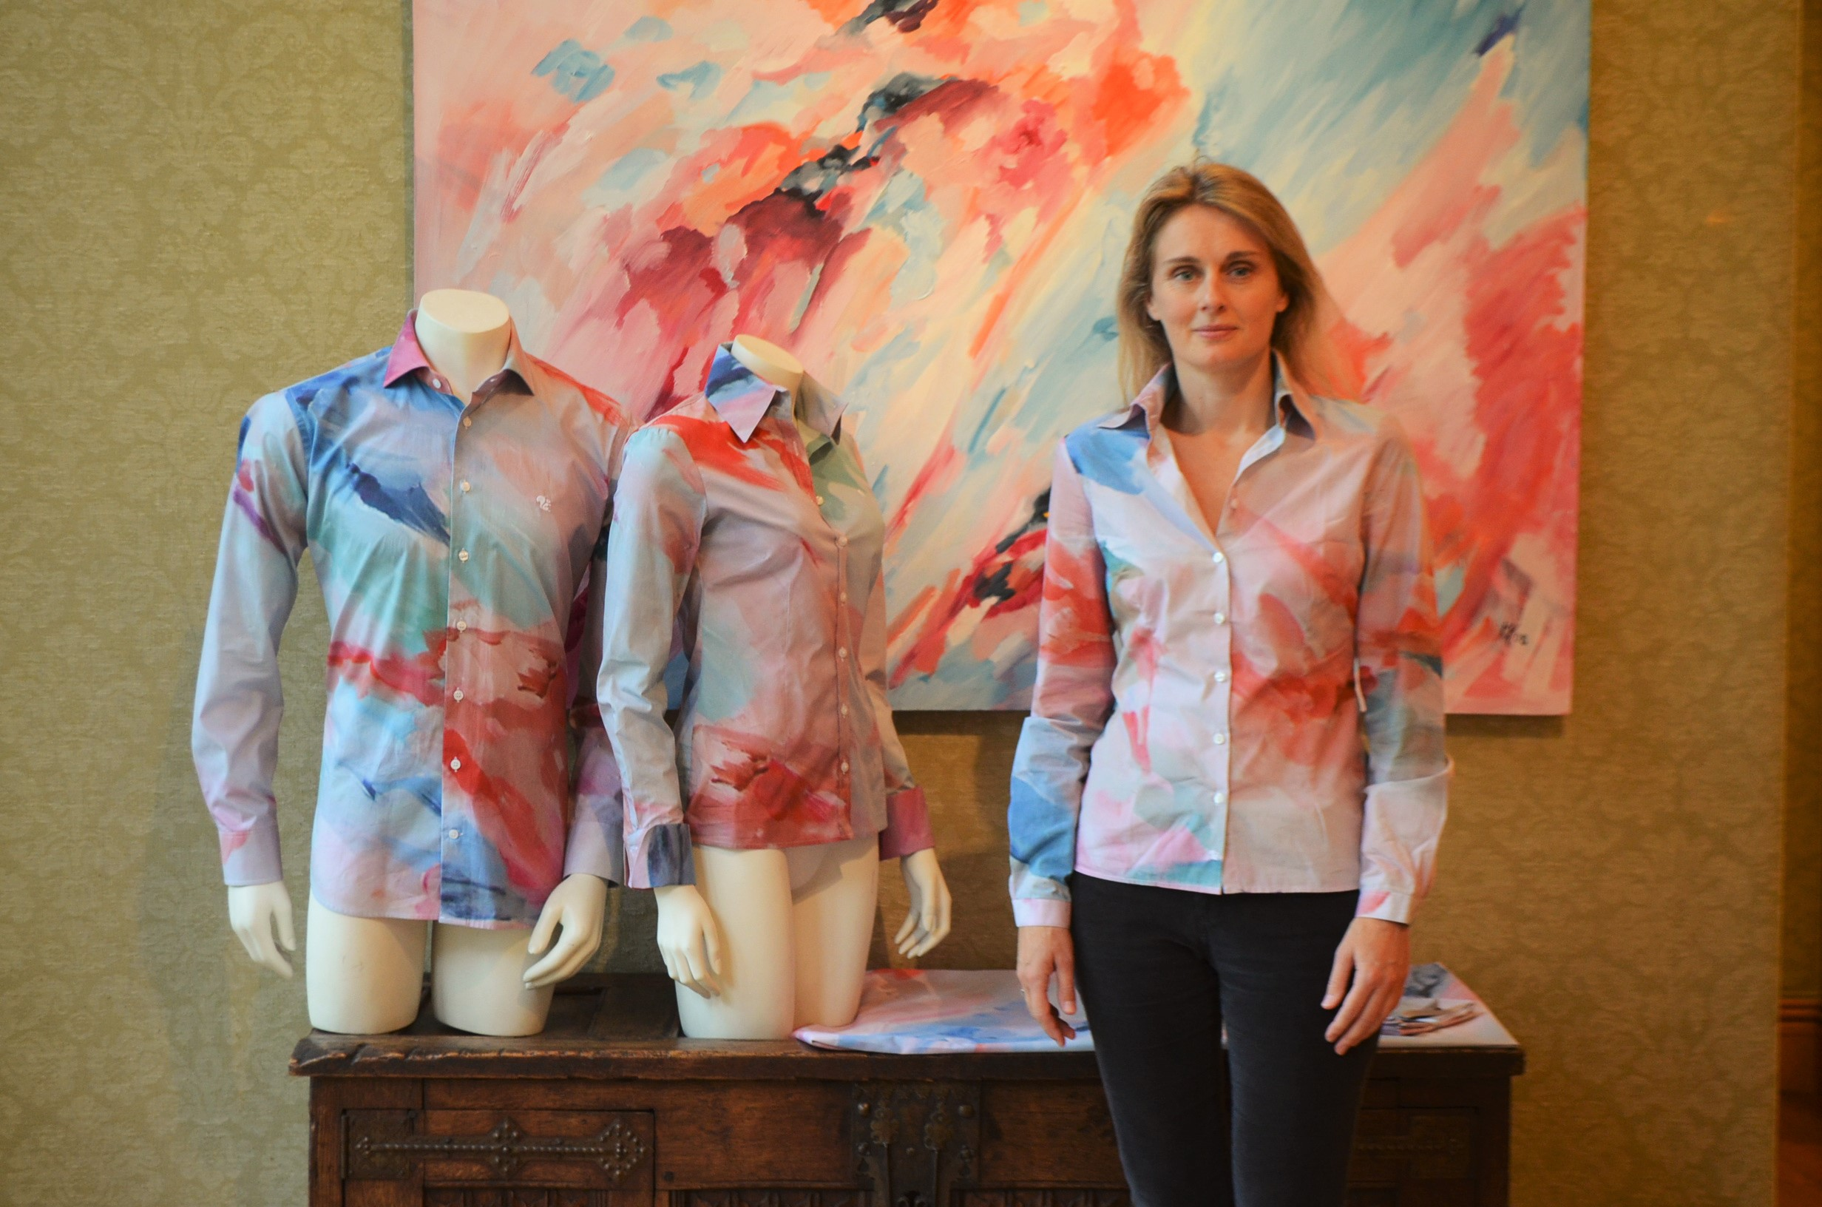
Lidia Zdzieszyńska - a blouse made basing on her graphic
Mieke Vanmechelen – a blouse made basing on her painting.

Slide 23
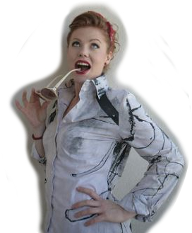
CONCLUSIONS
It is expected that iART will create extra revenues for artists and the European fashion and Clothing industry. SMEs take up ICT enabling innovative supply-chains to generate more revenues through high-margin made-to-order collections which cannot be imported from mass production countries.
Finally, ICT providers are stimulated to offer innovative tools generating new business and turnover. As this sustainable business model is supported by easily accessible advanced ICT tools (through open API’s) it will be replicable and so has the potential to create a wide impact.The project iART is implemented in the framework the EU H2020-program.

